Slide 1


“Universa Universis Patavina Libertas”
Effective 3-body forces: the case of
neutron-rich lead isotopes
Andrea Gottardo
IVICFA Seminar, Valencia 2013

Slide 2
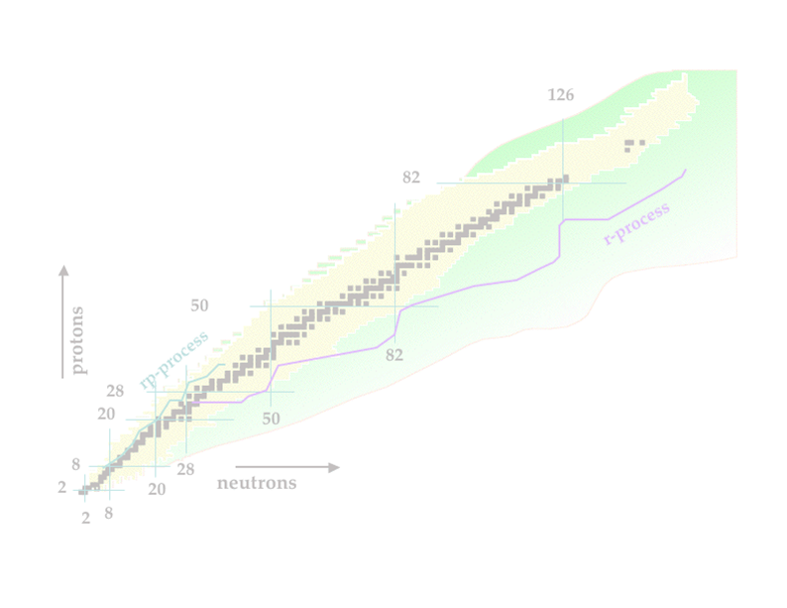
Contents
The nuclear shell model
Real and effective 3-body forces
The experiment for neutron-rich lead isotopes
Results for neutron-rich lead isotopes

Slide 3
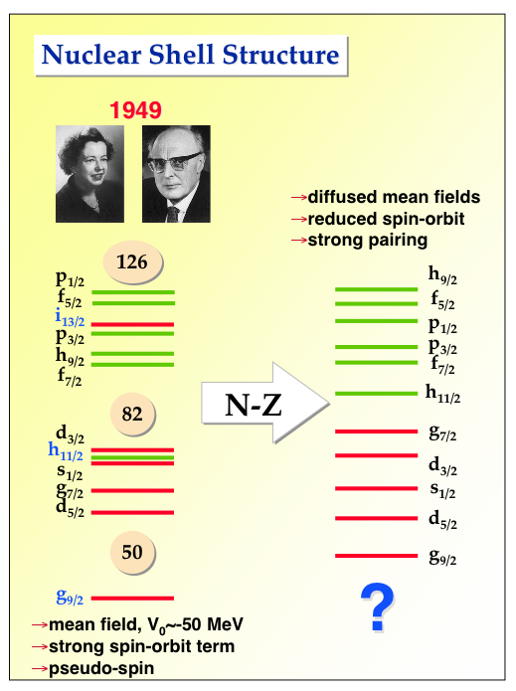
The nuclear shell model
Main tenets of shell model:
Atomic-like shell orbits for the nucleons
Magic numbers
Central mean field (3d harmonic oscillator + SO) and a residual two-body interaction
It appeared difficult to define what one should understand by first principles in a field of knowledge where our starting point is empirical evidence of different kinds, which is not directly combinable. N. Bohr, 1952

Slide 4
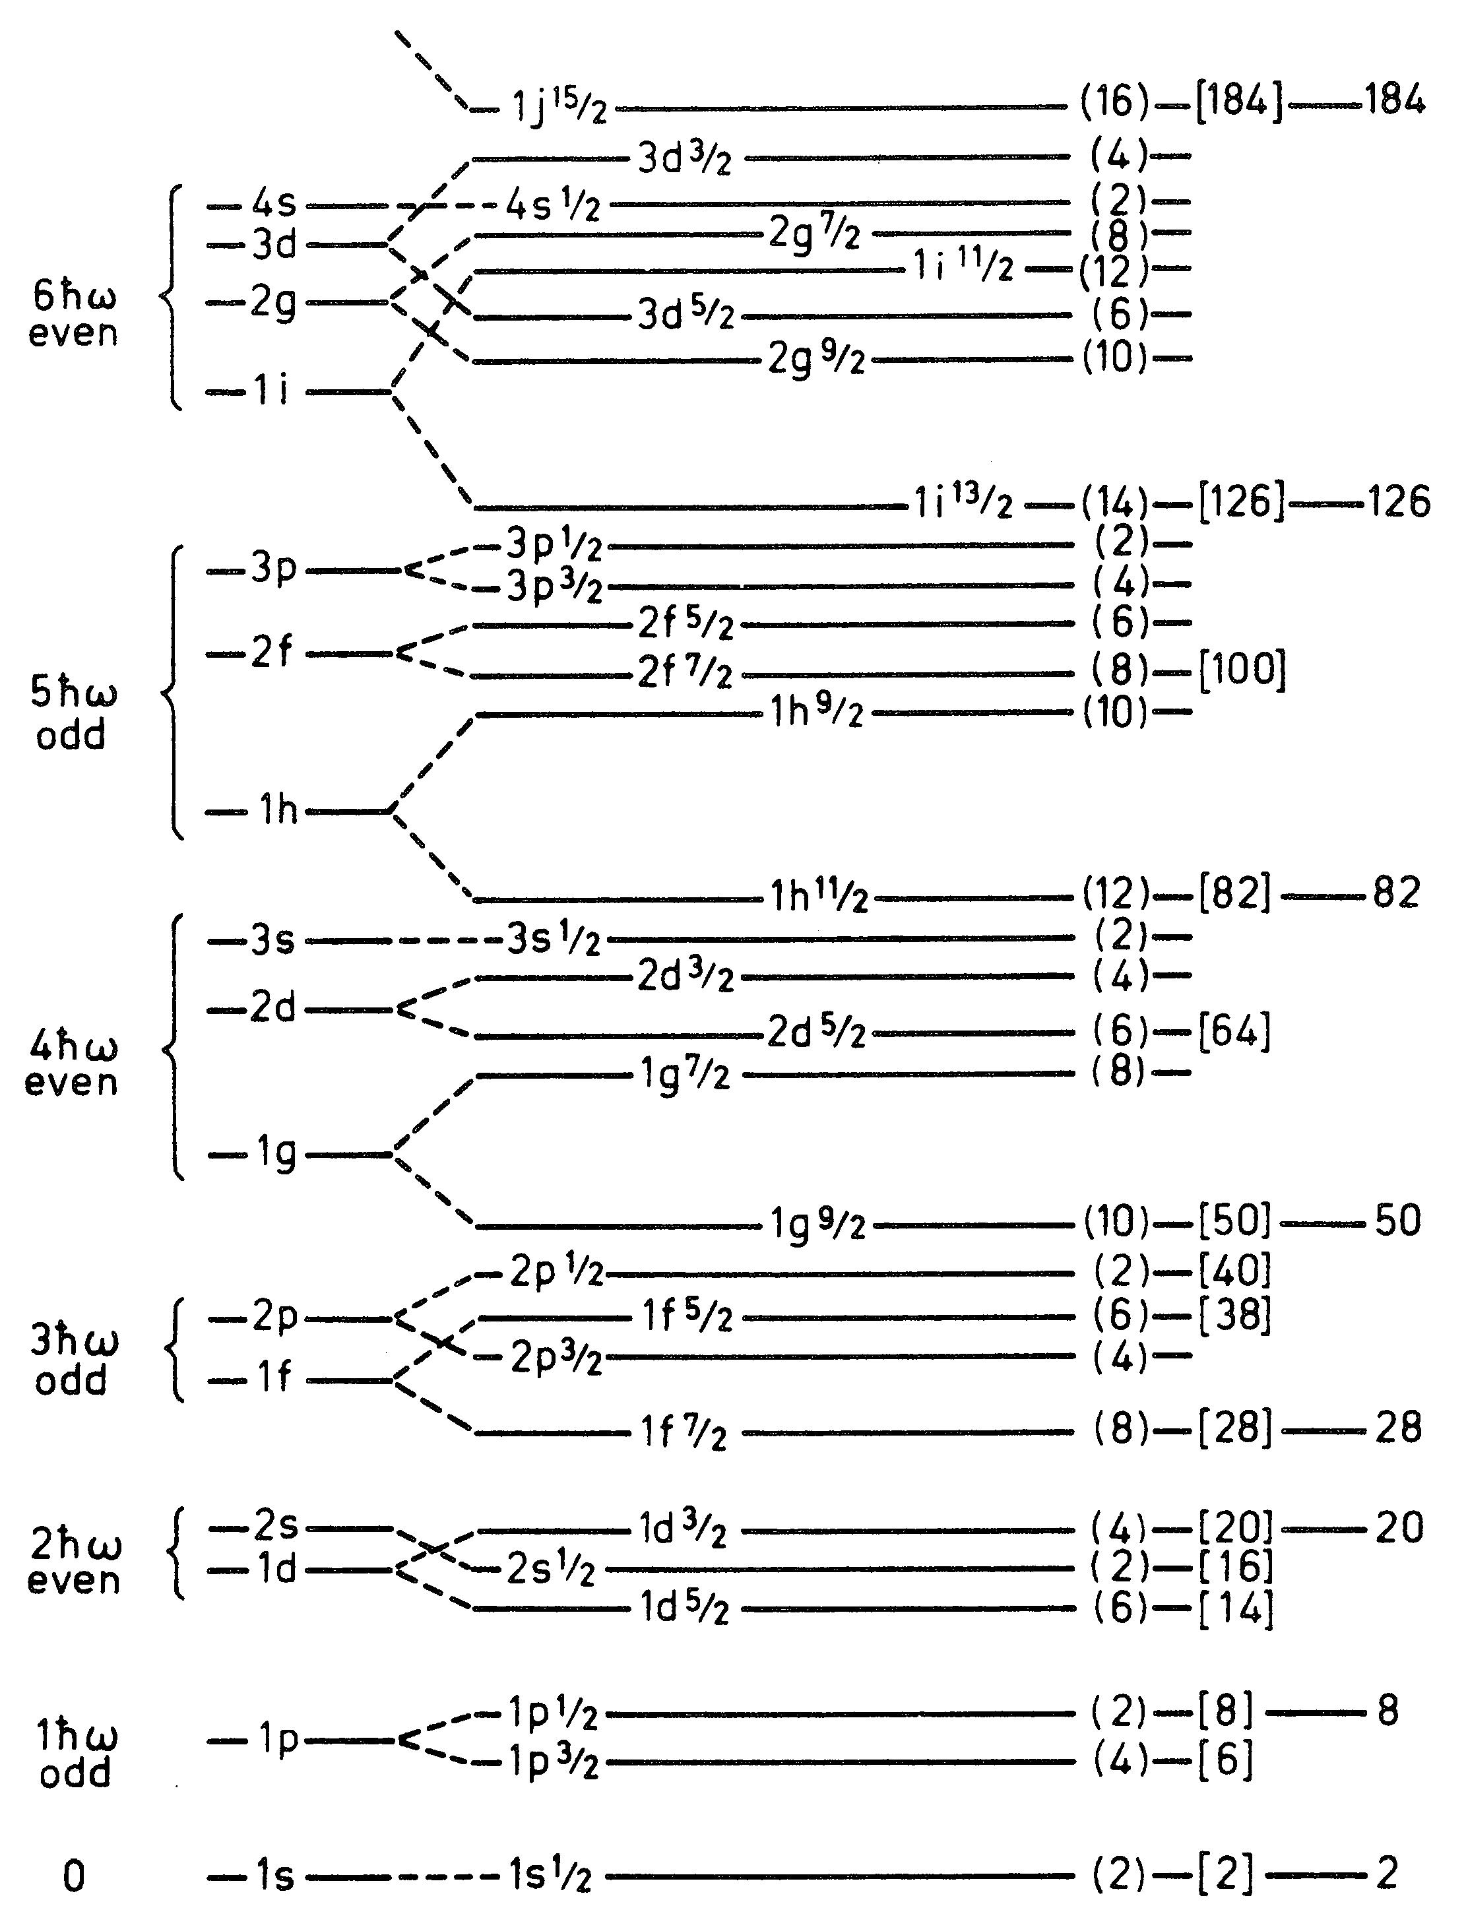
The nuclear shell model: instructions for use
Main «ingredients» of shell model:
Valence space
Realistic hamiltonian renormalized
Shell-model codes (Antoine, Nathan, Oxbash, Nushell)
N=126
Q
Model space P
Excluded space Q
P

Slide 5
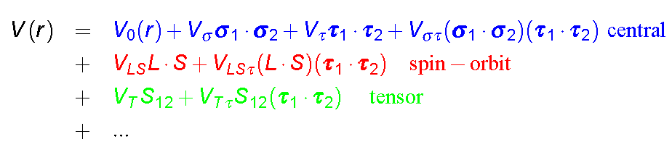
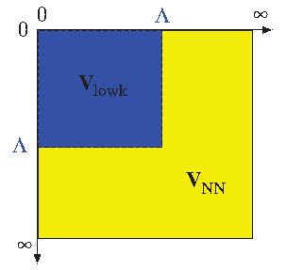
“Effective interaction”
Bare nucleon-nucleon potential from nucleon-nucleon scattering data
Potential fitted on experimental data: phenomenological potential
Argonne V18, Kuo-Herling, CD-BONN…
The Hamiltonian is then renormalized to the valence space chosen
V_{lowk} or G-matrix methods to extract an effective Hamiltonian to be diagonalized
Level Energies
Wavefuntions of nuclear states

Slide 6
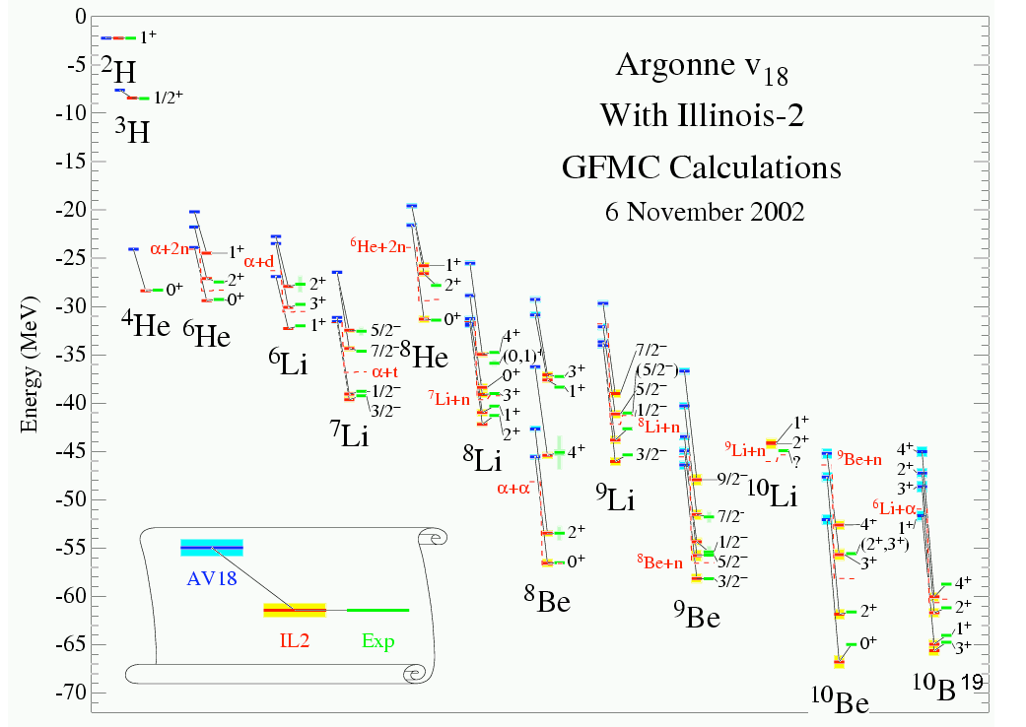
So everything OK? (1)
From SM calculations in light nuclei (no core), 2-body potentials seems unable to reproduce the level energies!
Phys. Rev. Lett. 89, 182501 (2002)

Slide 7
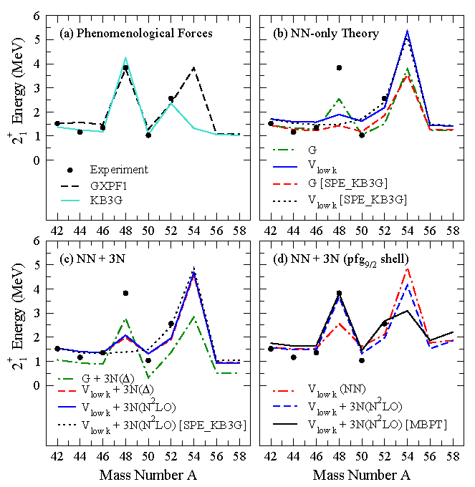
So everything OK? (2)
The doubly-magic ⁴⁸Ca is not reproduced by the 2-body interactions without further adjustements!

Slide 8
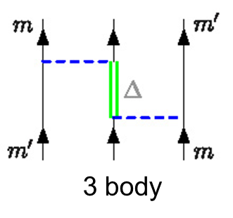
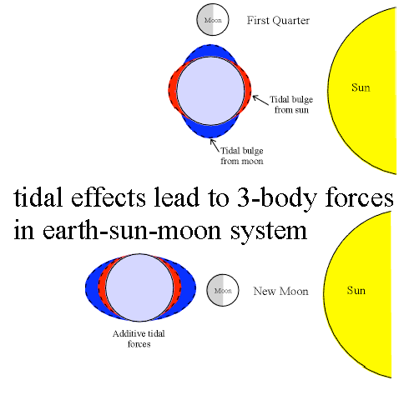
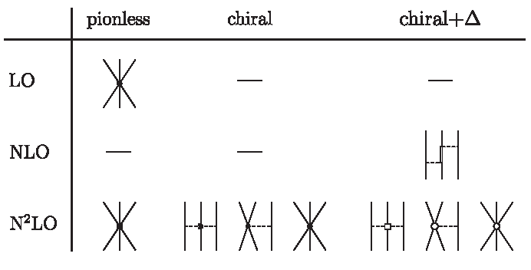
Real three-body forces
Interacting bodies could have internal degrees of freedom: this is the case of neutrons and protons!
There are many systems in nature where effective 3-body terms appear
Distinctive feature of the nuclear structure!
Delta excitation at 1232 MeV and many other short-range diagrams…

Slide 9

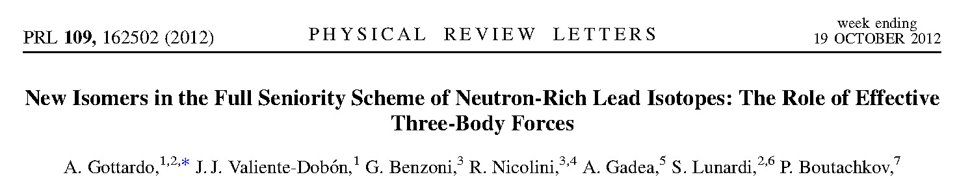
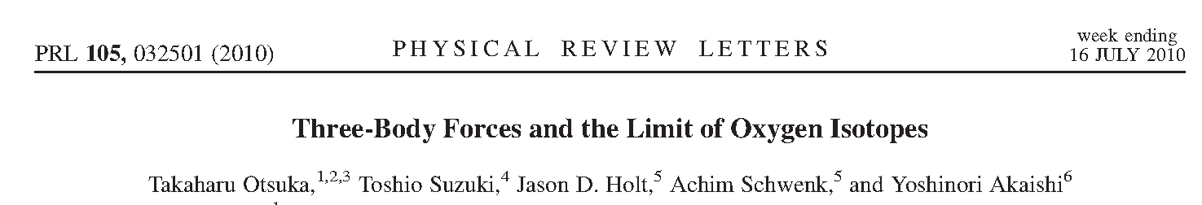
Effective three-body forces
For medium- and heavy-mass nuclei one has to work with an inert core excluded from the calculation
The core used has internal degrees of freedom: also effective 3-body forces in shell-model calculation!
Many publications on this subject recently!
Pb isotopes on Phys. Rev. Lett
O isotopes on Phys. Rev. Lett
⁵⁴Ca on Nature

Slide 10
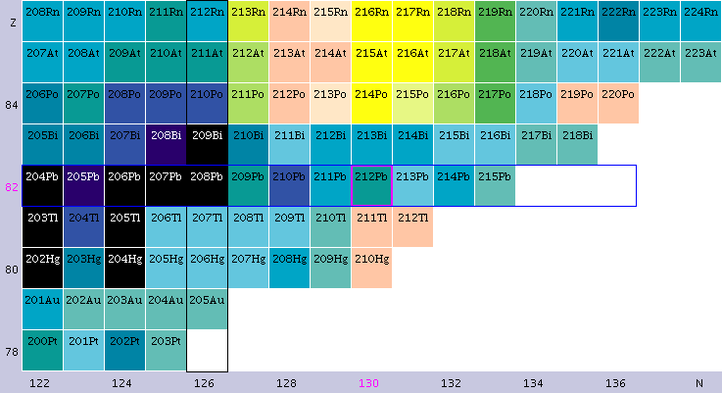
The Z=82 and beyond N=126 region
Presence of isomers involving high-j orbitals νg_{9/2}, νi_{11/2}, νj_{15/2}.Taking advantage of these isomers we want to study the nuclear structure from ²¹²Pb up to ²¹⁸Pb and nearby nuclei
²¹⁸Pb
Semimagic nuclei : possibility of a full diagonalization in the valence space
²¹⁶Pb
²¹²Pb
Good testing ground for SM → effective 3-body
g_{9/2}

Slide 11
Why Pb n-rich isotopes ?
Nucleons in a valence j^{n} configuration behave according to a seniority scheme: the states can be labelled by their seniority ν
8⁺
8⁺
8⁺
8⁺
6⁺
6⁺
6⁺
ν = 2
4⁺
6⁺
4⁺
4⁺
4⁺
2⁺
2⁺
2⁺
2⁺
ν = 0
0⁺
0⁺
0⁺
0⁺
(2g_{9/2})²
(2g_{9/2})⁴
(2g_{9/2})⁶
(2g_{9/2})⁸
For even-even nuclei, the 0⁺ ground state has seniority ν = 0, while the 2⁺, 4⁺, 6⁺, 8⁺ states have ν = 2
In a pure seniority scheme, the relative level energies do not depend on the number of particles in the shell j
SENIORITY SCHEME: VERY “CLEAN” SYSTEM TO STUDY !

Slide 12
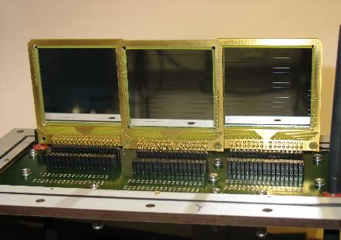
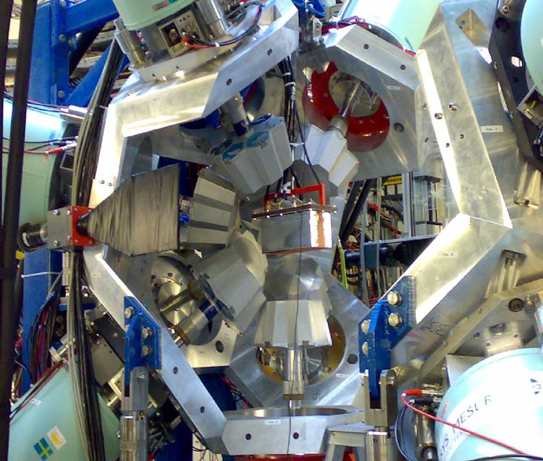
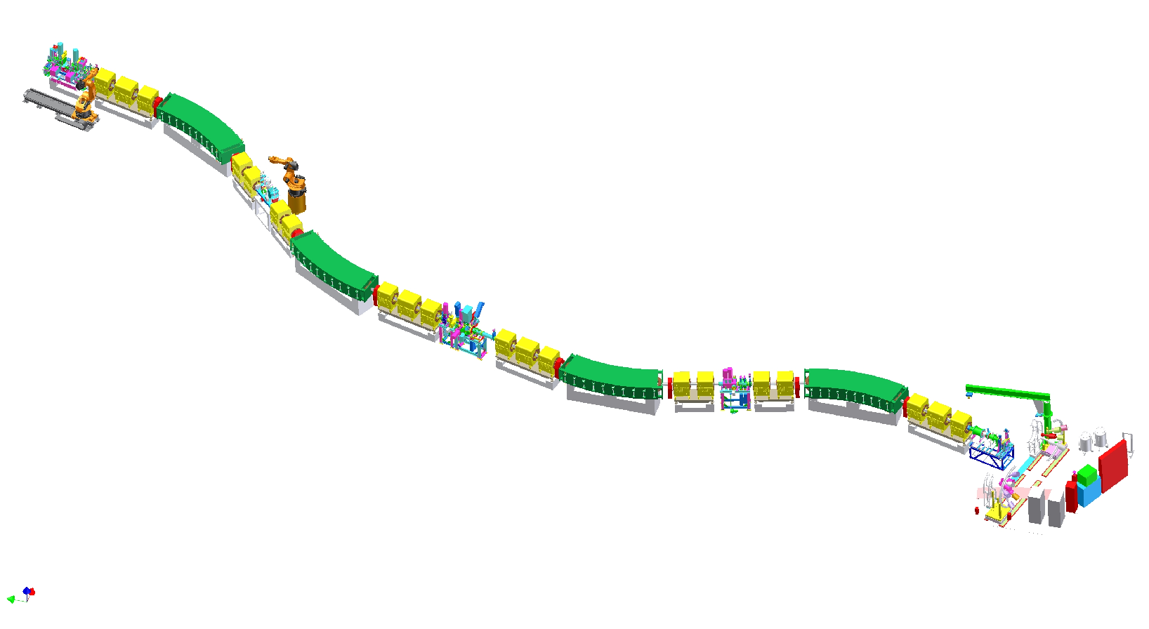
Experimental setup
FRS-Rising at GSI: stopped beam campaign
9 DSSSD, 1mm thick, 5x5 cm² 16x16 x-y strips
15 CLUSTERs x 7 crystals
ε_{γ} = 11% at 1.3MeV
Beam: ²³⁸U @ 1GeVA
S1
Target
2.5 g/cm² Be
S2
S3
S4
Deg. S1:
Al 2.0 g/cm²
MONOCHROMATIC
Deg S2: Al 758 mg/cm²

Slide 13
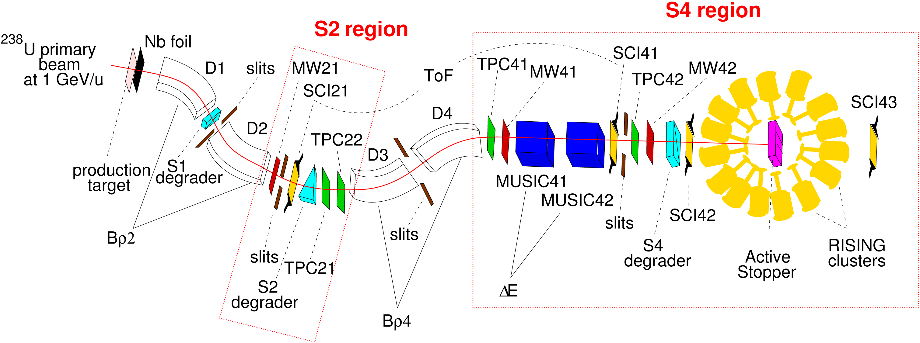
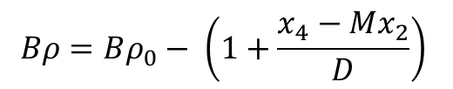
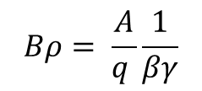
Experimental setup: FRS
72 m
H. Geissel et al., Nucl. Instr. Meth. B70, 286 (1992)
Fragment position: TPC, MWPC, Scintillators
Time Of Flight TOF: Scintillators
Atomic number: MUSIC
$$Bρ=Bρ_{0}− \left(1+\frac{x_{4}−Mx_{2}}{D}\right)$$
TOF → Velocity β
x₂, x₄ → Bρ
ΔE MUSIC → Z
$$Bρ= \frac{A}{q }\frac{1}{βγ}$$

Slide 14
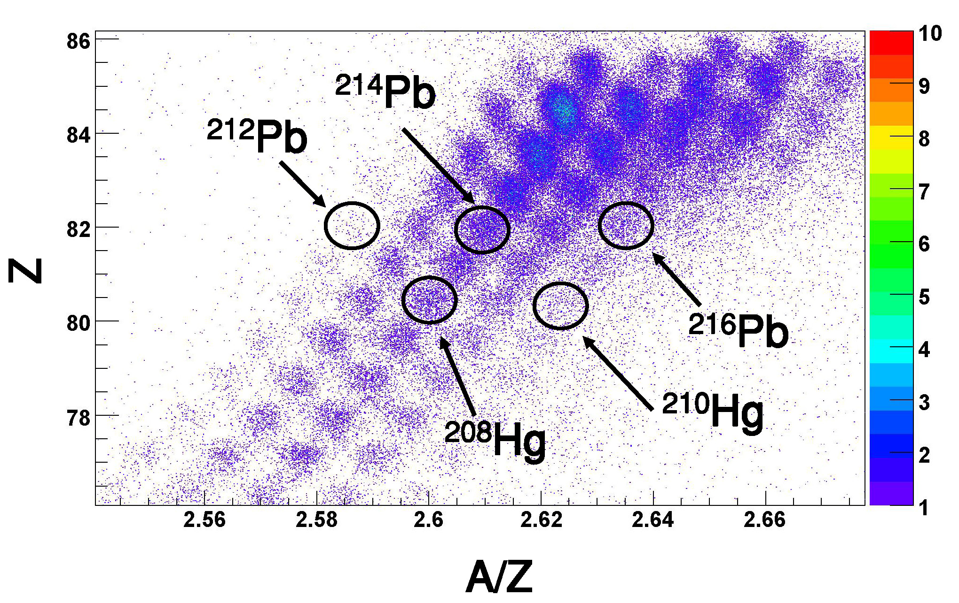
Nuclei populated in the fragmentation
1 GeV/u ²³⁸U beam from UNILAC-SIS at 10⁹ pps
²¹⁷Bi
²¹⁹Bi
²¹⁸Pb
²¹³Pb
²¹³Tl
²¹¹Tl

Slide 15
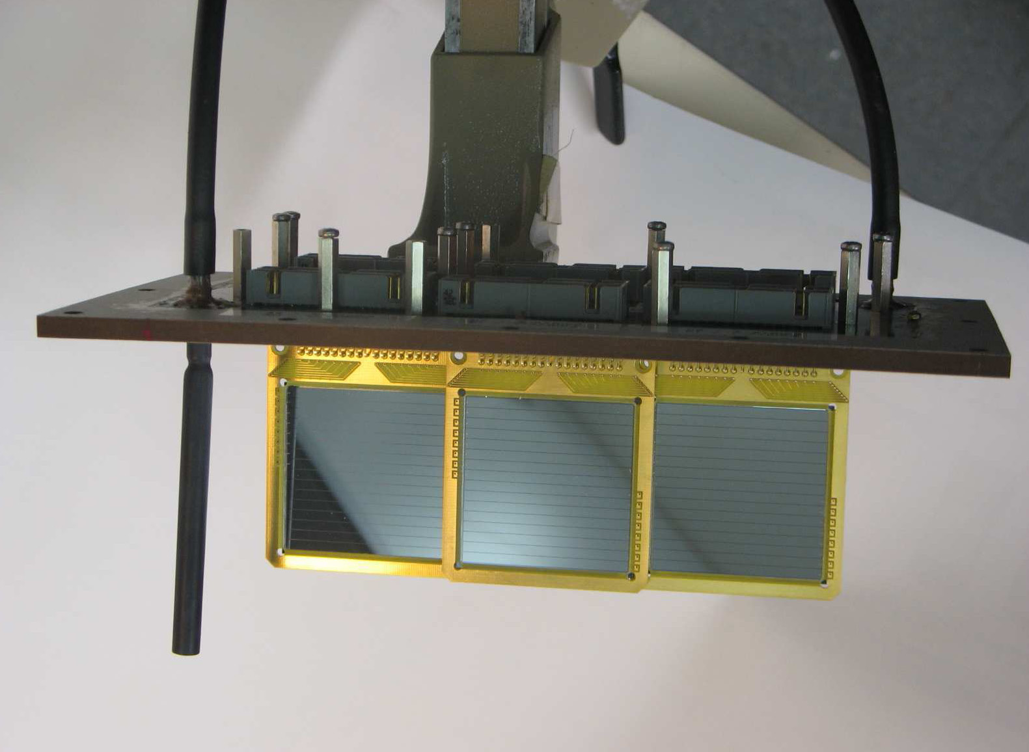
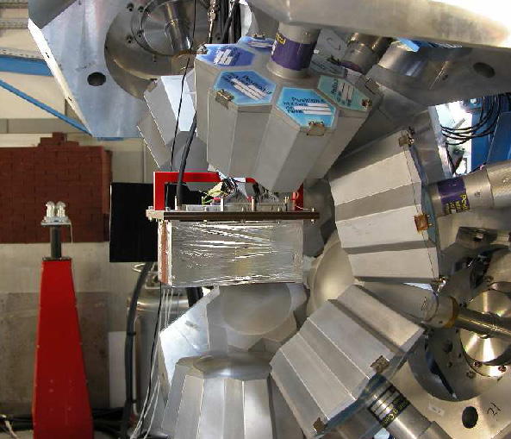
Implantation setup: RISING, DSSSD
Active stopper
RISING
9 DSSSD, 1mm thick, 5x5 cm² 16x16 x-y strips
15 CLUSTERs x 7 crystals,
ε_{γ} = 11% at 1.3MeV
CLUSTERS
SCI43
RISING
γ
DSSSD
e
fragment
Pietri et al., Nucl. Instr. Meth. B261, 79 (2007)
DSSSD
Kumar et al., Nucl. Instr. Meth. A598, 754 (2009)

Slide 16
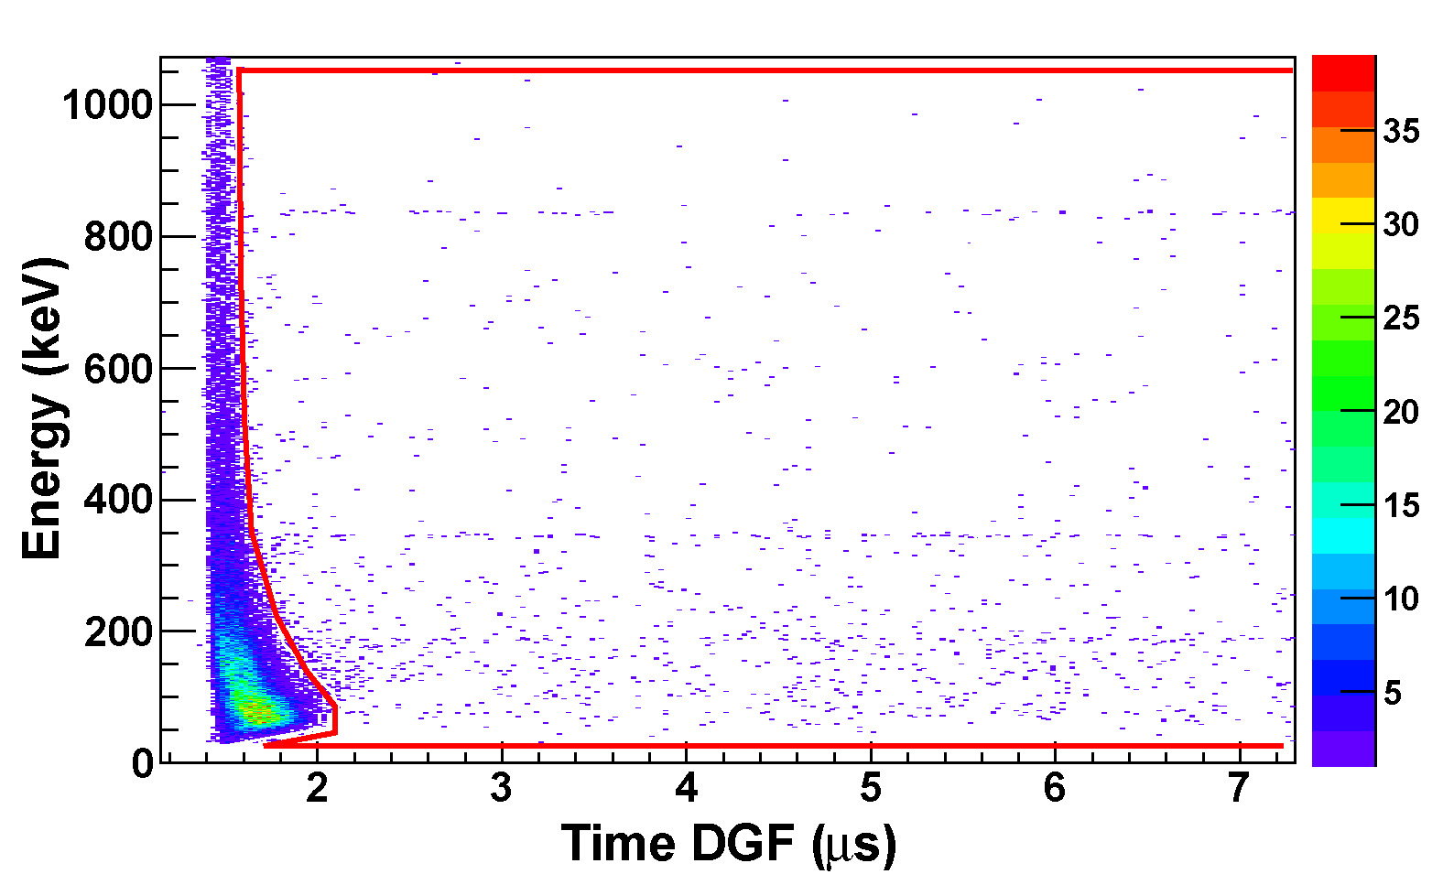
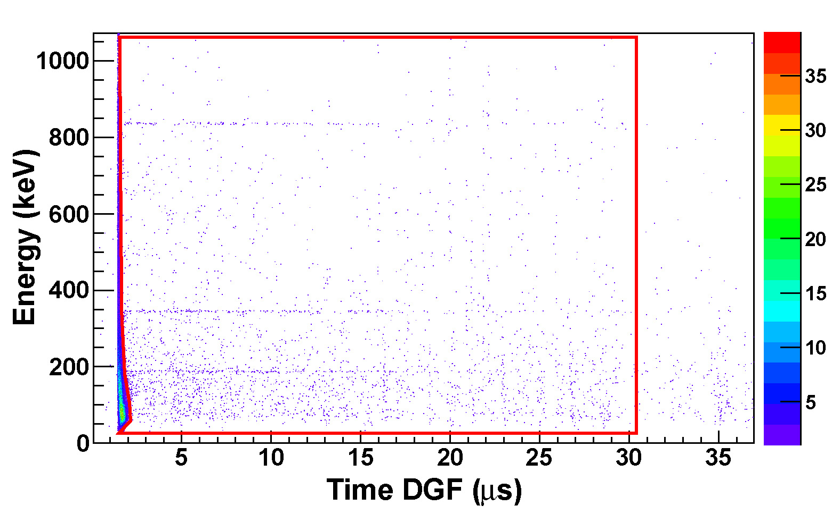
Isomer spectroscopy
²¹⁴Pb

Slide 17
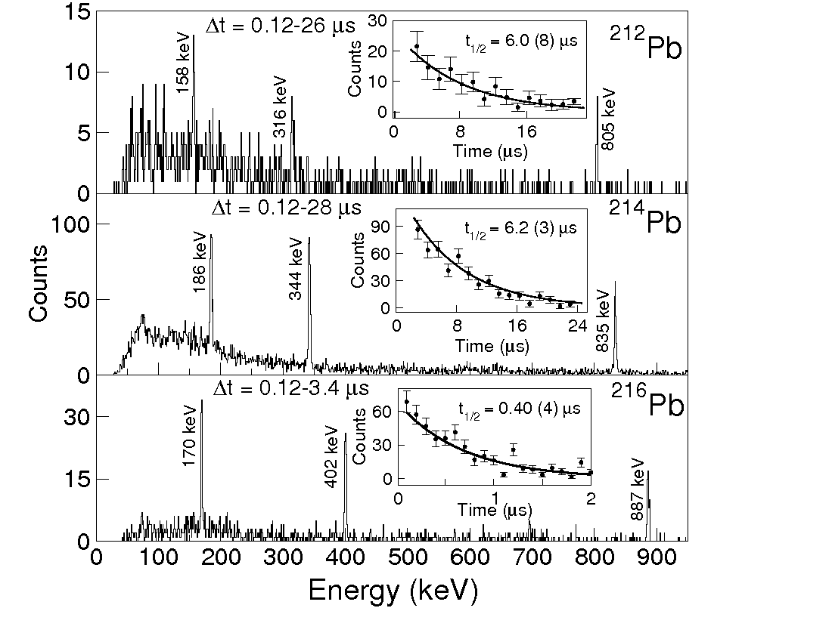
^{212,214,216}Pb: 8⁺ isomer

Slide 18
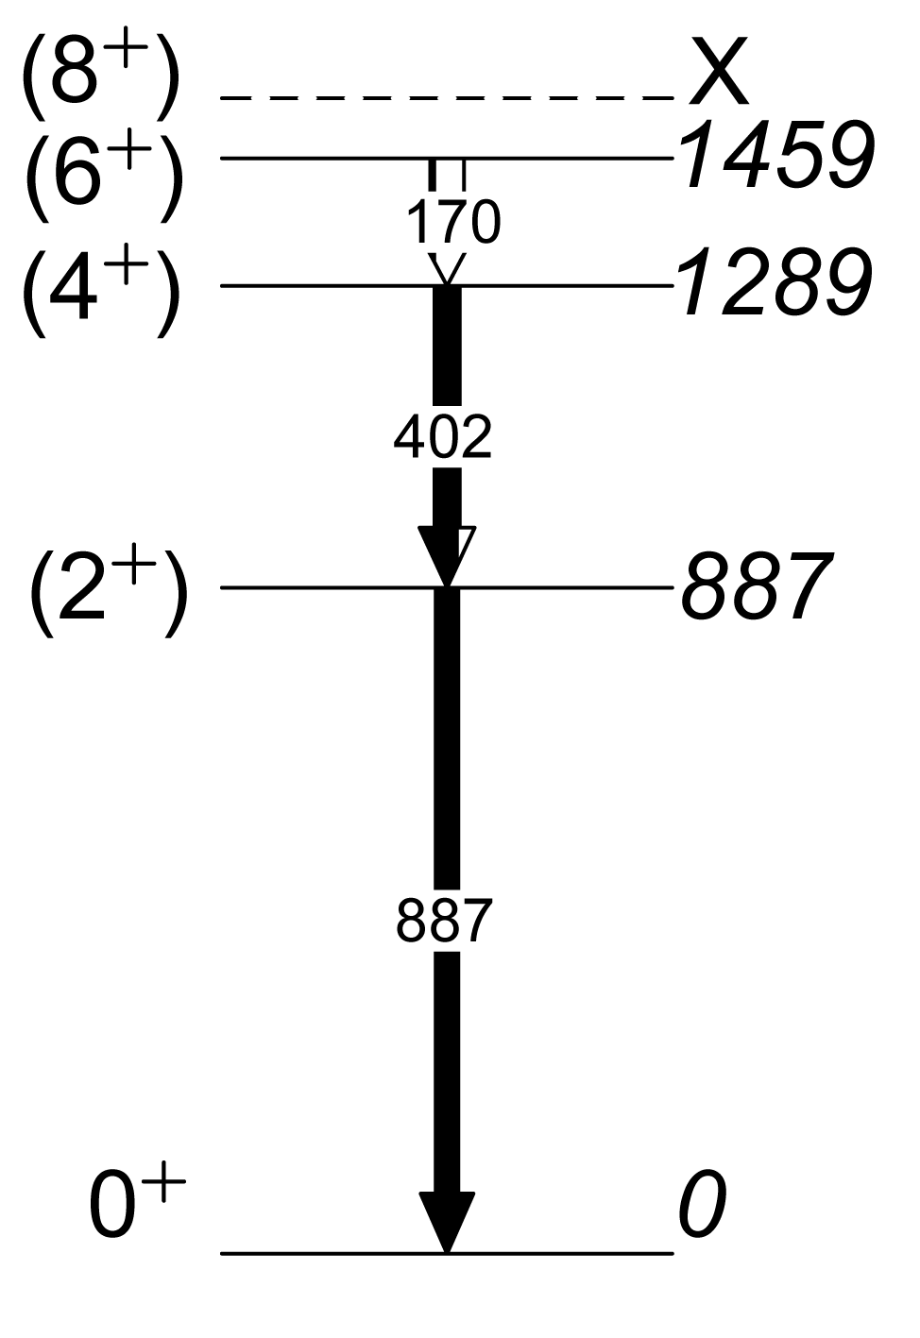
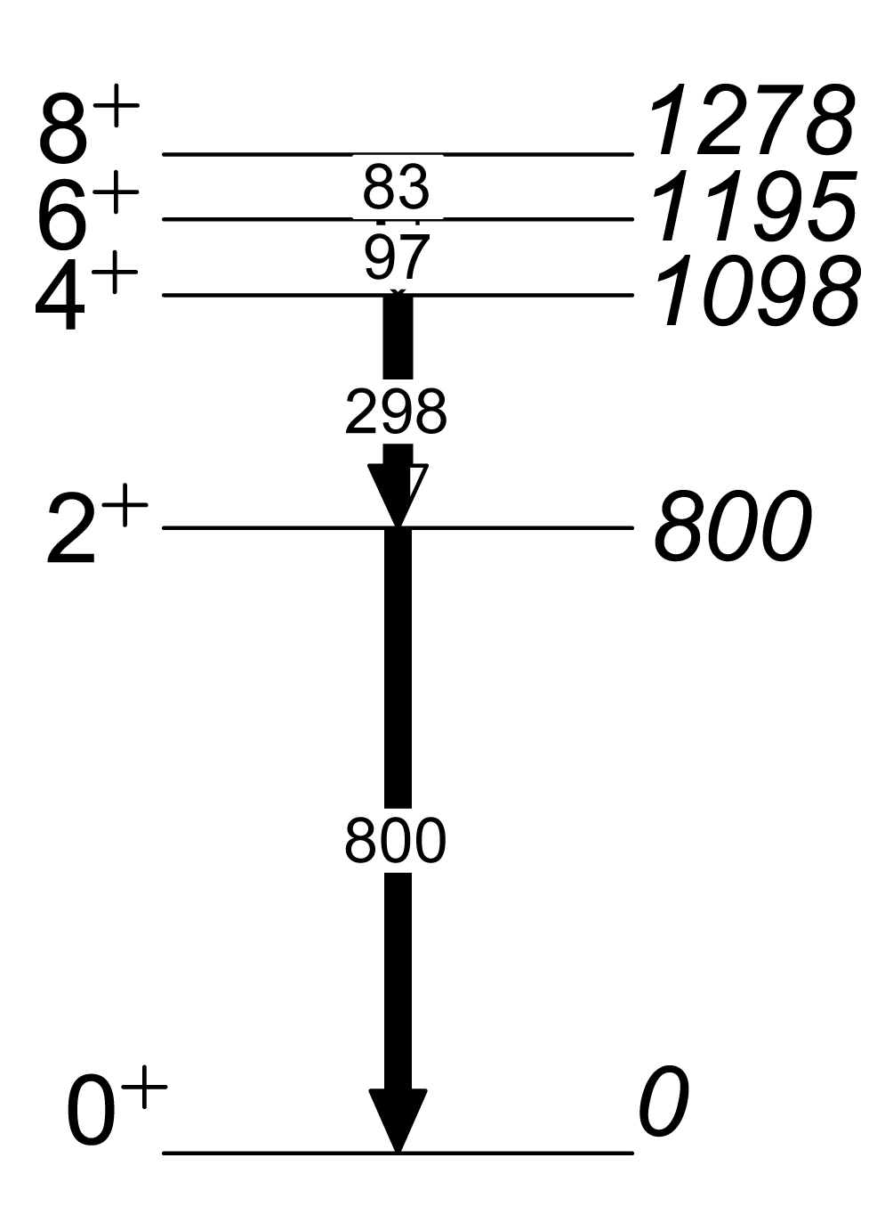
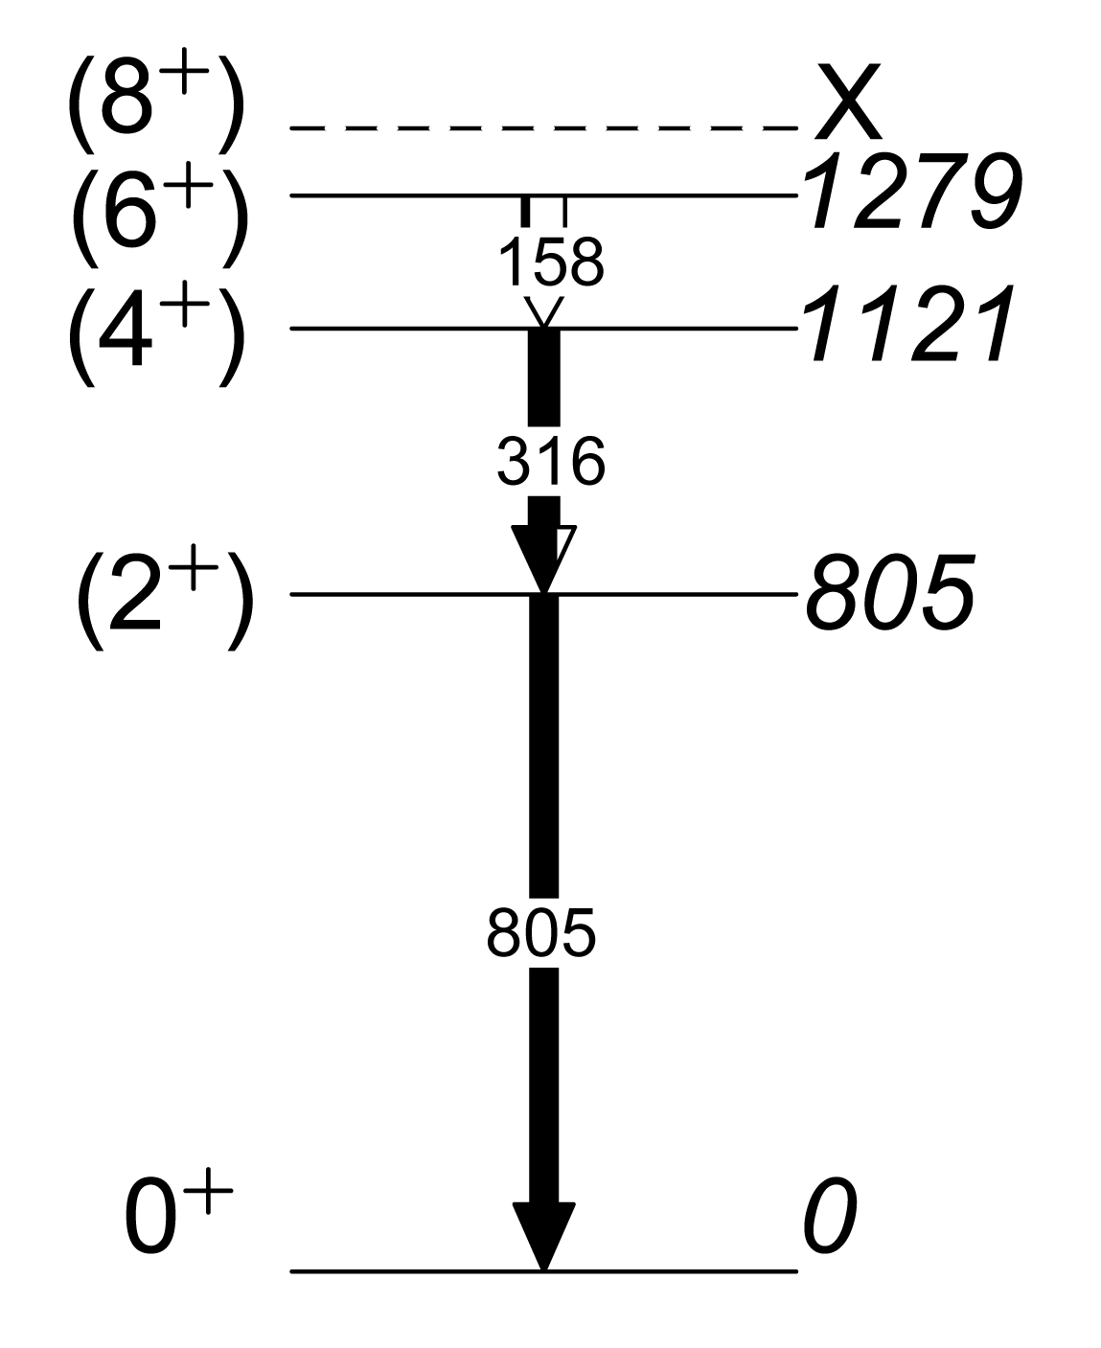
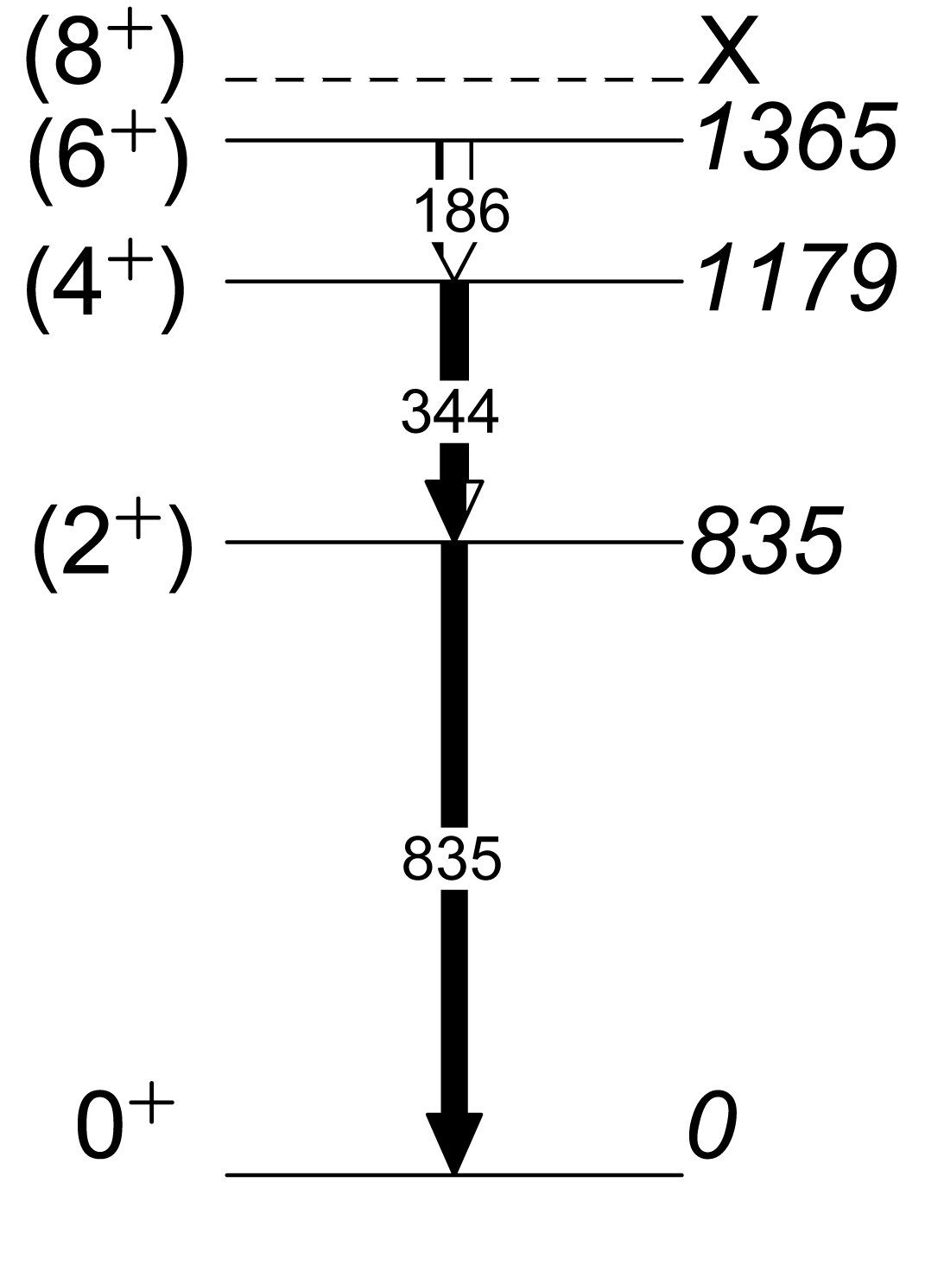
Experimental level schemes
The 8⁺ isomer is a seniority isomer, involving neutrons in the 2g_{9/2}
²¹⁰Pb
²¹²Pb
²¹⁴Pb
²¹⁶Pb
t_{1/2} = 0.201(17) μs
t_{1/2} = 6.0(8) μs
t_{1/2} = 6.2(3) μs
t_{1/2} = 0.4(4) μs

Slide 19
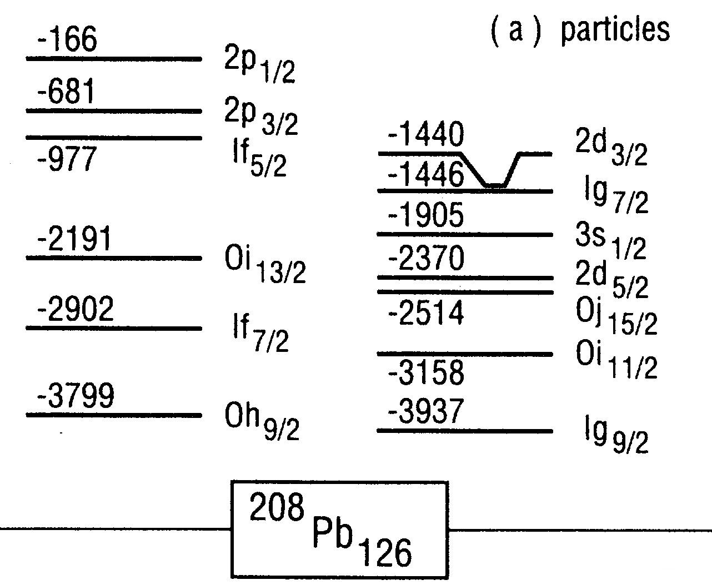
Kuo-Herling interaction: Valence space
²⁰⁸Pb is a doubly-magic nucleus (Z=82, N=126).
For neutron-rich Lead isotopes, the N=6 major shell is involved
From 2 neutrons (²¹⁰Pb) to 10 neutrons (²¹⁸Pb)
Warbourton and Brown PRC 43, 602 (1992)

Slide 20
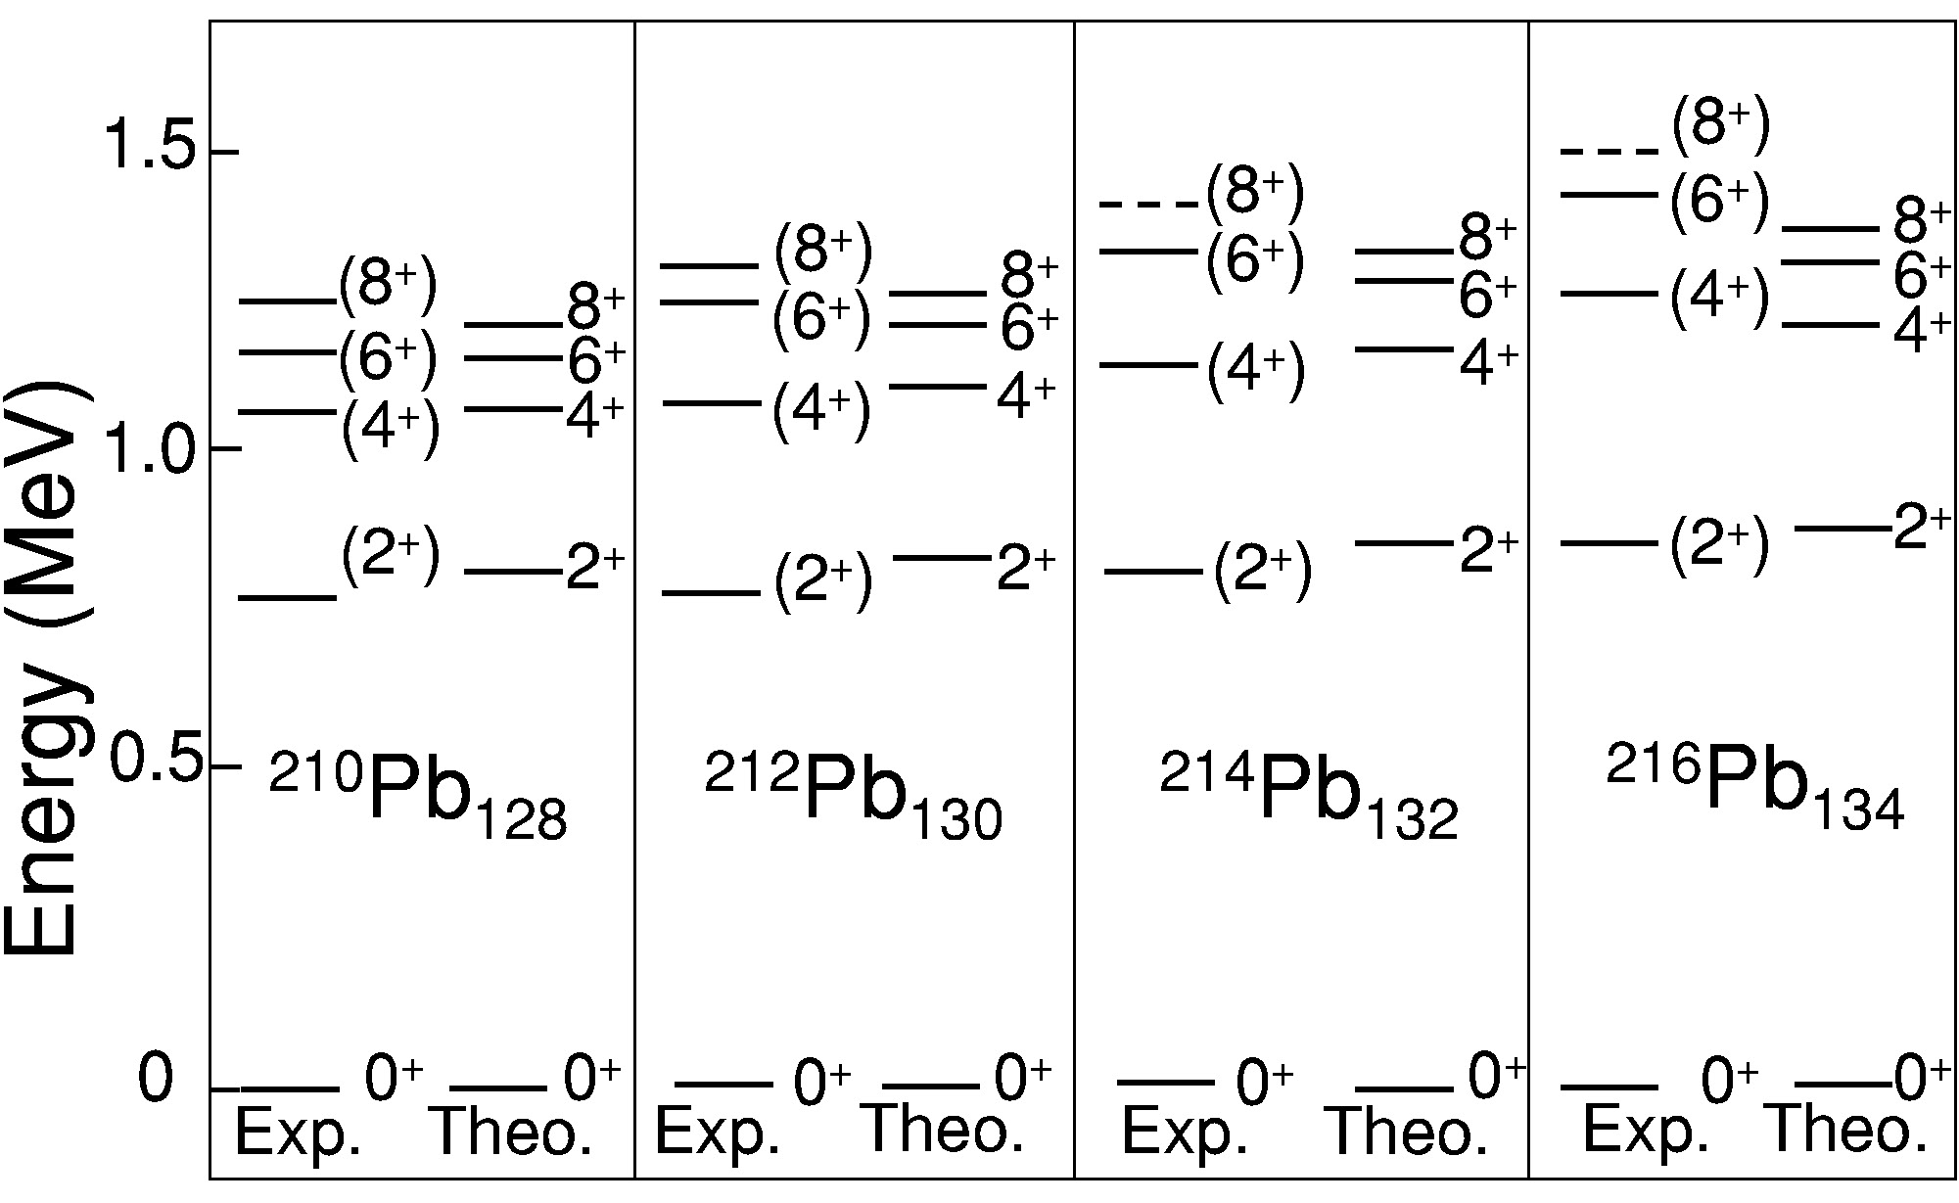
Shell Model calculations Kuo-Herling
Calculations with Antoine and Nathan codes and K-H interaction

Slide 21
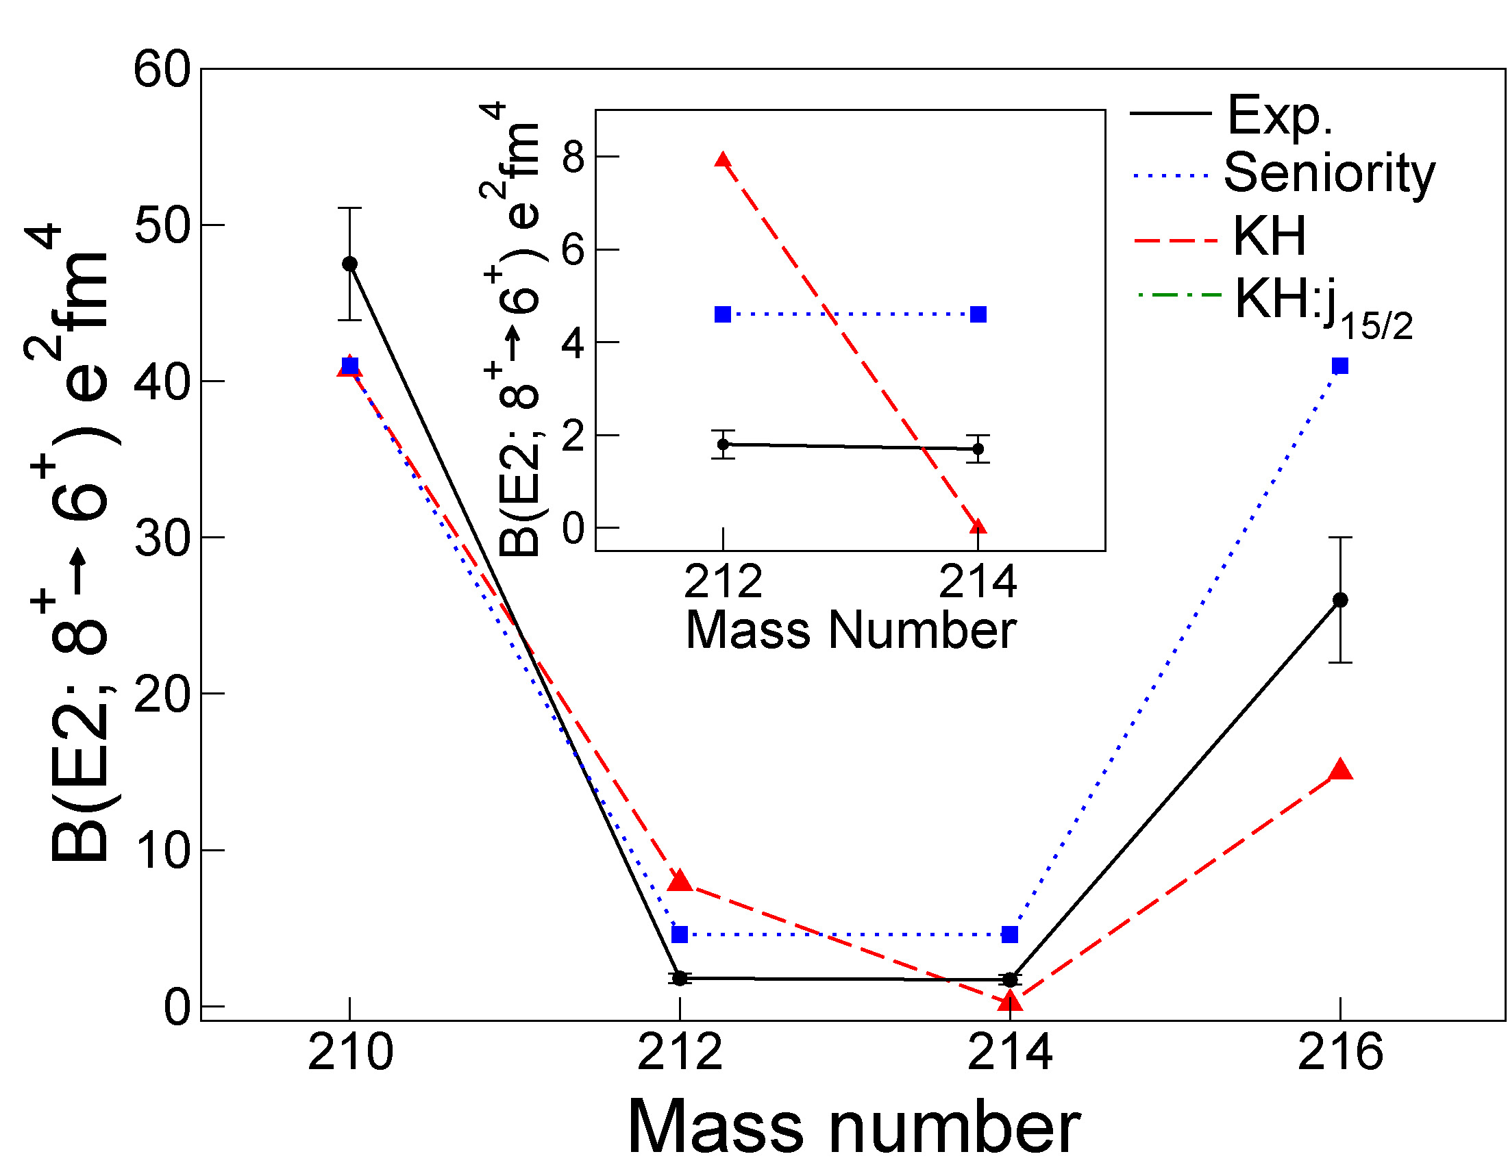
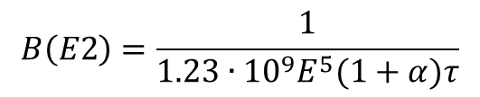
Reduced transition prob. B(E2)
 | ²¹⁰Pb | ²¹²Pb | ²¹⁴Pb | ²¹⁶Pb
Isomer t_{1/2} (μs) | 0.20 (2) | 6.0 (8) | 6.2 (3) | 0.40 (4)
B(E2) e²fm⁴ Exp. | 47(4) | 1.8(3) | 1.4-1.9 | 24.7-30.5
B(E2) e²fm⁴ KH | 41 | 8 | 0.26 | 16.4
$$B\left(E2\right)=\frac{1}{1.23∙{10}^{9}E_{}^{5}(1+α)τ}$$
E : transition energy
α : internal conversion
τ : lifetime
e_{ν} = 0.8e

Slide 22
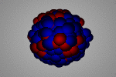
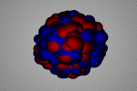
Effective three-body forces (I)
When an interaction is adapted to a model space, it has to be RENORMALISED
The renormalisation takes into account the coupling to the high-energy core excitation modes, as the giant quadrupole resonance (~10 MeV)
Isoscalar
Isovector
Bohr and Mottleson, Nuclear Structure (1975)
Constant effective charges e_{ν} ~ 0.5e, e_{π} ~ 1.5e
Dufour and Zuker PRC 54, 1641 (1996)
BUT not all the core excitation modes are at high energy…

Slide 23
Effective three-body forces (II)
SU(3) E2 ($ΔJ=Δℓ=2$ ) partner shells: ‘small’ energy $0ℏω$ p-h excitations
.
.
.
.
.
.
π shells above Z=82
ν shells above N=126
2f_{7/2}
2g_{9/2}
Z=82
1h_{11/2}
1i_{13/2}
N=126
Z=82 p-h core break
N=126 p-h core break
The wave function in the bare g_{9/2} is dressed, as a first-order perturbation, by these low-energy p-h excitations which are clearly state-dependent
+
GQR
coupling to 2⁺ (and 3⁻) excitations from the core

Slide 24
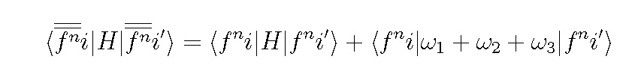
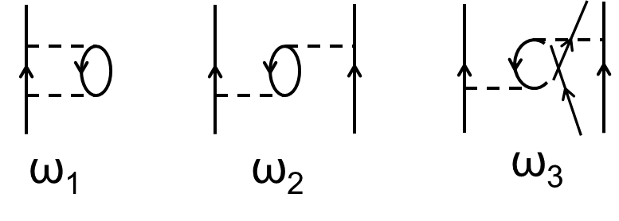
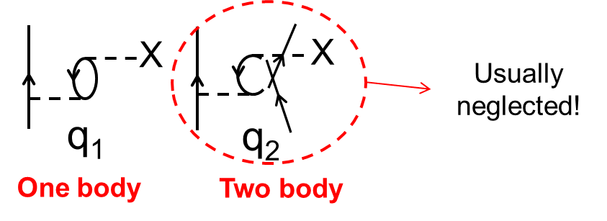
Effective three-body forces (III)
Effective 3-body terms appear naturally in the renormalization process, but they are NOT included in shell-model codes (ANTOINE and NATHAN):
Two-body operators (H) become effective 3-body operators
One-body transition operators (B(E2)) become effective 2-body operators
Usually neglected!
E2 quadrupole transition operator
One body
Two body
Three body
The only way to include these terms in a standard shell-model calculation is to diagonalize using the dressed wave function
.
.
.
.
.
.
π shells above Z=82
ν shells above N=126
Poves and Zuker, Phys Rep. 71, 141 (1981)
2g_{9/2}
2f_{7/2}
Poves et al., Phys. Lett. B82, 319 (1979)
Z=82
h_{11/2}
i_{13/2}
N=126
Z=82 p-h core break
N=126 p-h core break

Slide 25
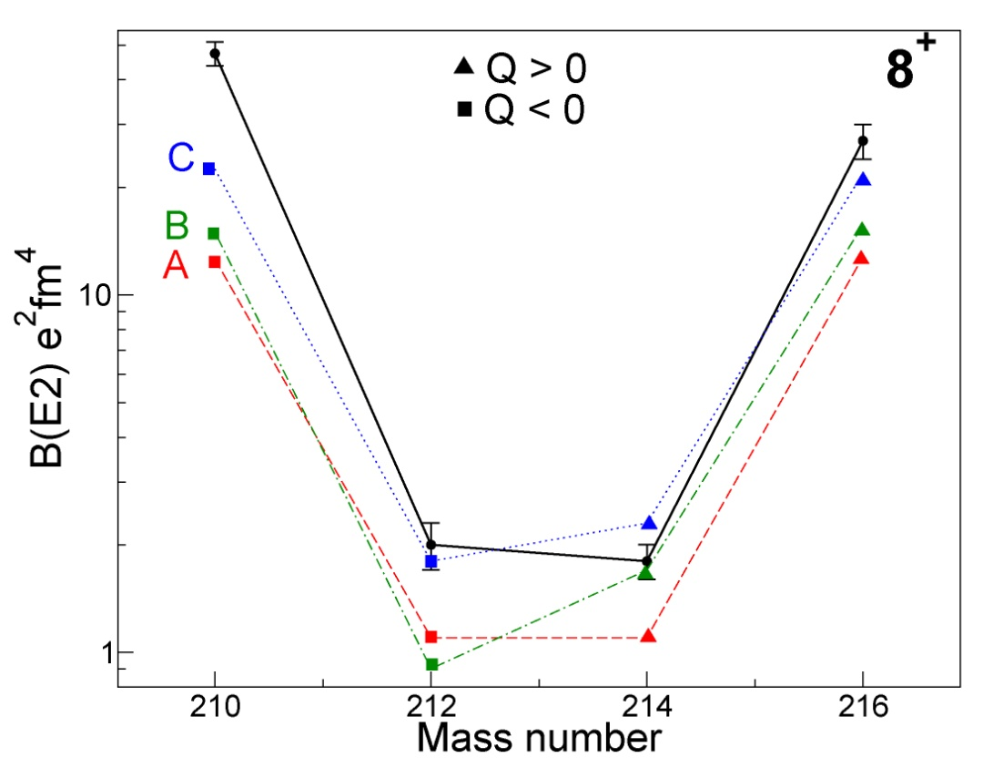
Effective 3-body interaction: results
Lee interaction for evaluating 3-body effects
Exp. data
g_{9/2}
g_{9/2} + ν shells above
g_{9/2} + ν shells above + core exc. (3 body)
Standard eff. charges:
e_{ν} = 0.5e, e_{π} = 1.5e
The explicit coupling to the core restores a seniority-like behaviour (midshell symmetry) and also justifies e_{ν} = 0.8e from the standard e_{ν} = 0.5e

Slide 26
Conclusions
Presence of real and effective three-body forces as a general feature of the nuclear system
Experiment with radioactive beam, with the in-flight technique. Several experimental challenges overcome. State-of-the-art experimental devices.
The neutron-rich region along Z = 82 was populated, enabling to study the nuclear structure in this region up to now unknown due to experimental difficulties
The observed shell structure seems to follow a seniority scheme. However, a closer look reveals that the B(E2) values have an unexpected behaviour. B(E2) values are a sensitive probe to understand in detail the features of the nuclear force The mechanism of effective 3-body forces is general, and could be relevant also for other parts of the nuclide chart (Sn?, Ni?, Cd?)..

Slide 27
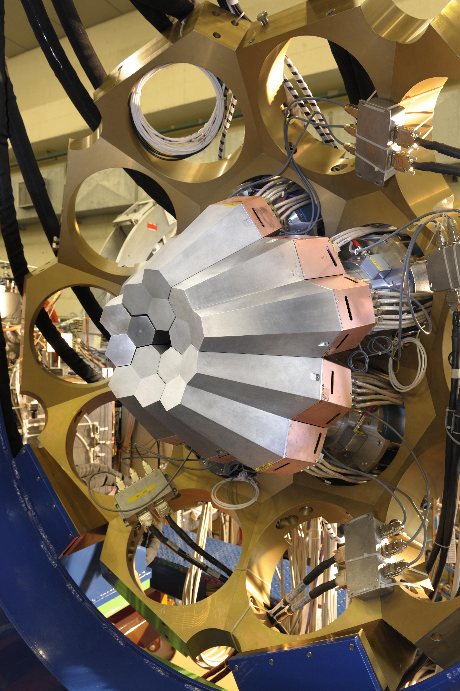
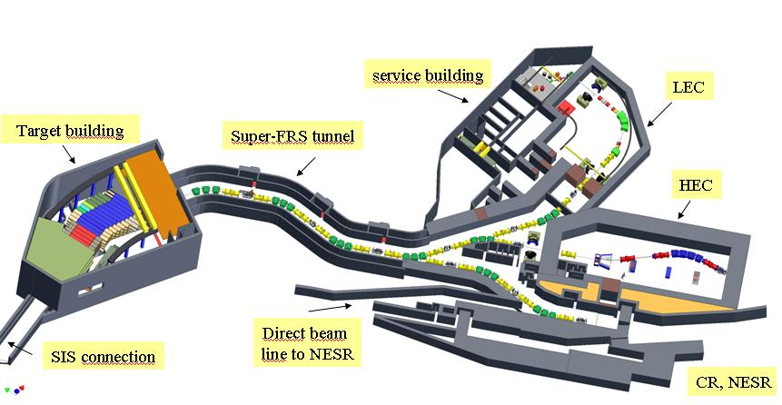
Future perspectives
Super FRS: a factor from 100 to 1000 in yield
New detectors: AGATA,

Slide 28
Collaboration
Gottardo, J.J. Valiente-Dobon, G. Benzoni, R. Nicolini,
E. Maglione, A. Zuker, F. Nowacki
A. Bracco, G. de Angelis, F.C.L. Crespi,F. Camera, A. Corsi, S. Leoni, B. Million, O. Wieland, D.R. Napoli, E. Sahin, S.Lunardi, R. Menegazzo, D. Mengoni, F. Recchia, P. Boutachkov, L. Cortes, C. Domingo-Prado,F. Farinon, H. Geissel, J. Gerl, N. Goel, M. Gorska, J. Grebosz, E. Gregor, T.Haberman,I. Kojouharov, N. Kurz, C. Nociforo, S. Pietri, A. Prochazka, W.Prokopowicz, H. Schaffner,A. Sharma, H. Weick, H-J.Wollersheim, A.M. Bruce, A.M. Denis Bacelar, A. Algora,A. Gadea, M. Pf¨utzner, Zs. Podolyak, N. Al-Dahan, N. Alkhomashi, M. Bowry, M. Bunce,A. Deo, G.F. Farrelly, M.W. Reed, P.H. Regan, T.P.D. Swan, P.M. Walker, K. Eppinger,S. Klupp, K. Steger, J. Alcantara Nunez, Y. Ayyad, J. Benlliure, Zs.Dombradi E. Casarejos,R. Janik,B. Sitar, P. Strmen, I. Szarka, M. Doncel, S.Mandal, D. Siwal, F. Naqvi,T. Pissulla,D. Rudolph,R. Hoischen, P.R.P. Allegro, R.V.Ribas, and the Rising collaboration
Università di Padova e INFN sezione di Padova, Padova, I; INFN-LNL, Legnaro (Pd), I;
Università degli Studi e INFN sezione di Milano, Milano, I; University of the West of Scotland, Paisley, UK; GSI, Darmstadt, D; Univ. Of Brighton, Brighton, UK; IFIC, Valencia, E; University of Warsaw, Warsaw, Pl; Universiy of Surrey, Guildford, UK; TU Munich, Munich, D; University of Santiago de Compostela, S. de Compostela, E; Univ. Of Salamanca, Salamanca, E; Univ. of Delhi, Delhi, IND; IKP Koeln, Koeln, D; Lund University, Lund, S; Univ. Of Sao Paulo, Sao Paulo, Br; ATOMKI, Debrecen, H.

Slide 29
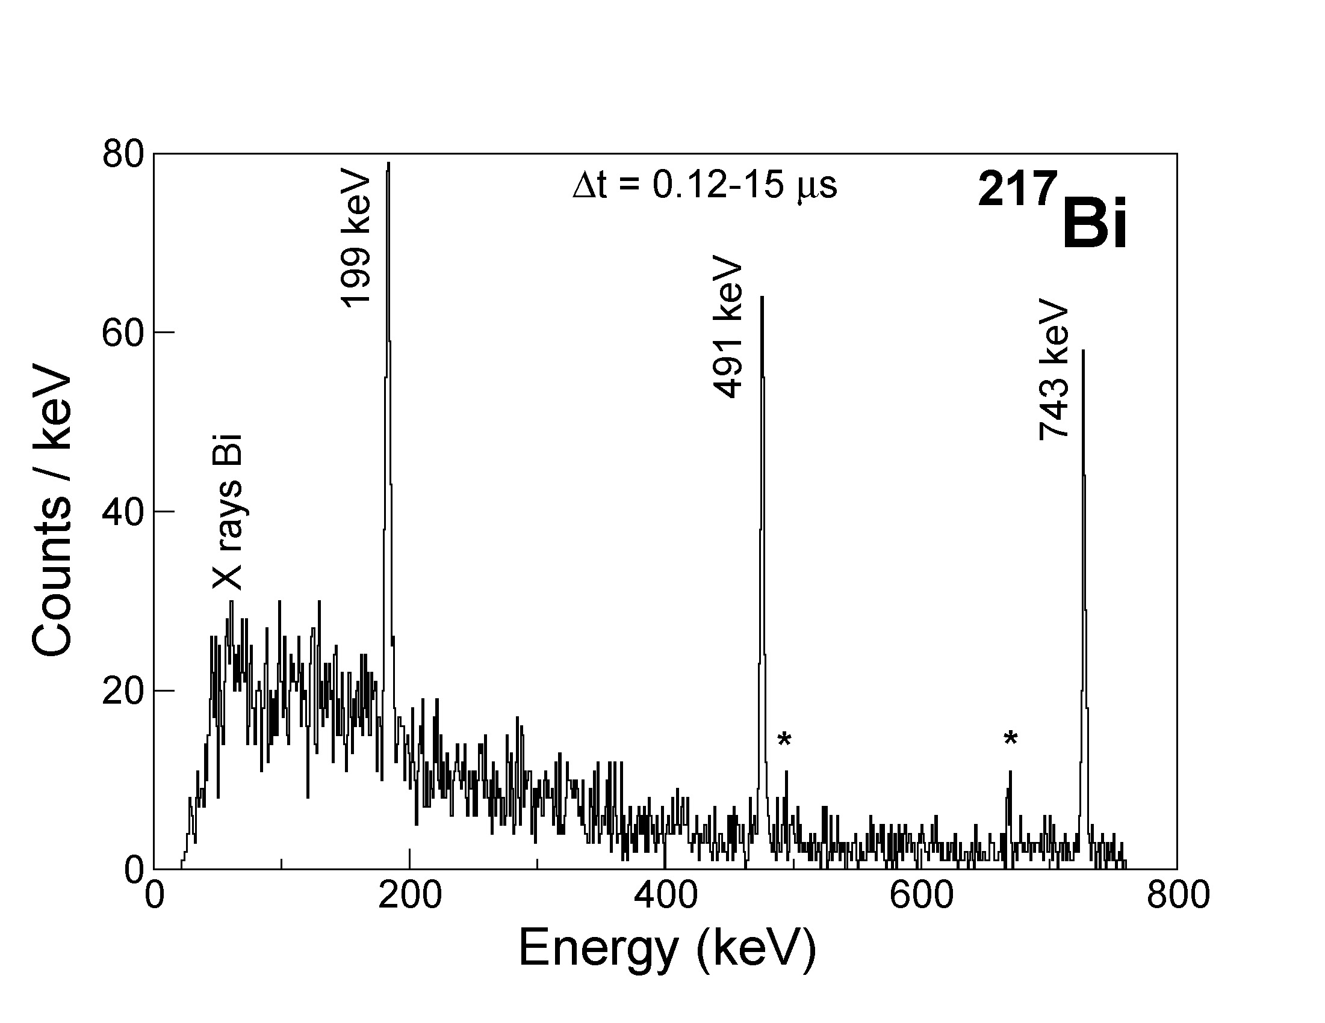
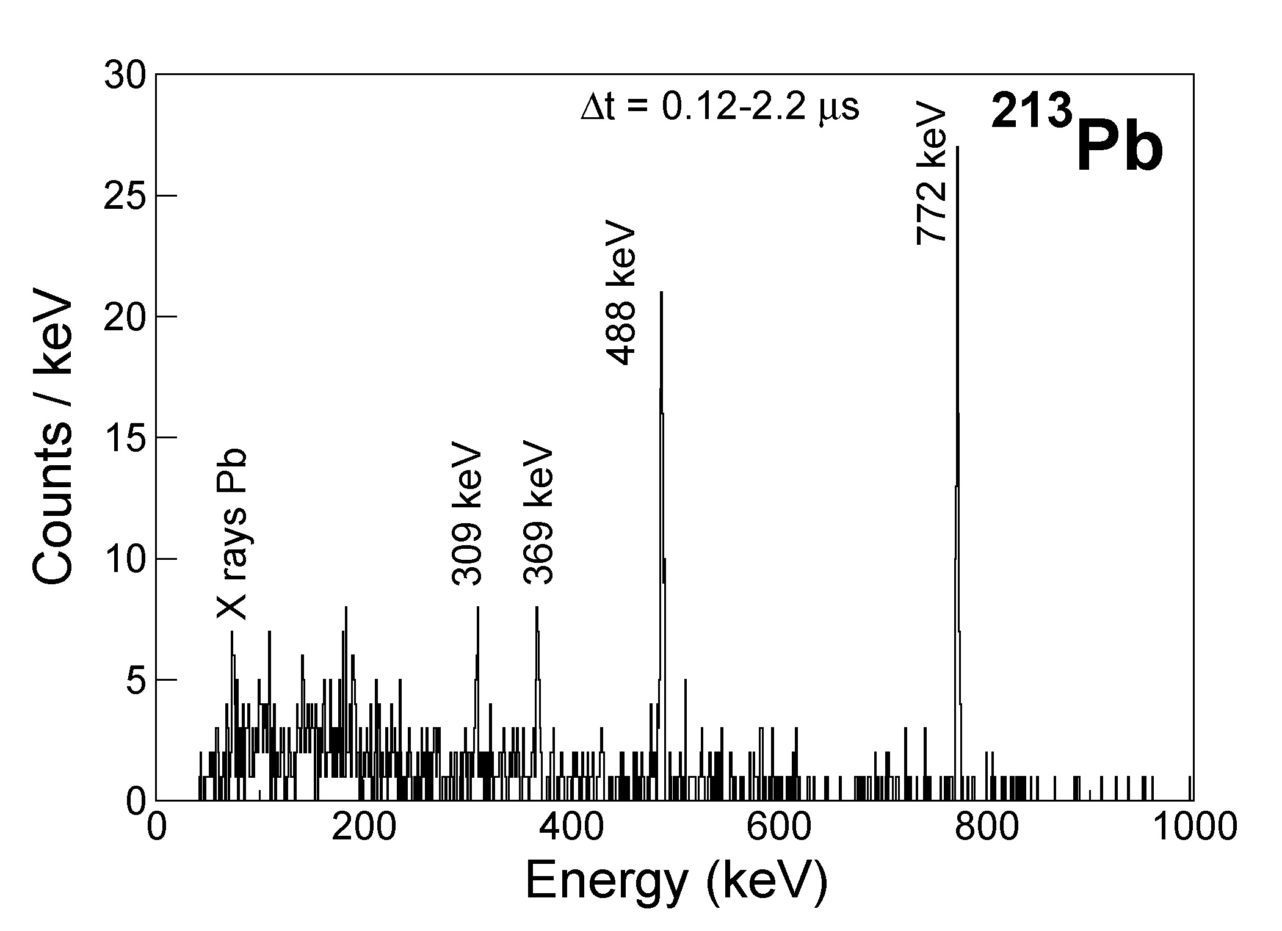
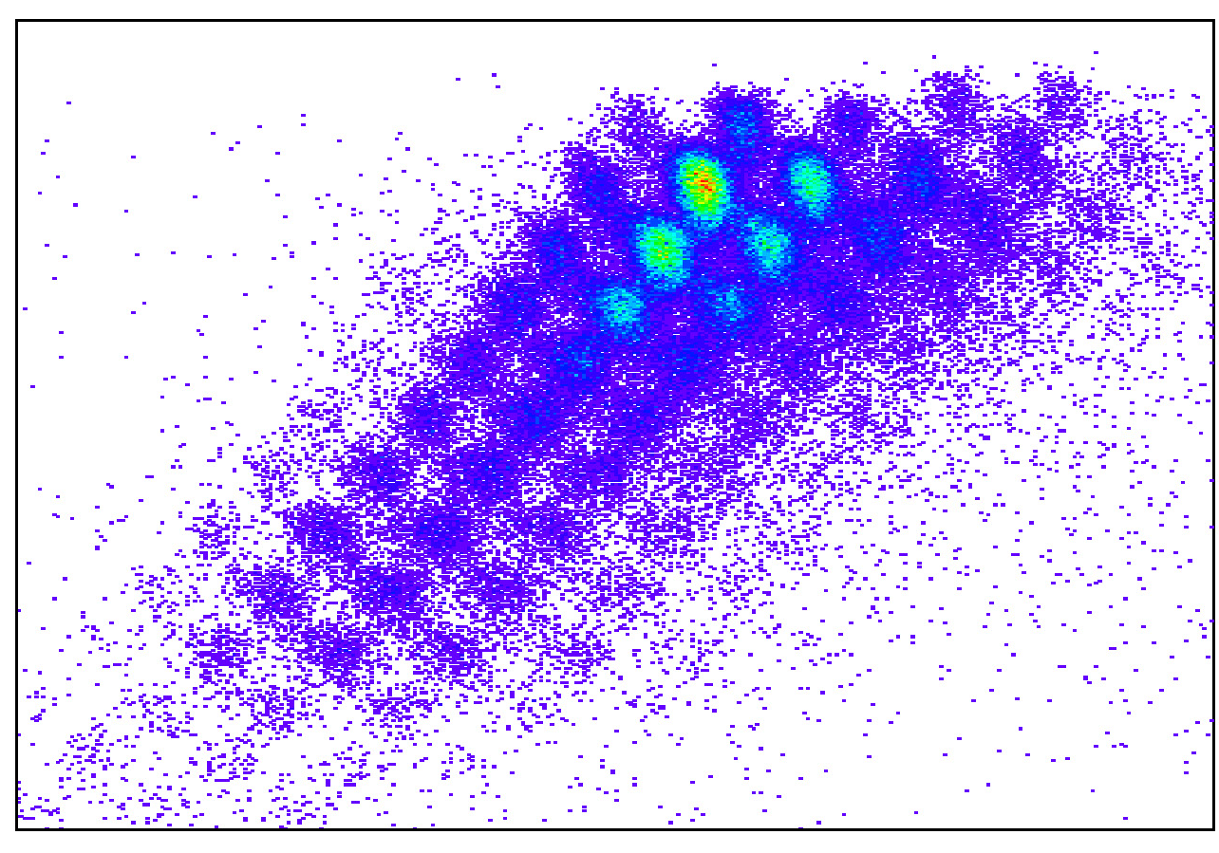
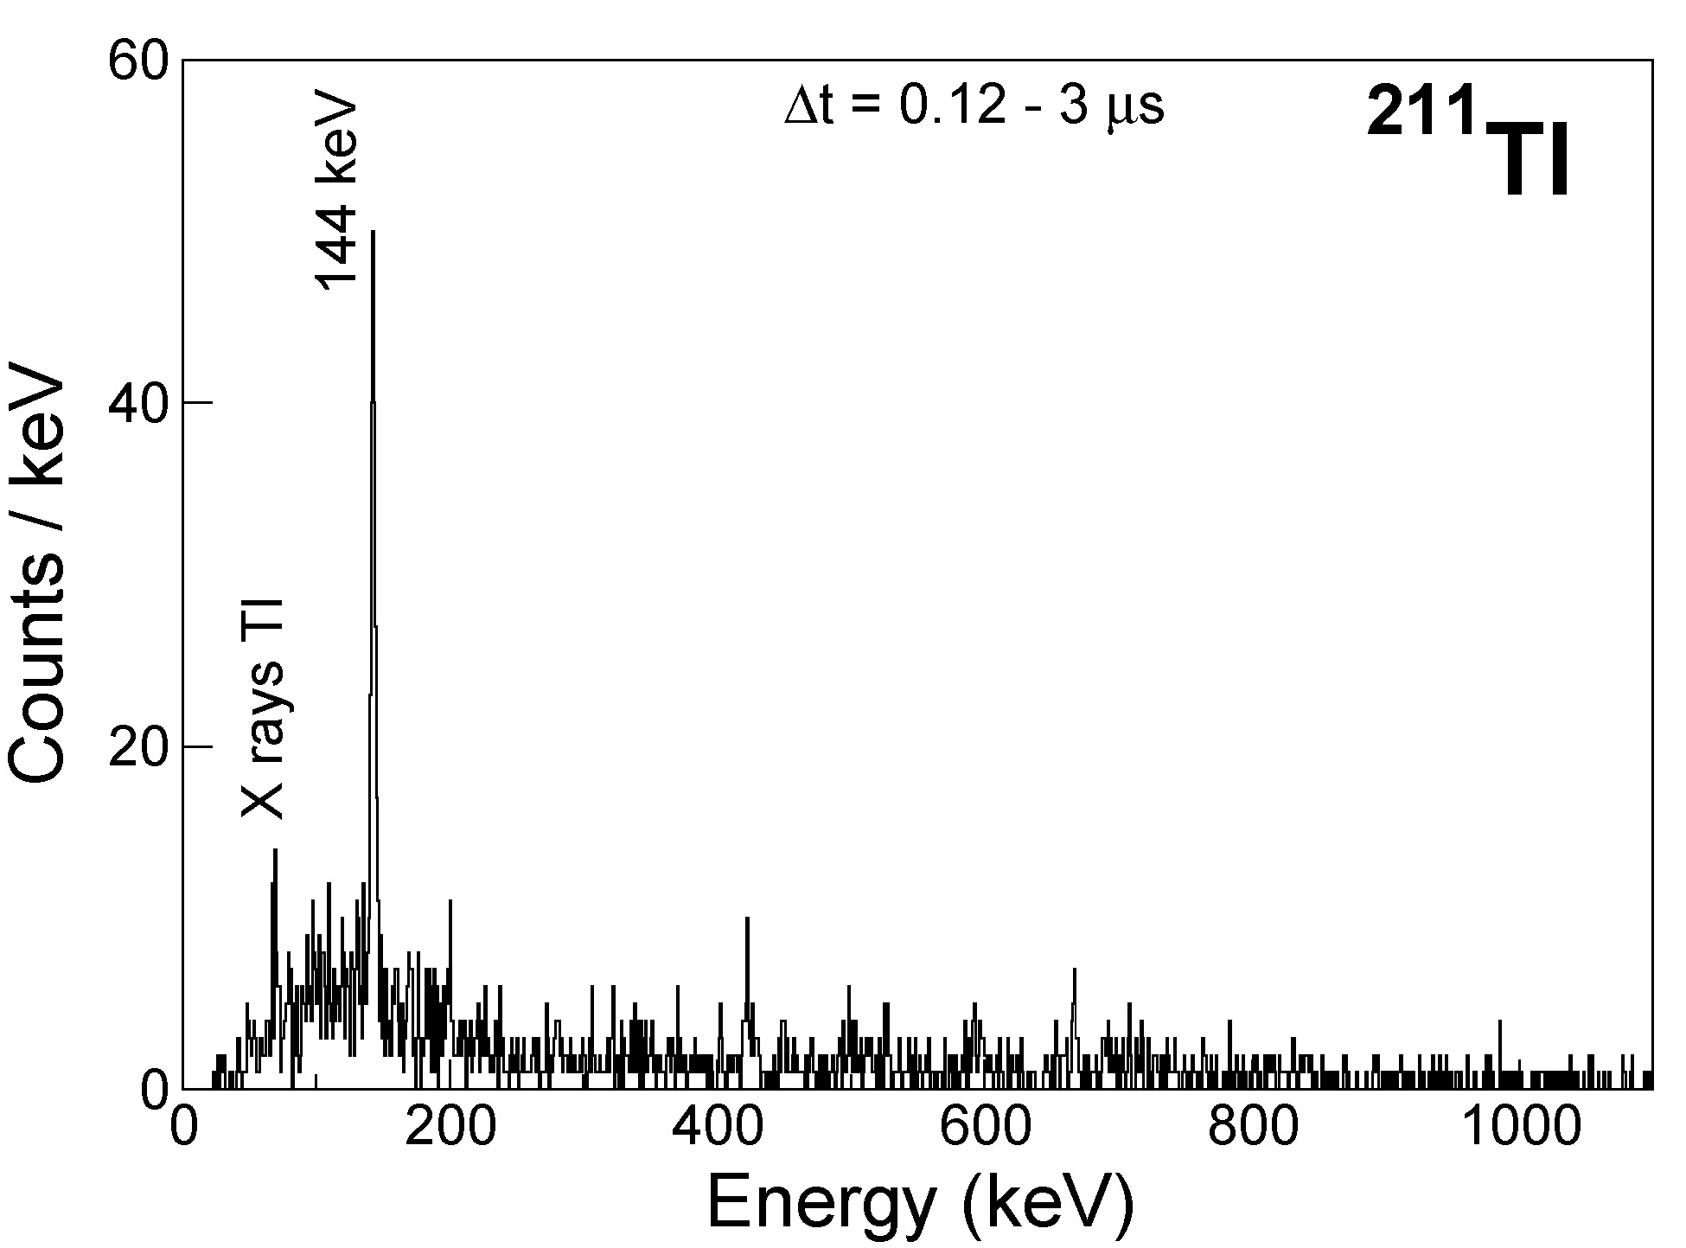
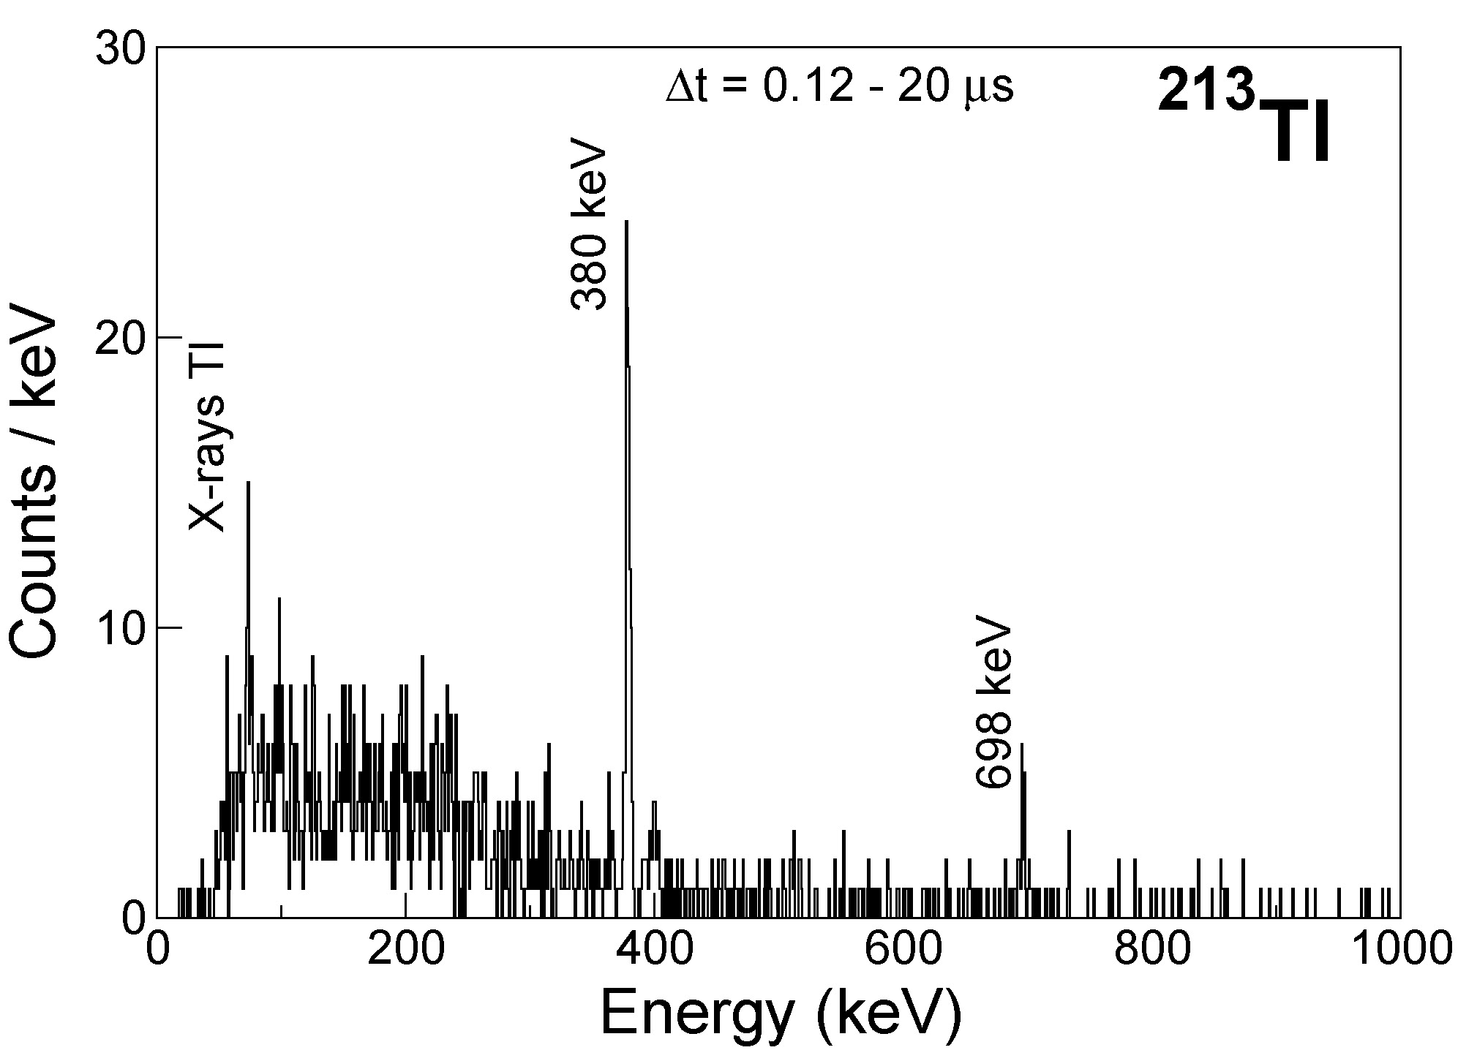
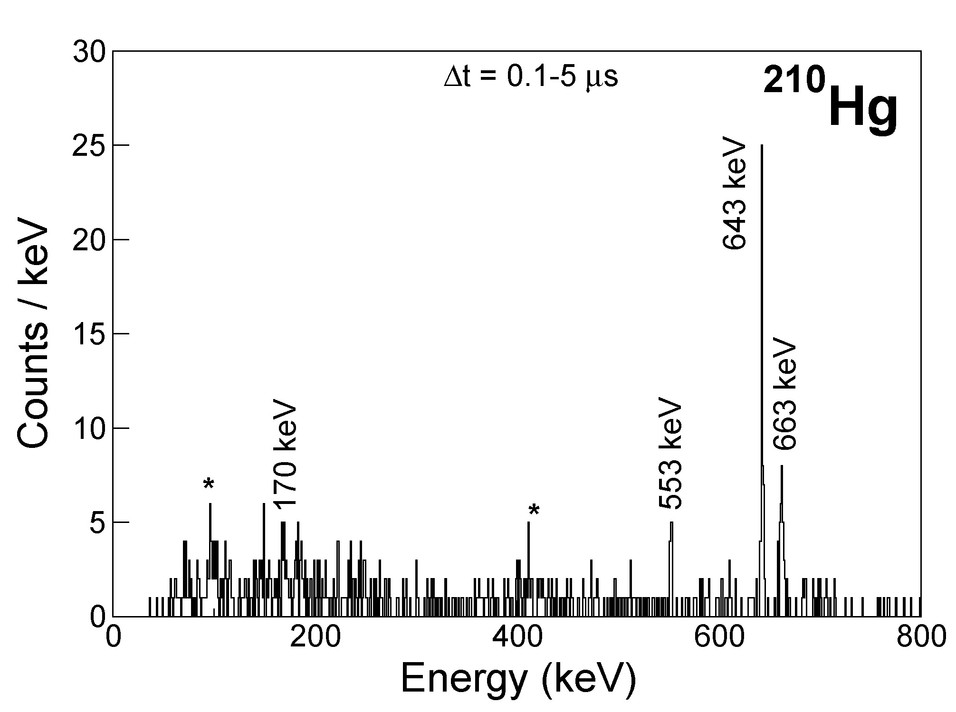
A glimpse of the other results

Slide 30
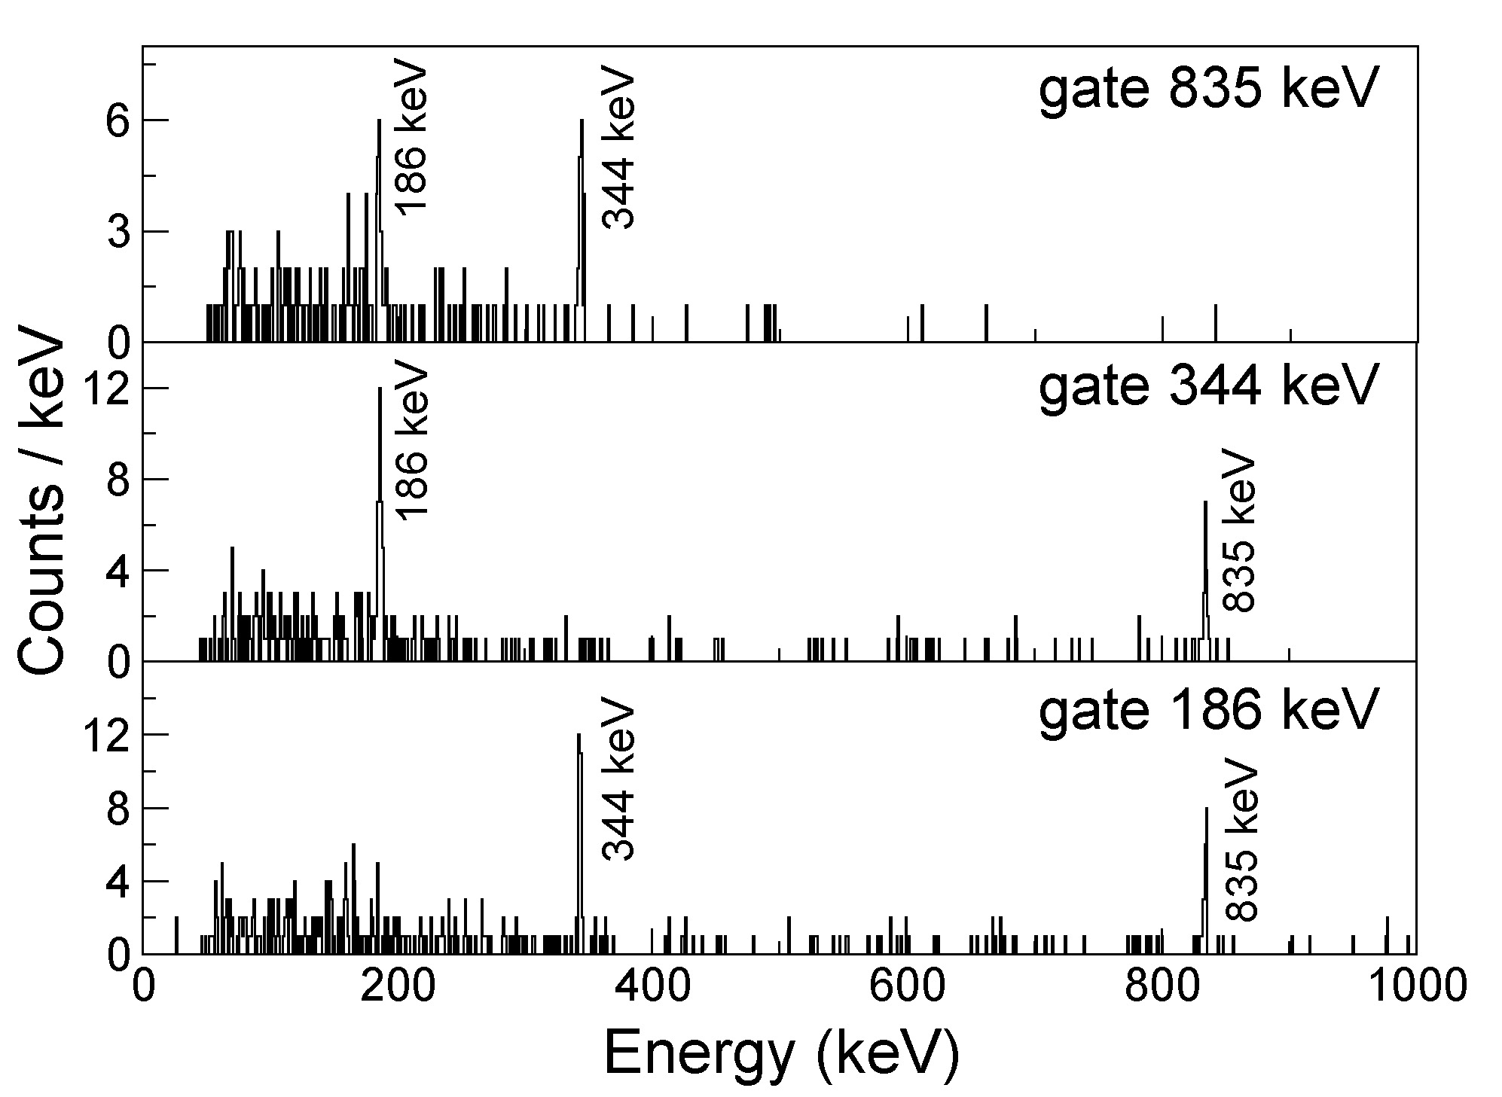
γγ coincidences
²¹⁴Pb
6.2(3) μs
The 8⁺→6⁺ transition is not observed because fully converted with atomic electrons

Slide 32
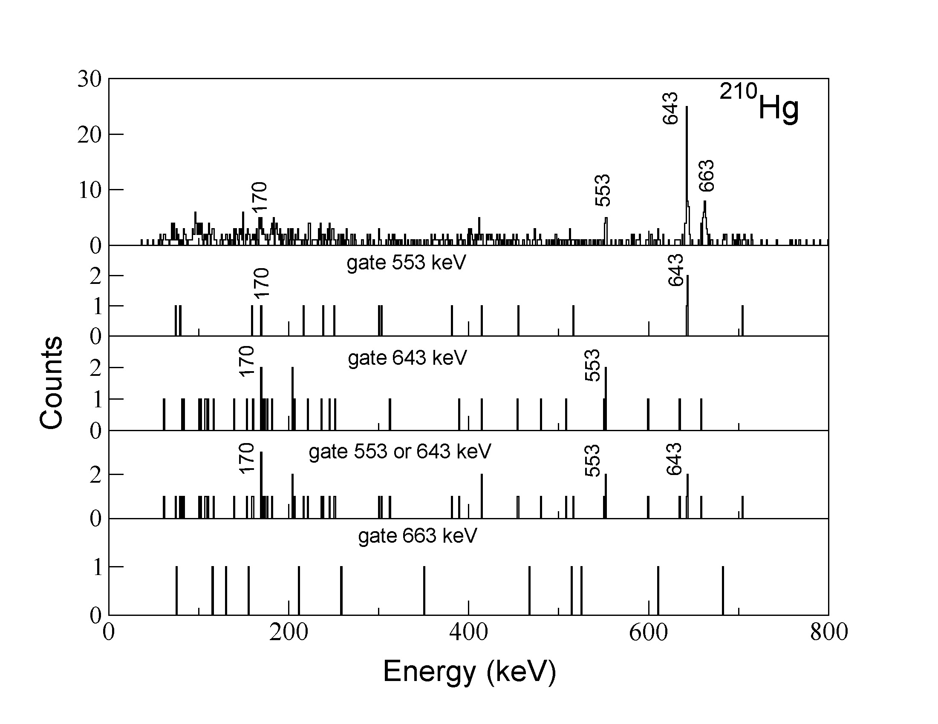
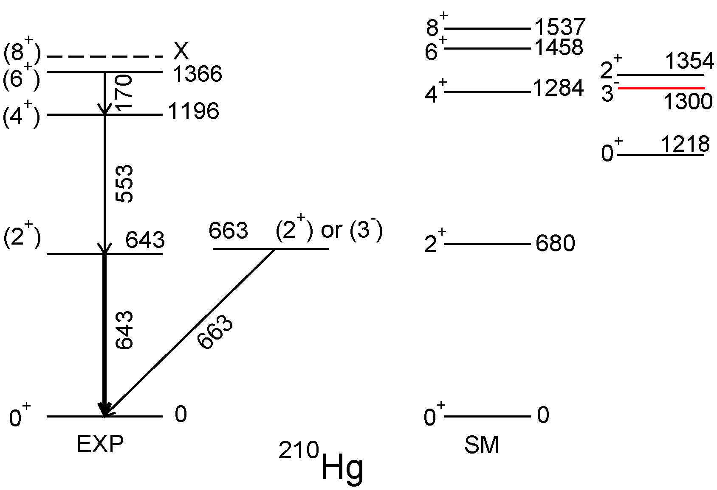
Mercury isotopes (II): ²¹⁰Hg
Δt = 0.12 – 5.50 μs
Energy | Area corrected
553 | 12 (4)
643 | 49 (8)
663 | 28 (7)
170 | 13 (7)
t_{1/2} (553 keV)= 1.1 (4) μs
t_{1/2} (663 keV)= 1.3(3) ns
t_{1/2} (643 keV)= 1.2(1) ns

Slide 33




Mercury isotopes (I)
Z = 82
N = 126
Valence space

Slide 34



Bismuth isotopes (I)

Slide 35


Bismuth isotopes (II)
e_{ν} = 0.8, e_{π} = 1.5
Valence space
 | ²¹¹Bi | ²¹⁷Bi
B(E2; 25/2⁻→21/2⁻) EXP. | 8 (2) e²fm⁴ | 4.4 (3.6) e²fm⁴
B(E2; 25/2⁻→21/2⁻) KH | 92 e²fm⁴ | 1.0 e²fm⁴
Z = 82
N = 126

Slide 36


²¹³Pb: a strange case
What are we observing in ²¹³Pb ? More than one isomer, but appearantly NOT the seniority isomer

Slide 37


γγ coincidences
²¹²Pb
²¹⁴Pb
²¹⁶Pb

Slide 38

Charge state identification
Formation of many charge states owing to interactions with materials
Isotope identification is more complicated
Need to disentangle nuclei that change their charge state after S2 deg.
(Bρ)_{TA-S2} – (Bρ)_{S2-S4}
DQ=-2
DQ=0
DQ=-1
Z
DQ=+1
Bρ₁ - Bρ₂

Slide 39




²³⁸U charge-state problem
Mocadi simulation
LISE++ simulation

Slide 40

Nuclei populated in the fragmentation
1 GeVA ²³⁸U beam from UNILAC-SIS at 10⁹ pps
²¹⁵Bi
²¹⁹Bi
²¹²Pb
²¹⁸Pb
Z
²⁰⁹Tl
²¹³Tl
²⁰⁶Hg
²¹⁰Hg
A/Z

Slide 41


The nuclear shell model
Main tenets of shell model:
Atomic-like shell orbits for the nucleons
Magic numbers
Central mean field (3d harmonic oscillator + SO) and a residual two-body interaction
Certain effects become clearer in exotic nuclei:
It appeared difficult to define what one should understand by first principles in a field of knowledge where our starting point is empirical evidence of different kinds, which is not directly combinable. N. Bohr, 1952
Tensor force
3 body
Otsuka et al, Phys. Rev. Lett. 95, 232502 (2005)
Wiringa and Pieper, Phys. Rev. Lett. 89,182501 (2002)

Slide 42

Exotic nuclei
Stable
ε/β⁺ decay
⁻ decay
α decay
p decay
spontaneous fission
Exotic nuclei → need of radioactive beams
- ISOL (Isolde, Spiral2, SPES, IsacII)
- In-flight separation (GSI, MSU, RIKEN)
Nuclei far from stability:
Better understanding of nuclear structure (3-body), new magic numbers
Coupling to continuum, neutron skins or halos
Nucleosynthesis

Slide 43


The rapid process
Beta-decay half-lives for the r-process
β⁻
Z
Neutron capture
N
Experimental β-decay data needed around ²⁰⁸Pb to validate theoretical models.
Lifetime measured only up to ²¹⁵Pb
Borzov, Phys. Rev. C 67,
025802 (2003)

Slide 44

Effective three-body forces (II)
The hamiltonian matrix elements are determined as:
where:
Usually neglected!
ω₁
ω₂
ω₃
One body
Two body
Three body
Same calculations for transition operators (e.g. electric quadrupole)
X
X
where:
Usually neglected!
Poves and Zuker, Phys Rep. 71, 141 (1981)
q₁
q₂
Poves et al., Phys. Lett. B82, 319 (1979)
One body
Two body

Slide 45





Separation method and particle identification
$Bρ− ∆E −Bρ$ separation
TOF → Velocity β
x₂, x₄ → Bρ
ΔE MUSIC → Z
$$Bρ=Bρ_{0}− \left(1+\frac{x_{4}−Mx_{2}}{D}\right)$$
$$Bρ= \frac{A}{q }\frac{1}{βγ}$$

Slide 46



The fragmentation reactions
spectators
Relativistic energies : 1 GeV/u
Abrasion: fast process, adiabatic behaviour of spectators
Ablation: slower process, evaporation of particles for de-excitation
participants
H. Wieman (2005)
Very low cross sections!

