Slide 1

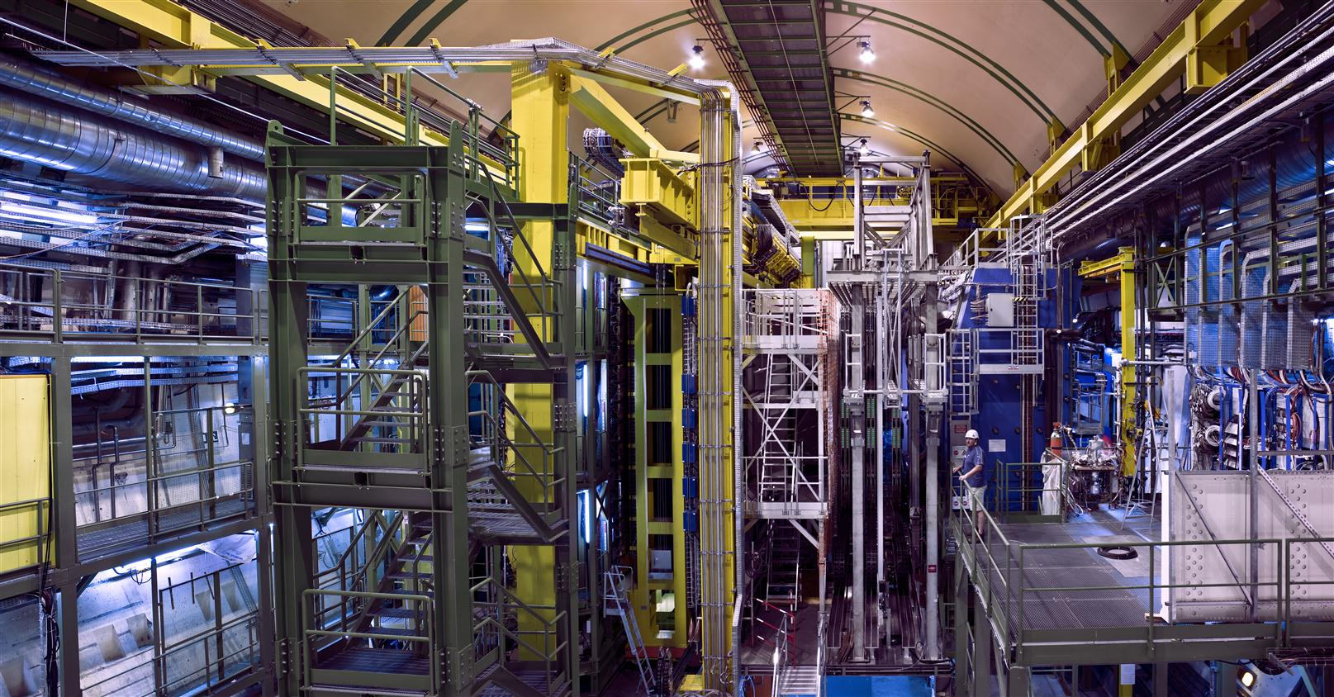
Valencia, October 25, 2013
Charming and beautiful: Search for New Phenomena with Heavy Mesons at LHCb
Outline:
Search for New Physics
LHCb Experiment
Meson Mixing and CPV
Direct CPV & CKM angle γ
Rare B decays
Ulrich Uwer • Physikalisches Institut • Universität Heidelberg
Notes:
Thanks for Invitation. Shipyard or an industrial plant. It does not really fit into the experiemental hall.

Slide 2
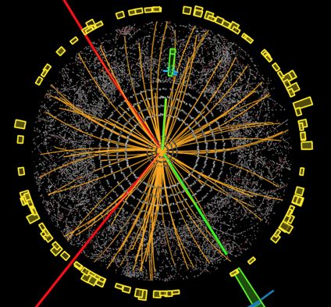
Search for New Physics
ATLAS & CMS @ LHC
Precision Experiments
New particles in quantum loops
b
s
Muon (g-2)
Neutron EDM
K- , B- und D-meson decays
lepton-flavour violation
Direct searches at LHC → 4…5 TeV
Indirect searches → > O(100 TeV)

Slide 3
Physics with B-mesons
b Hadrons:
Experimentally well measurable
m_{B} ~ 5.3 GeV/c², τ_{B} ~ 1.5 ps
Tree-level decays are CKM suppressed
Quantum corrections are important:

Slide 4
“New Physics” in FCNC processes
Standard Model
„New Physics“
q
W
b
q
Y
b
+
b
u, c, t
q
b
X
q
W
Y
+
b
u, c, t
s
b
X
s
Limits:
O(100 TeV) for c_{NP}=1
No (O(1)) effects seen in B decays: limits for New Physics
→ High rate experiments to increase the sensitivity: LHCb

Slide 5
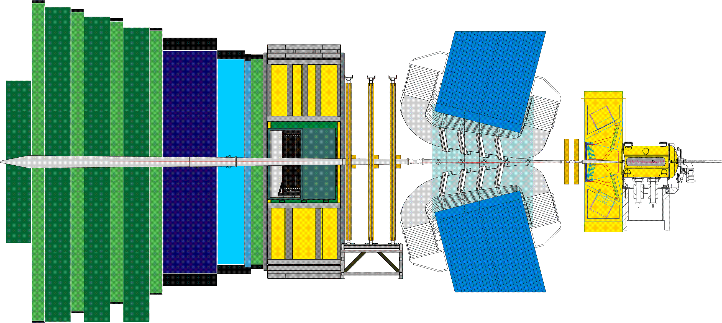
Heavy flavor production at LHC(b)
b
p
p
b
pp collisions at √s = 7 TeV:
LHCb, Eur. Phys. J. C 71 (2011) 1645.
σ_{bb} ~ 250 μb (theory) →
Every 400th collision with bb
200 kHz / 2 MHz (LHCb / ATLAS)
σ_{cc} ≈ 20× σ_{bb}
pp: 18 × 10¹³
cc: 59 × 10¹¹
bb: 26 × 10¹⁰
2010-12 in LHCb:
~ 3fb⁻¹

Slide 6
Typical bb event
K⁻
π⁺
D⁻
π⁻
b hadron
μ⁻
ν
B_{s}
μ⁻
7 mm
μ⁺
t = /βγc
K⁻
K⁻
Detector requirements:
excellent vertex reconstruction
excellent momentum and mass resolution
excellent particle identification (π/K/p and μ)

Slide 7
LHCb Detector
Muon System
μ/h separation
Trigger
ε_{μ} ≈98% @ 1%MisID
Vertex Detector
σ_{IP}≈20μm (p_{T}>2 GeV)
RICH Detectors
p/K/π
ε_{K} ≈95% @ 5%MisID
Dipol magnet
2 m
Calorimeter
h/e/γ/ separation
Trigger
Tracking-System
σ_{p}/p= 0.4 ÷ 0.6%

Slide 8
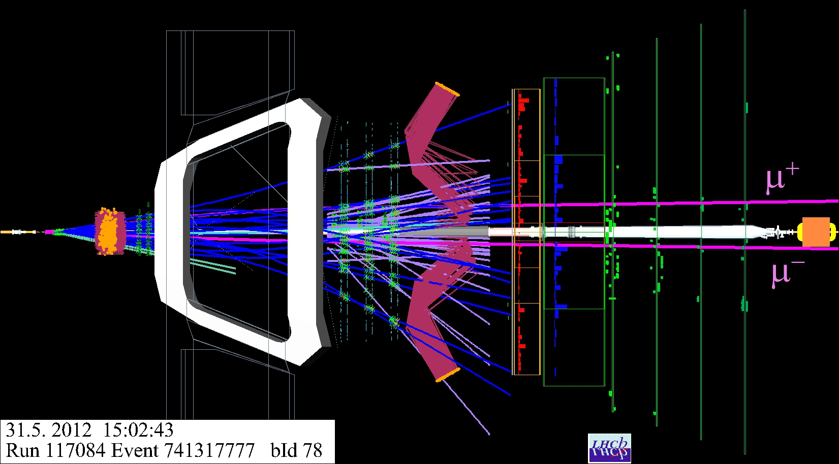
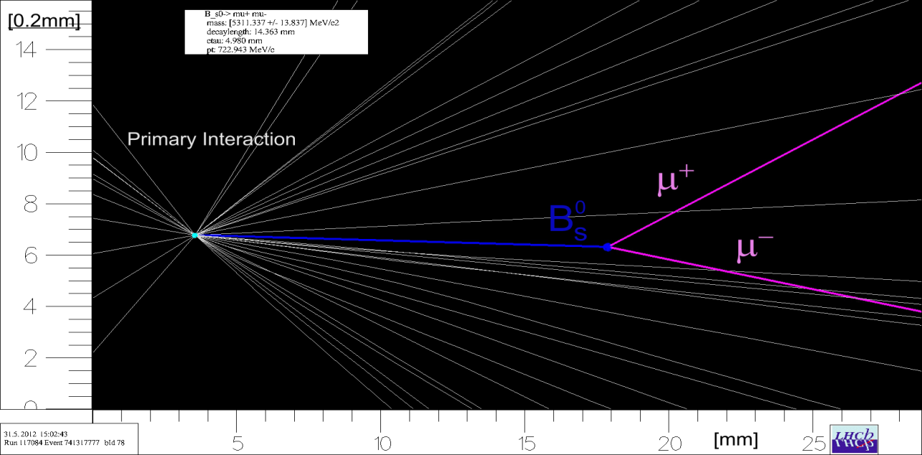
B-decay in LHCb
Muon-System
Tracking System
Magnet
VELO
2 m
Calorimeter
14 mm
1× proton-proton interaction

Slide 9
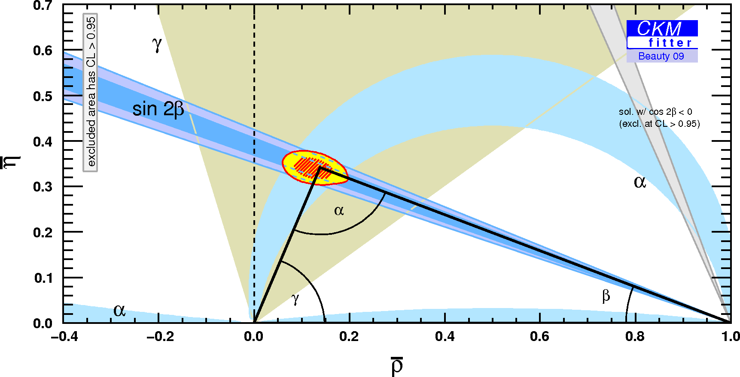
Some LHCb key measurements
Meson - Mixing
CKM Metrology: γ
Rare decays
angular distribution
CPV to get mixing phase
& direct CPV
rates
D⁰ – Mesons
Mixing and
CP violation

Slide 10
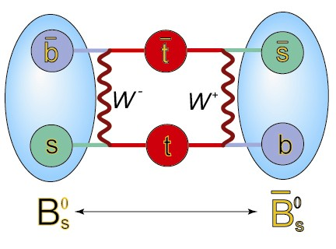
Neutral Meson Mixing

Slide 11
Mixing Phenomenology
Mass eigenstates:
with
Mixing parameters

Slide 12
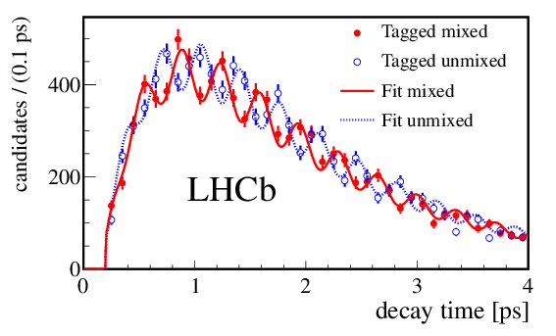

B_{s} Mixing
LHCb
34k signal events
(5 decay channel)
B_{s} → B_{s}
Decay time modulation
~cos(Δm_{s}t)
B_{s} → B_{s}
Δm_{s} = 17.768± 0.023 ± 0.006 ps⁻¹
New J. Phys. 15 (2013) 053021
Δm_{s} = 17.77 ± 0.10 ± 0.07 ps⁻¹
PRL 97 062003 (2006).
Notes:
Systematics: z scale & momentum scale.

Slide 13
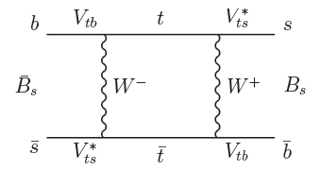

Mixing Phase φ_{s} and mixing induced CPV
B_{s} → J/ψ φ(KK)
→ J/ψ ππ
Mixing phase φ_{s} from t-dep. CP asymmetry
A_{CP}(t) ~ sin(φ_{s})sin(Δmt)
Mixing phase in the Standard Model:
prediction:
(CKMFitter)
→ very small CPV
Possible New Physics contributions:
→ large CPV?

Slide 14
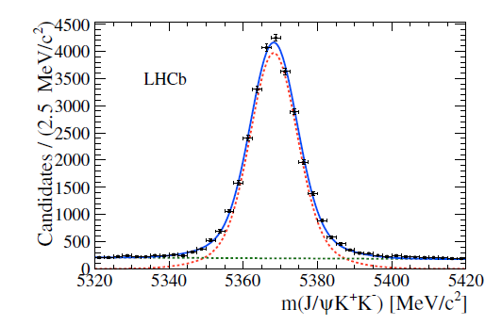
B_{s}→ J/ψ (μμ) φ(KK)
arXiv:1304.2600
Phys. Rev. D 87, 112010 (2013)
experimentally clean signature
VV final state: angular analysis to separate CP even/odd components
Non-resonant KK (s-wave, CP-odd) component: → allows to solve sign ambiguity
1 fb⁻¹
27600 signal evts

Slide 15
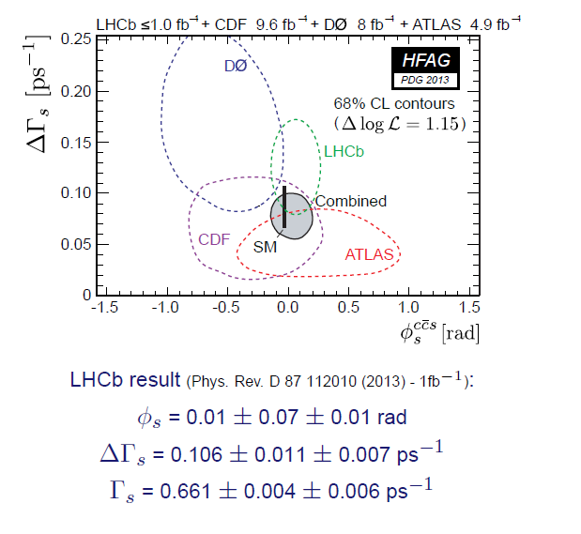
Mixing Phase φ_{s}
arXiv:1304.2600
Phys. Rev. D 87, 112010 (2013)
Results from
B_{s}→J/ψφ
& B_{s}→J/ψππ
(pure CP odd)
ΔΓ_{s} > 0
PRL 108 (2012)
Good agreement with Standard Model.
Notes:
Systematics - φ_{s} : Angular accept. ; ΔΓ: Bckg + t accept.

Slide 16
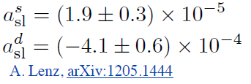
CP Violation in Mixing
P( )
≠ P( )
B⁰
B⁰
B⁰
B⁰
B⁰
B⁰
B⁰
B⁰
μ⁻ X
μ⁺ X
CP
Semi-leptonic asymmetry
SM
The D0 experiment observed significant deviations from zero.

Slide 17
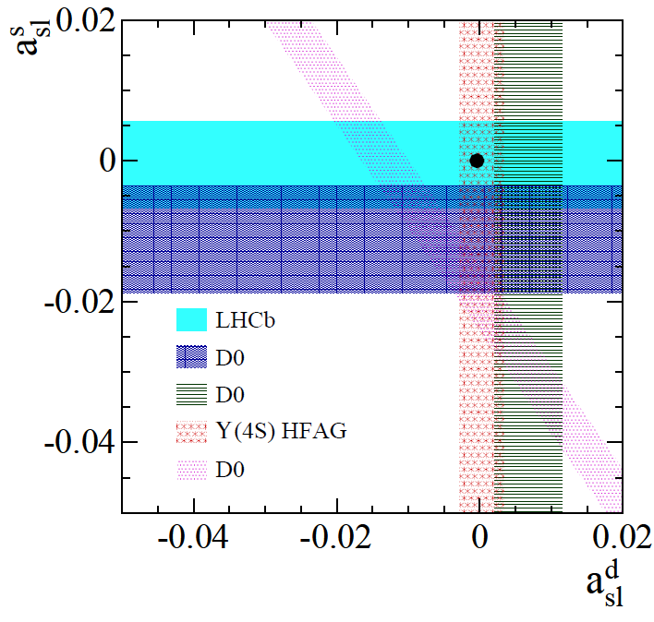
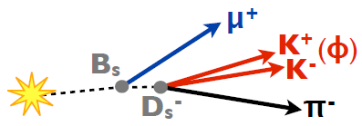


CP Violation in B_{s} Mixing
LHCb-PAPER-2013-033
arXiv:1308.1048
Problem at LHC:
Unknown production asymmetry O(1%)
⇒ Use quickly oscillating B_{s} mesons, untagged and time integrated analysis.
(untagged + t integrated)
consistent with Standard Model
Analysis for B⁰ is on-going – results soon!
Notes:
3 different control channels to determin detection asymmetry:
J/Psi (trig + tracking), D* tagged D->Kkpi (tracking), Bd->Dmunu (trig)
Largest effect: L0 muon trigger asymmetry

Slide 18
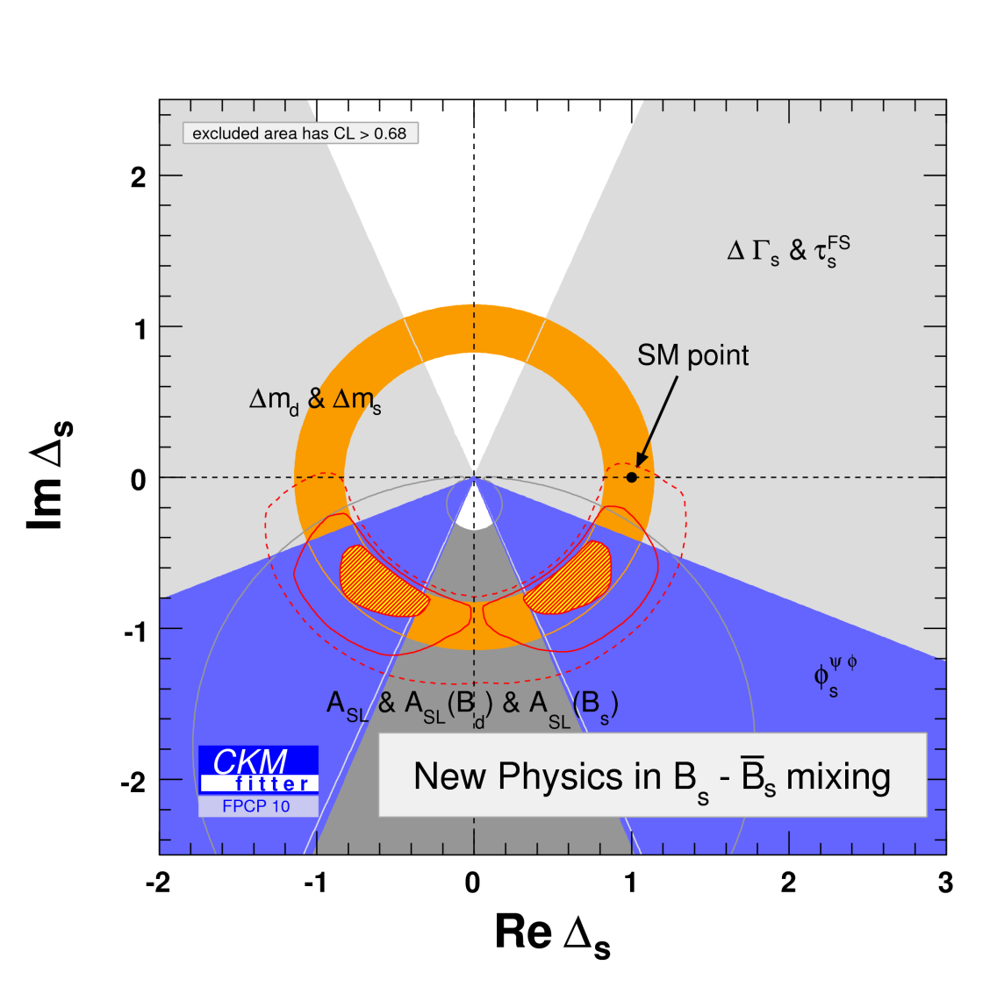
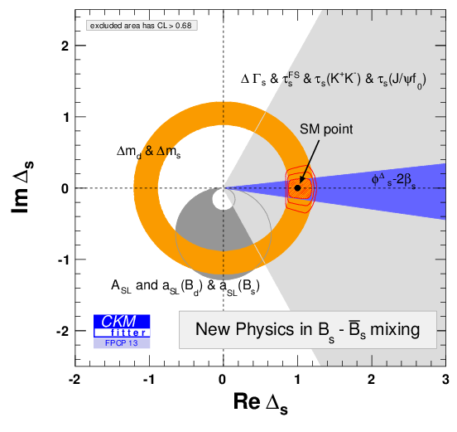
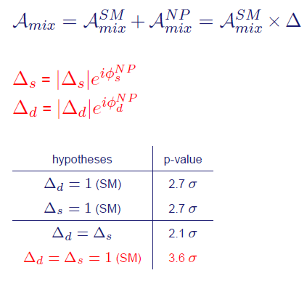
New Physics in B_{S} Mixing?
ckmfitter.in2p3.fr
FPCP 2010
q
W
b
b
u, c, t
q
A. Lenz , U. Nierste & CKM Fitter
Agreement with Standard Model, but still room for New Physics (10-20%)

Slide 19
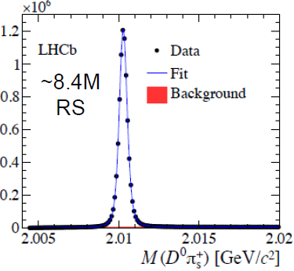
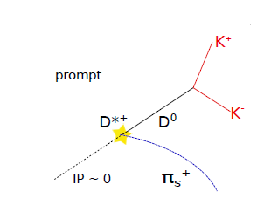
Charm Mixing and CPV
Mixing and CPV
Direct CPV
FCNC processes strongly GIM suppressed (d-type quarks) → very slow mixing
Expect tiny CPV ~ O(10⁻³)
Tagging

Slide 20
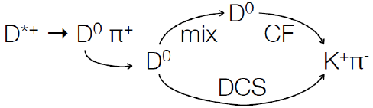
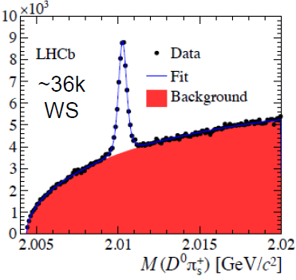

D⁰ – D⁰ Mixing
PRL 110, 101802 (2013)
arXiv:1211.1230
1 fb⁻¹
WS
K⁻ π⁺
RS
DCS
CF
≈

Slide 21
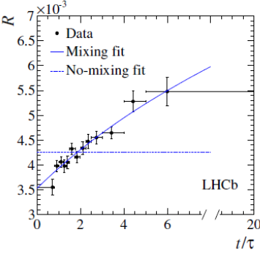
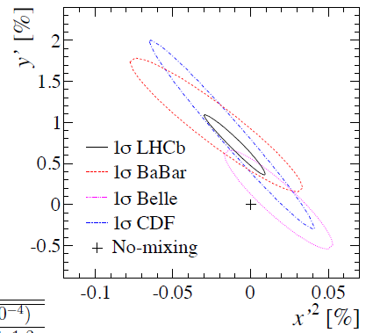
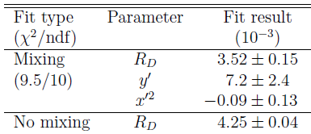
D⁰ – D⁰ Mixing
PRL 110, 101802 (2013)
arXiv:1211.1230
No mixing excluded w/ 9.1σ
Interpretation requires the knowledge of strong phase δ.
Notes:
Main Systematics: Effects which alter the t-dep R ratio
D from B (2.7%)
D reconstructed with doubly misID -> peaking background in deltaM
Constraint in the fit and treated in the fit.
All other effects are negligible.

Slide 22
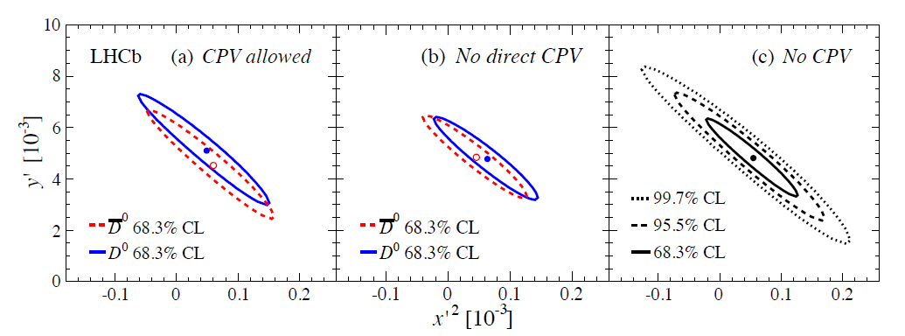
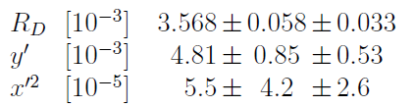
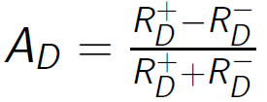

CPV in D-Mixing w/ 3 fb⁻¹
LHCB-PAPER-2013-053
arXiv:1309.6534
2.5× more precise
R⁺_{D} ≠ R⁻_{D}
R⁺_{D} = R⁻_{D}
No sign for CPV
Test for CP violation:
R⁺_{D} ≠ R⁻_{D} (direct CP violation)
CPV in mixing (|q/p|≠1)
Notes:
Systematice: production asymmetry, detection asymmetry are included in the fit -> contours contain systematic errors.

Slide 23
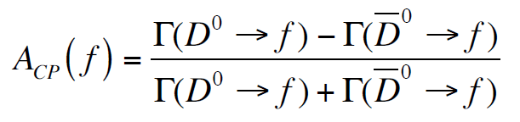
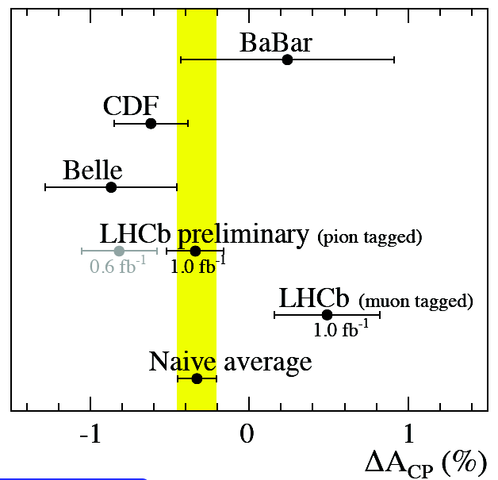
Direct CP Violation
CP eigenstate f : π⁺ π⁻ , K⁺ K⁻
Theoretical expectation: A_{CP} is very small, ≤ 10⁻³.
Difficult to measure because of production and detection asymmetr.
Observable:
ΔA_{CP} = A_{raw}(K⁻K⁺) − A_{raw}(π⁻π⁺)
= A_{CP}(K⁻K⁺) − A_{CP}(π⁻π⁺)
Prompt D (LHCb-Conf-2012-003 )
ΔA_{CP} = [ - 0.34 ± 0.15_{stat} ± 0.10_{syst} ] %
Semi-leptonic B→D (PL B 723 (2013) 33)
ΔA_{CP} = [ + 0.49 ± 0.30_{stat} ± 0.14_{syst} ] %
Notes:
Systematics: Prompt: IPχ² cut for π_{s;} Semileptonic: backgrounds at t=0 different for KK and PiPi

Slide 24
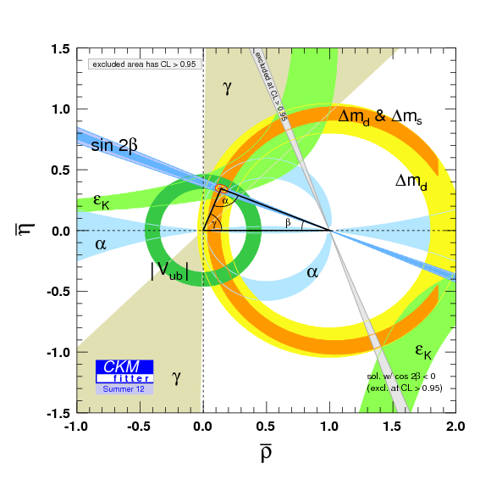
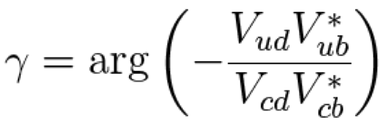
Direct CP violation and CKM Angle γ
Measurement exploits direct CPV in B→DK decays

Slide 25
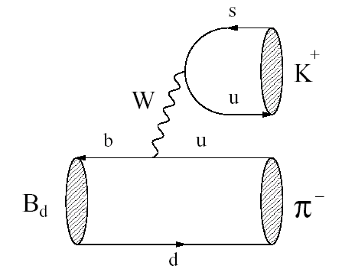
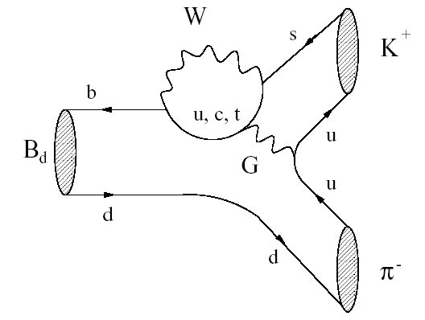
Direct CP Violation in B→Kπ
Tree
B⁰
Penguin
B⁰
g
Strong phase: difficult to predict

Slide 26
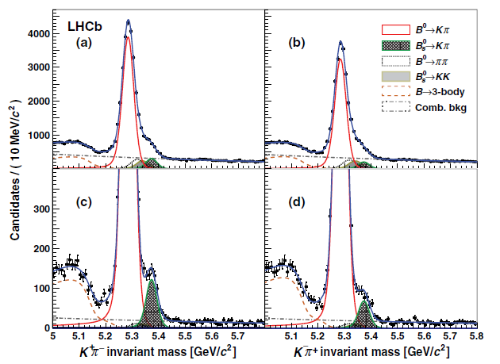
Direct CP asymmetries for B_{d,s}→ Kπ
0
PRL 110, 221601 (2013)
B⁰ → K⁺ π⁻
B⁰ → K⁻ π⁺
[6.5σ]
B_{s} → K⁺ π⁻
B_{s} → π⁺ K⁻
Need correction for detection / production asymmetry.
Notes:
Discovered in 2004.
Systematics:
Bd=Detection asymmetry
Bs=Detecttion asymmetry, signal model, combinatorial backgr,, cross feed,

Slide 27


Direct CP asymmetries for B_{d,s}→ Kπ
PRL 110, 221601 (2013)
[10.5σ]
[6.5σ]
1st observation of CPV in B_{s} mesons
Standard Model relation:
[J.Lipkin Phys. Lett. B621 (2005) 126.] *)
Direct CPV in B→Kπ fully consistent with SM.
.*) But in the standard model a miracle occurs …

Slide 28
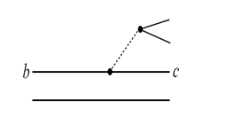
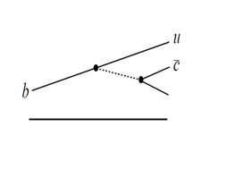
Determination of γ from B→DK decays
V_{cb}
D⁰ K⁻
B⁻
f_{D} K⁻
V_{ub}
D⁰ K⁻
Gronau, London, Wyler (GLW)
Atwood, Dunietz, Soni (ADS)
Giri, Grossman, Soffer, Zupan
(GGSZ)
f_{D} = KK, ππ (CP state)
f_{D} = Kπ and πK
Self conjugated Dalitz modes
B± → D(KK) K±
B± → D(ππ) K±
B± → D(KK) π±
B± → D(ππ) π±
B± → D(π⁺K⁻) K±
B± → D(K⁺π⁻) K±
B± → D(π⁺K⁻) π±
B± → D(K⁺π⁻) π±
LHCb
1 fb⁻¹
LHCb
1 fb⁻¹
LHCb
1 fb⁻¹ + 2 fb⁻¹
Phys. Lett. B 712 (2012) 203.
Phys. Lett. B 712 (2012) 203.

Slide 29
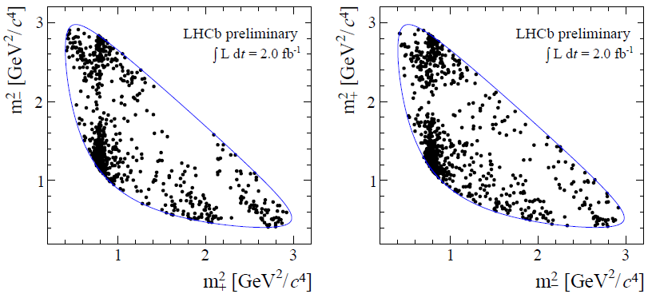
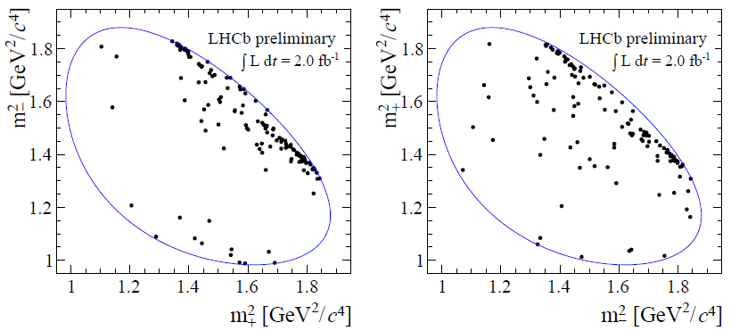
GGSZ analysis: B→ D(K_{s}h⁺h⁻)K
preliminary, LHCb-CONF-2013-004
m± = m(K_{S}h ±)
B⁺
B⁻
D →K_{S}π⁺π⁻
690 signal events
1 + 2 fb⁻¹
γ = (57 ± 16) ⁰
r_{B} = (8.8 ^{+2.3}_{-2.4}) × 10⁻³
δ_{B} = (128 ⁺¹⁵₋₁₇) ⁰
D →K_{S}K⁺K⁻
110 signal events
Notes:
2fb analysis: ~ 1500 Kspipi, ~200 KsKK events
Exploits interference pattern in the D→K_{S}h⁺h⁻ Dalitz plots (different for B⁺ and B⁻)
(powerful method – dominates the gamma determination at B factories).
Use discrete measurements of δελτα_{D} in Dalitz plot bins from CLEO-c: c_{i},s_{i} [PRD82(2010)112006]
Ci, si =cos/sin(delta_D)
Ki from flavor specific D decays.
Dalitz plots are divided into bins that have been chosen to maximise the
statistical sensitivity.
Systematics:
Strong phase uncertainty: knowledge of ci und si
Assumption of no interference in Dpi control mode
Remarr Dpi cannel is an important control mode: midID yield for DK and efficiency correction.

Slide 30
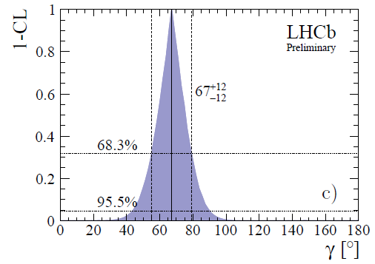
Combination of B→DK results
preliminary, LHCB-CONF-2013-006
ADS/GLW 1 fb⁻¹ + GGSZ 3 fb⁻¹
γ =(67±12)º
For comparison:
BaBar : <γ> = 69 ⁺¹⁷ ₋₁₆ (°)
Belle : <γ> = 68 ⁺¹⁵ ₋₁₄ (°)
Notes:
Significantly improved Gaussian behavior when including the 3 fb GGSZ data with respect to the ADS/GLW

Slide 31

Rare (FCNC) B Decays

Slide 32
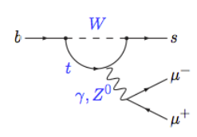
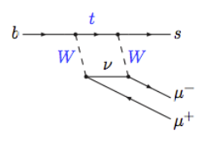
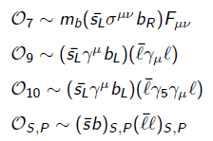
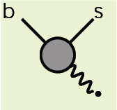
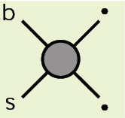
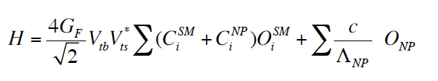
FCNC decays & Effective Field Theory
Standard Model:
Operator product expansion
New Physics can lead to new operators with new Lorentz structure or can modify the Wilson coefficients → modifies the angular distribution

Slide 33
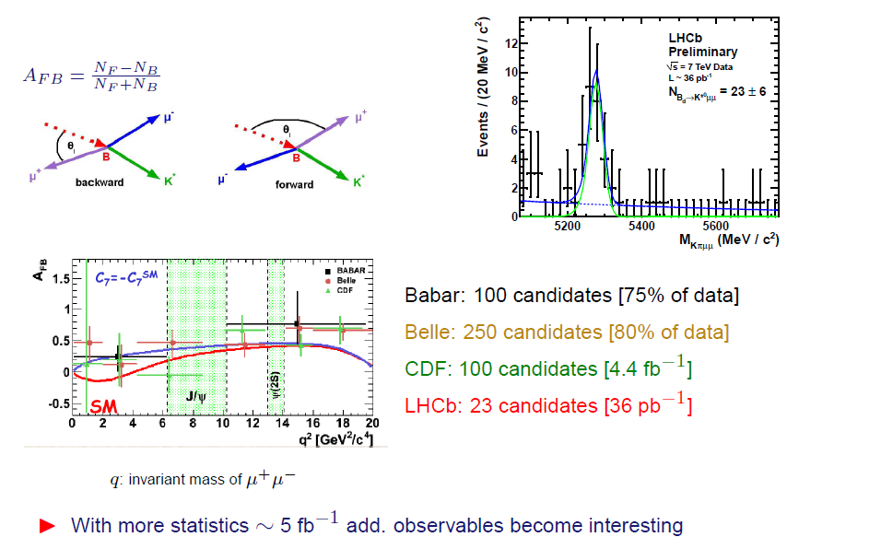
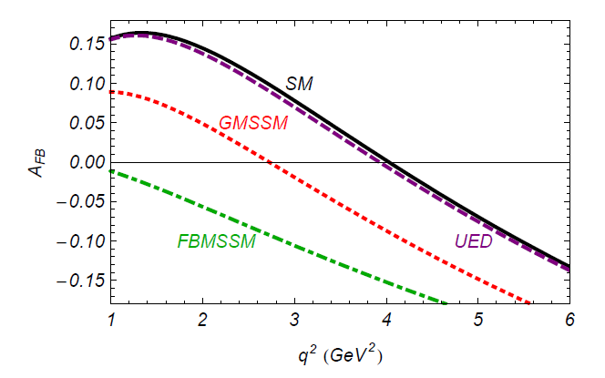
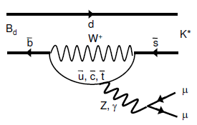
Angular distribution in B⁰ → K*μμ
Simplest angular analysis:
Forward-backward asymmetry
W. Altmannshofer et al. 2009.
q² = m_{μμ}
FBMSSM Flavor Blind MSSM
GMSSM: MFV MSSM
UED: Universal extra diim.
m²_{μμ} [GeV²]

Slide 34
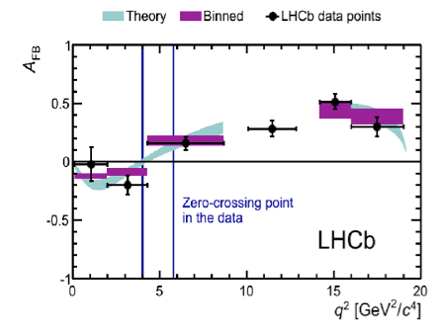
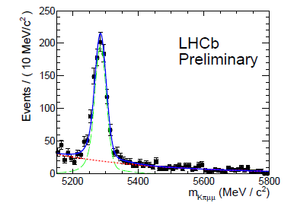
A_{FB} in B⁰ → K* μμ
LHCb-PAPER-2013-019
arXiv:1304.6325
~ 900 events
BABAR+BELLE+CDF: ~600
Zero crossing:
q₀² = 4.9 ±0.9 GeV²
M. Neubert (EPS 2011): “Textbook confirmation of Standard Model”
Notes:
Systematics: Acceptance model, data-simulation difference

Slide 35


Full angular analysis
B⁰ → K* (Kπ) μμ
Observables F_{L} and S_{i} are functions of Wilson coefficients.

Slide 36





Different Parametrization
Different set of observables with reduced dependence on form-factor uncertainties have been proposed by several authors:
In general data well described by SM prediction
LHCb-PAPER-2013-037
arXiv:1308:1707
Notes:
S-wave komponent: <7% from external measurement
Systematics: angular acceptance, uncertainties in the signal and
background invariant mass models, the angular
model for the background, and the impact
of a possible S-wave amplitude.

Slide 37


Deviation for P₅′
LHCb-PAPER-2013-037
arXiv:1308:1707
P₅′ shows deviation of 3.7σ from SM (4.3 < q² < 8.68 GeV²/c⁴)
2.5σ for 1< q² < 6 GeV²/c⁴ (theoretically favored region)
Possible interpretation:
deviation in di-lepton vector operator C₉
But: only 1 / 24 bins (0.5% probability)

Slide 38




Very rare FCNC decay B_{s,d} → μ⁺μ⁻
Standardmodell
NP contributions: SUSY Higgs sector
Sensitive to additional scalar and pseudo-scalar contributions
Helicity suppressed
Correction due to finite ΔΓ_{s}
BR(B_{s} →μ⁺μ⁻)= (3.25 ± 0.17)x10⁻⁹
BR(B_{s} →μ⁺μ⁻)= (3.56 ± 0.18)x10⁻⁹
BR(B_{d} →μ⁺μ⁻)= (1.07 ± 0.10)x10⁻¹⁰
Notes:
High sensitivity for scalar/pseudo scalar sector of extended Higgs models

Slide 39





Observation of B_{s}→μμ
PRL 111 (2013) 101805
CMS
4.0σ
4.3σ
2.0σ
2.0σ
-10
< 7.4×10⁻¹⁰ @ 95 CL
significance > 5.0
-10
CMS + LHCb
Notes:
Systematics: background modelling, signal modelling – included as nuissance parameters in the fit.

Slide 40

Implications for New Physics
Notes:
MFV: Models with MFV
RSc: Randall-Sundrum Modells w/ Custodial Protection
SM4: Standard Model with sequential 4th Geneation
SUSY Flavor Models:
1) Models mit RH currents
AC = Agashe and Carone (AC) [36] based on a U(1) avour symmetry
RVV2 = Ross, Velasco-Sevilla and Vives, non abelian
AKM= Antusch, King and Malinsky,, based on Flavor SU(3)
2) LL left-handed, CKM like model

Slide 41



Search for Lepton-Flavor Violation in B decays
Lepton Flavor Violation forbidden in SM
Possible LFV extensions of SM:
SUSY [Diaz et al., 2005]
Heavy singlet Dirac neutrino [Ilakovac, 2000]
Pati-Salam lepto-quarks [Pati & Salam, 1974]
B_{s} → eμ
Spin-1
LHCb search for B_{d,s}→eμ follows B_{d,s}→μμ search
LHCb-PAPER-2013-030
arXiv:1307.4889
@ 95% CL
CDF 2009
Illustrates the power of indirect searches.

Slide 42

At the End
High-precision heavy flavor physics is an excellent tool to search for effects of New Physics beyond the TeV scale.
With LHCb a new era of precision B & D physics has started
So far we have not observed any significant difference from the Standard Model.
In the coming years LHCb (w/ upgrade in 2018) & BELLE II will significantly reduce the room for New Physics (e.g. from O(15%) to O(2%) in B_{d,s} mixing ).

Slide 43
Backup

Slide 44

B_{s} Mixing Measurement
σ_{t} ≈ 45 fs
K⁻
Signal B (flavor specific decay)
K⁺
π⁻
B_{s} → D_{s}⁻ π⁺
B_{s} → D_{s}⁺ π⁻
D_{s}⁻
B_{s}
π⁺
PV
B
Opposite B
Can be used for flavor tagging
Problem w/ neutral B’s (→mixing)
Effective tagging efficiency: ~ 3.5% (opposite+same side)

Slide 45



B_{s}→ J/ψ (μμ) φ(KK)
LHCb-Paper-2013-002
to be submitted to PRD
experimentally clean
VV final state:
Preliminary
1 fb⁻¹
27600 signal evts
(L = 0, 1,2 = relative orbital momentum)
3 different polarization amplitudes with different relative orbital momentum:
angular analysis to disentangle CP even/odd state

Slide 46




Angular dependent t distributions
Helicity angles
B_{s}
a_{k,} b_{k} c_{k,} d_{k,} contain φ_{s} and complex polarization amplitudes.
B_{s}

Slide 47


Analysis procedure φ_{s}
Unbinned maximum likelihood fit to proper time and angular distributions:
Acceptance correction:
Proper time acceptance from data
Angular acceptance from simulation
Proper time resolution:
Calibration of per-event error w/ prompt J/ψ’s + random tracks
Preliminary
1 fb⁻¹
σ_{t} ≈ 45 fs

Slide 48

Flavor Tagging
LHCb-Paper-2013-002
Preliminary
new
Same Side Kaon Tagger
Calibrated using B_{s}→D_{s}π
Diff. calibration for B_{s} / B_{s}
= 10.26%, ω=35.27%
εD² = (0.89±0.17)%
Opposite Side Tagger (OST)
Calibrated using B→J/ψK⁺
Different calibration for B/B
ε = 33.00%, ω=36.83%
εD² = (2.29 ± 0.06)%
Combined tagging performance
ε = 39.36%, ω=35.9%
εD² = (3.13±0.23)%

Slide 49

Sign of ΔΓ
LHCb-Paper-2013-002
Invariance: ⇔
Resolved via m_{KK} dependent phase difference between p and s-wave
(resonant p-wave contribution changes phase from -π/2 → +π/2)
Preliminary
1 fb⁻¹
Physical solution
ΔΓ_{s} > 0

Slide 50

Fitting procedure
LHCb-Paper-2013-002
Preliminary
Preliminary
CP-even CP-odd S-wave
Preliminary
Preliminary

Slide 51


Mixing Phase φ_{s}
LHCb-Paper-2013-002
1 fb⁻¹
Determination of sign of ΔΓ= Γ_{L}−Γ_{H}: +
PRL 108
(2012) 241801.
|λ| = 0.94 ± 0.03 ± 0.02 (compatible w/ no CPV in decay)
Systematics - φ_{s} : Angular accept. ; ΔΓ: Bckg + t accept.

Slide 52

Penguin pollutions in B_{s}→J/ψφ
O. Leroy, La Thuile 2011

Slide 53





B⁰ mixing and t-dependent CPV
1 fb⁻¹
1 fb⁻¹
~8000
events
OST + SSπ tagging
Combination of B⁰ →Dπ & B⁰→J/ψK*
Δm_{d} = 0.516 ± 0.005 ± 0.003 ps⁻¹
Single best measurement by BELLE
OST tagging
HFAG: ±0.02
Notes:
Major systematics from background modeling.
CPV:
70% of Ks decays outside the velo!!!
Need to account for production asymmetry (1.7+/-1.5)%
Largest systematics: Tagging calibration.

Slide 54

New Physics in B_{d} Mixing
Status FPCP 2013
q
W
b
b
u, c, t
q
Some tension with Standard Model at 10-20% level.
A. Lenz , U. Nierste & CKM Fitter

Slide 55

Sensitivity of B→DK decays to γ
γ
Gronau, London, Wyler (GLW)
Atwood, Dunietz, Soni (ADS)
Giri, Grossman, Soffer, Zupan
(GGSZ)
f_{D} = KK, ππ (CP state)
f_{D} = Kπ and πK
Self conjugated Dalitz modes
B± → D(KK) K±
B± → D(ππ) K±
B± → D(KK) π±
B± → D(ππ) π±
B± → D(π⁺K⁻) K±
B± → D(K⁺π⁻) K±
B± → D(π⁺K⁻) π±
B± → D(K⁺π⁻) π±
LHCb
1 fb⁻¹
LHCb
1 fb⁻¹
LHCb
1 fb⁻¹ + 2 fb⁻¹

Slide 56




GLW / ADS Observables
-
GLW / ADS observables are ratios of branching ratios:
→ many systematic uncertainties cancel in the ratios

Slide 57
Suppressed ADS Mode B⁻ →[π-K⁺]_{D}K⁻

Slide 58



GGSZ Method with B⁺→[K_{s}h⁺h⁻]_{D}K⁺
Idea: Exploit interference between D⁰→ K⁰ h⁺h⁻ and D⁰→ K⁰ h⁻h⁺
across the Dalitz plane
K_{s}
D⁰K⁺
B⁺
[K_{s}hh]_{D} K⁺
D⁰K⁺
Different interference structure for B⁺ and B^{-.}→ γ
Powerful method – dominates the precision of γ at B factories.

Slide 59



GGZS analysis: B→ D(K_{s}h⁺h⁻)K
preliminary, LHCb-CONF-2013-004
m± = m(K_{S}h ±)
B⁺
B⁻
CLEO binning
CLEO strong phases
D →K_{S}π⁺π⁻
690 signal events
1 + 2 fb⁻¹
γ = (57 ± 16) ⁰
r_{B} = (8.8 ^{+2.3}_{-2.4}) × 10⁻³
δ_{B} = (128 ⁺¹⁵₋₁₇) ⁰
D →K_{S}K⁺K⁻
110 signal events
Notes:
2fb analysis: ~ 1500 Kspipi, ~200 KsKK events
Exploits interference pattern in the D→K_{S}h⁺h⁻ Dalitz plots (different for B⁺ and B⁻)
(powerful method – dominates the gamma determination at B factories).
Use discrete measurements of δελτα_{D} in Dalitz plot bins from CLEO-c: c_{i},s_{i} [PRD82(2010)112006]
Ci, si =cos/sin(delta_D)
Ki from flavor specific D decays.
Dalitz plots are divided into bins that have been chosen to maximise the
statistical sensitivity.
Systematics:
Strong phase uncertainty: knowledge of ci und si
Assumption of no interference in Dpi control mode
Remarr Dpi cannel is an important control mode: midID yield for DK and efficiency correction.

Slide 60


Gamma from GGSZ Method
2011+2012
data (3 fb⁻¹)

Slide 61

The LHCb γ combination
Slide by S. Ricciardi

Slide 62

Gamma Combination
LHCb-Conf-2013-006
Data: ADS/GLW: 1 fb⁻¹ (2011) GGSZ: 1 + 2 fb⁻¹ (2011+2012)
γ =(67±12)º
For comparision:
BaBar : <γ> = 69 ⁺¹⁷ ₋₁₆ (°)
Belle : <γ> = 68 ⁺¹⁵ ₋₁₄ (°)

Slide 63


ADS/GLW versus GGSZ
LHCb-Conf-2013-006

Slide 64



Experimental challenge
inv. Masse
Topologie (BDT)

Slide 65



Measure B→μμ w/r reference
Reference channel:

Slide 66
Charm Physics
Mixing and CPV
Direct CPV
Rare decays
FCNCs are strongly GIM suppressed in charm sector.

Slide 67



Indirect CP Violation in D decays
Effective D⁰ lifetimes for decays to CP eigenstates sensitive to indirect CPV
Decay time for D⁰→KK
4.8 M D⁰
CPV in mixing and interference mixing & decay.
4.8 M D⁰
Decay time fits to extract A_{Γ}
1.6 M D⁰
Consistent with no indirect CPV
preliminary
LHCb-TALK-2013-269 @ CHARM 2013
Notes:
Main systematics: Lifetime acceptance.

Slide 68


D⁰ →μ⁺μ⁻
LHCb-Conf-2012-005
Highly suppressed in SM:
BR(D→μμ) < 6× 10⁻¹¹
New Physics (e.g. R-parity violating SUSY can enhance BR)
Analysis strategy:
use D* → D⁰ (xx) π
xx = μμ for signal
xx = ππ for normalization
(also backgr.: mis-ID)
Use BDT to select μμ cand.
2-dim fit to m_{μμ} and Δm(D*-D⁰)
D* → D⁰ (ππ) π
1710 ±47 events

Slide 69


D⁰ →μ⁺μ⁻
LHCb-Conf-2012-005
m(μμ) ∈ [1820;1885] MeV
comb
Kπ
ππ
μμ
ππ
μμ
10× smaller than previous best limit from BELLE
Notes:
Systematics are implemented in the fit and are part of the fit error:
Nomraliation, background evaluation

Slide 70


Search for LFV in τ-decays: τ→μμμ
LHCb-CONF-2012-015
τ production
σ_{τ} = 80±8 μb (in LHCb)
8 × 10¹⁰ τ in 2011 (1 fb⁻¹)
Dominant porduction: D_{s}→τν (78%)
Analysis strategy:
3-body likelihood M_{3body}
μ-PID likelihood M_{PID}
Normalization/control D_{s}→ φ (μμ) π⁻
Largest background D_{s}→ η(μμγ) μ⁻ν
4 bins w/ highest signal probability:
1 fb⁻¹
ε=11%, B=0.03%
BR(τ→μμμ) < 6.3 × 10⁻⁸ @ 90% CL
< 7.8 × 10⁻⁸ @ 95% CL
BELLE: < 2.1 × 10⁻⁸ @ 90% CL
BABAR: < 3.3 × 10⁻⁸ @ 90% CL
Notes:
Largest (irreducible backgrd) for tau_->mumumu: Ds->eta( mu mu \gamma) mu nu.

Slide 71


Slide 72

Upgrade to increase luminosity
Fill 2663
25/05/2012
6.5×10³³cm⁻²s⁻¹
CMS / ATLAS
2× 10³³
LHCb
4.1× 10³²
Detector-Upgrade in 2018: Lumi increase 2×10³³ cm⁻²s⁻¹
⇒ triggerless 40-MHz readout
⇒ new vertex detector, and tracking detector: Central Tracker

Slide 73

Future LHCb Data-Taking and Upgrade
Design Luminosity: 2×10³² cm⁻²s⁻¹ @ 25 ns
μ=0.5
4× 10³² cm⁻²s⁻¹ @ 50 ns
(6× 10³² cm⁻²s⁻¹ tested ok)
μ=1.8
> 1 MHz of Charm in LHCb
Significant increase of LHCb
instantaneous luminosity difficult:
1 MHz Trigger limitations
Operate at luminosities up to
L= 20 × 10³² cm⁻²s⁻¹
No hardware trigger anymore
Expected annual yields:
×5 for decays with muons
×10 for hadronic channels
Collect ~50 fb⁻¹ in < 10 years
> 5 fb⁻¹/year

Slide 74




Trigger at Higher Luminosity
Main limitation: Low-level Trigger

Slide 75

Upgrade Projects
Change sub-detector readout electronics to allow 40 MHz readout

Slide 76
Physics Reach
Obervable | LHCb 2017 (7 fb⁻¹) | Upgrade (+ 50 fb⁻¹) | Theory Uncertainty
B_{s} Mixing phase φ_{s} | 0.025 | 0.008 | ~0.003
BR(B_{s}→μμ) BR(B_{d}→μμ) / BR B_{s} →μμ | 0.5×10⁻⁹ ~100% | 0.15×10⁻⁹ ~35% | 0.3×10⁻⁹ ~5%
CKM angle γ | 4º | 0.9º | small
CPV in D (ΔA_{CP}) | 0.7×10⁻³ | 0.1×10⁻³

Slide 77

Physics Potential
arXiv:1208.3355
LFV in Tau: 8 …10 × 10⁻⁹ for 50 fb⁻¹ (my estimate)

