Slide 1

The NUSTAR facility at FAIR
Zsolt Podolyák
University of Surrey

Slide 2
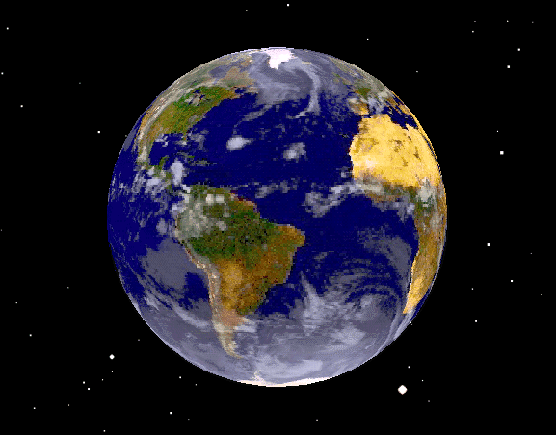
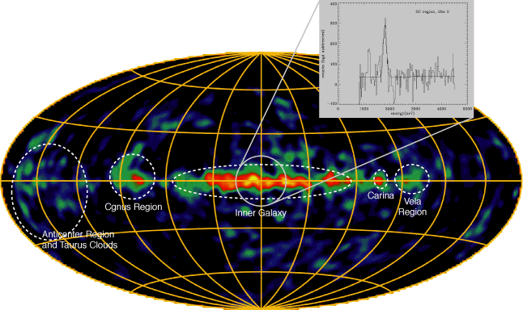
Earth:
~1890 Kelvin: ~20-40 Myears
1905 Rutherford => billions
of years
radioactivity
Heaven:
²⁶Al all-sky map:
T_{1/2}=0.74 My
E_{γ} =1.8 MeV
continuous
nucleosynthesis
picture by COMTEL
Notes:
If you had any doubts about Nuclear Physics as an intellectual activity you need only contemplate this picture.

Slide 3
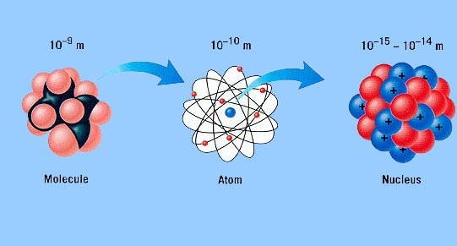
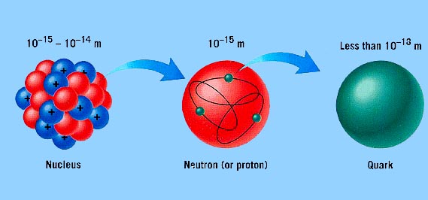
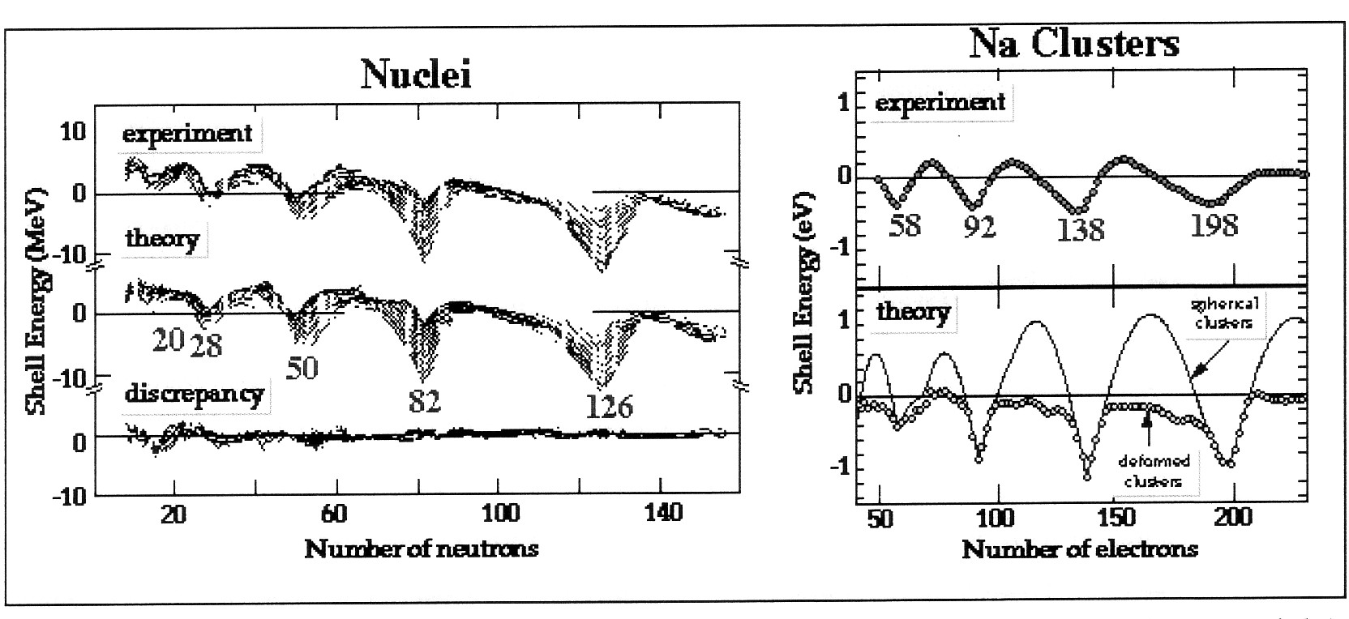
molecule atom nucleus nucleon quark
Shell structure:
Key feature of all mesoscopic (finite N) systems.
Bunching of quantum levels into groups separated by gaps.
Observed in:
atoms,
nuclei (‘two liquids’),
metallic clusters,
quantum dots.
Pairing,
collective modes
of motion.
Notes:
Nuclear physics to study properties of molecules (NMR),
Atomic physics techniques to study nuclei (laser spectroscopy, charge distribution)

Slide 4
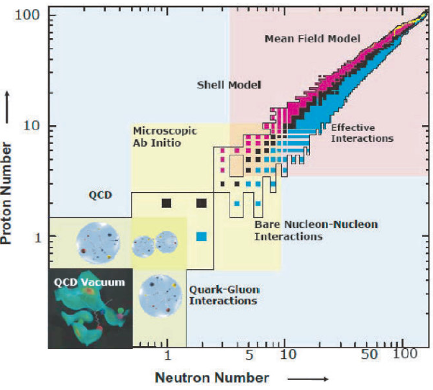
Towards a predictive (and unified) description of nuclei

Slide 5
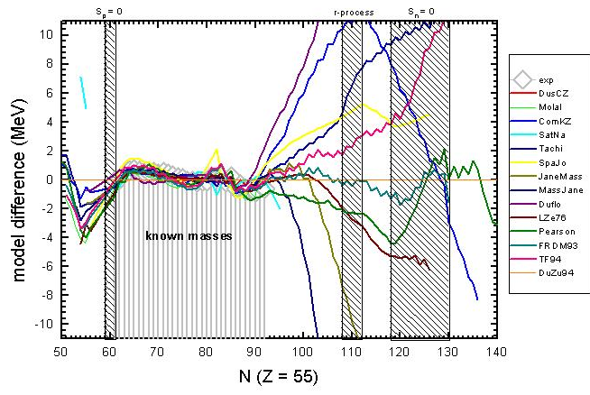
Models/theories have their limitations
Relative theoretical predictions of mass models for the Cs isotopes
Known masses
S_{n}=0
titan.triumf.ca

Slide 6

Facility for:
Nuclear (NUSTAR)
Hadron (Panda)
Atomic
Laser
Capital cost:
1187M€
on ESFRI roadmap
(European Strategy Forum on
Research Infrastructures)

Slide 7
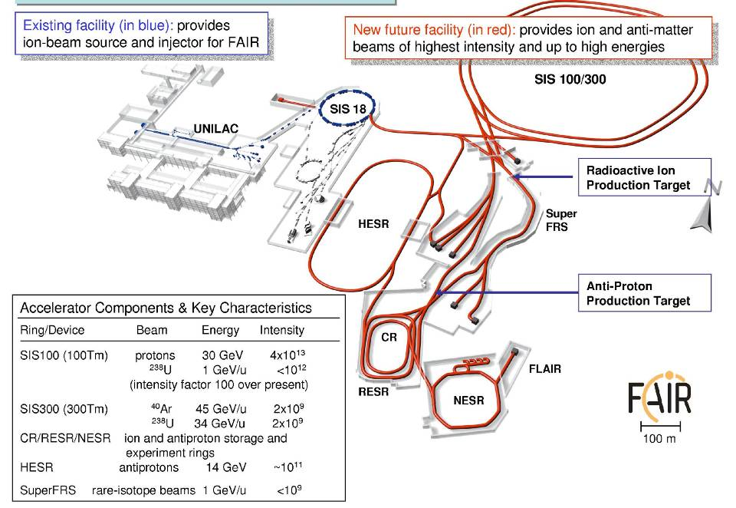
FAIR (Facility for Antiproton and Ion Research)
New accelerators => higher primary beam intensities

Slide 8
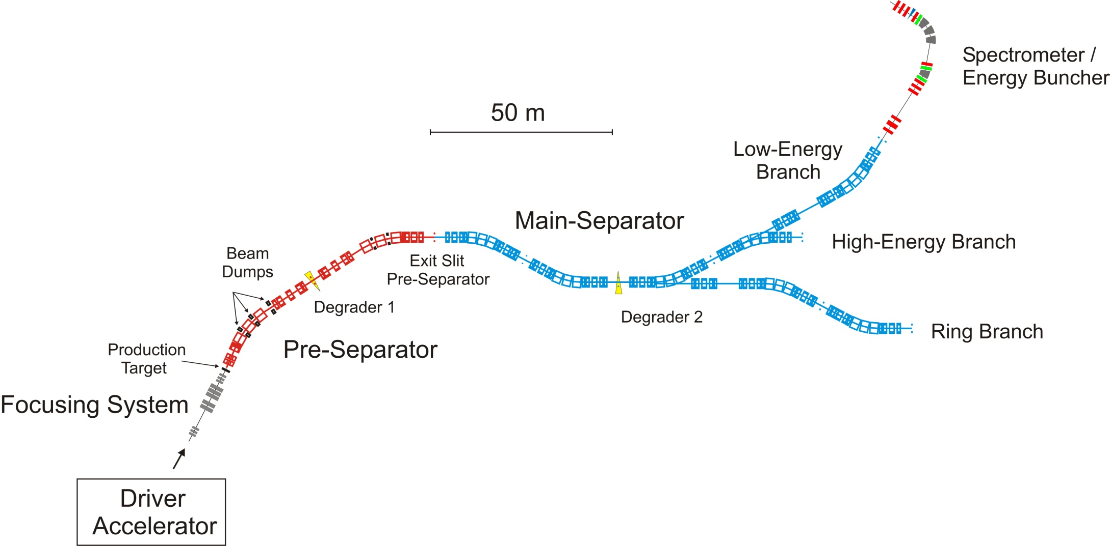
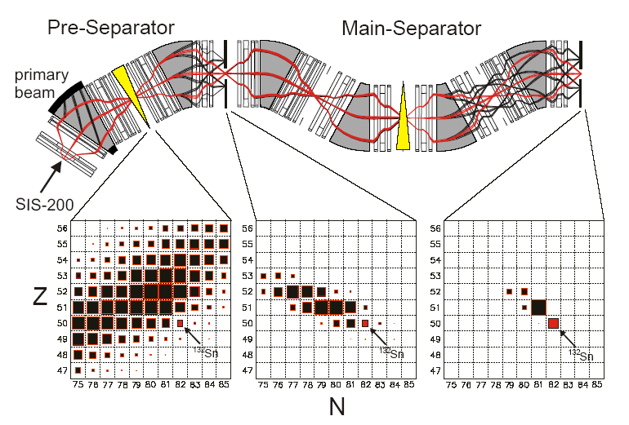
NuSTAR (Nuclear Structure, Astrophysics and Reactions)
Transmission
3 branches
=> Radioactive beam intensity:
~10² – 10³ higher than today
and ‘cleaner’

Slide 9
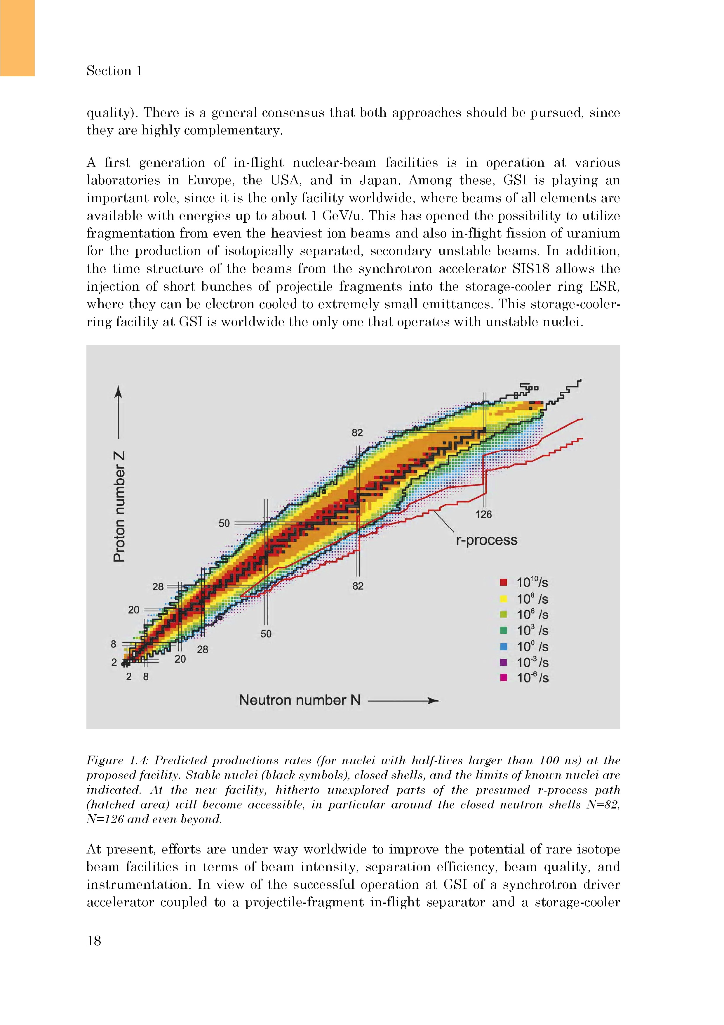
Exotic nuclei at NUSTAR/FAIR
production yields at FAIR

Slide 10

NuSTAR – Nuclear Structure, Astrophysics and Reactions
R³B kinematically complete reactions at high beam energy
HISPEC in-beam γ spectroscopy at low and
intermediate energy
DESPEC γ-, β-, α-, p-, n-decay spectroscopy
LASPEC laser spectroscopy
MATS in-trap mass measurements and
decay studies
EXL light-ion scattering reactions in a storage ring
ILIMA masses and lifetimes of nuclei in
ground and isomeric states
ELISE elastic, inelastic, and quasi-free
e⁻-A scattering
AIC antiproton-ion collision
Super FRS RIB production, identification
The Collaboration
> 800 scientists
146 institutes
38 countries
The Investment
82 M€ Super FRS
71 M€ Experiments

Slide 11
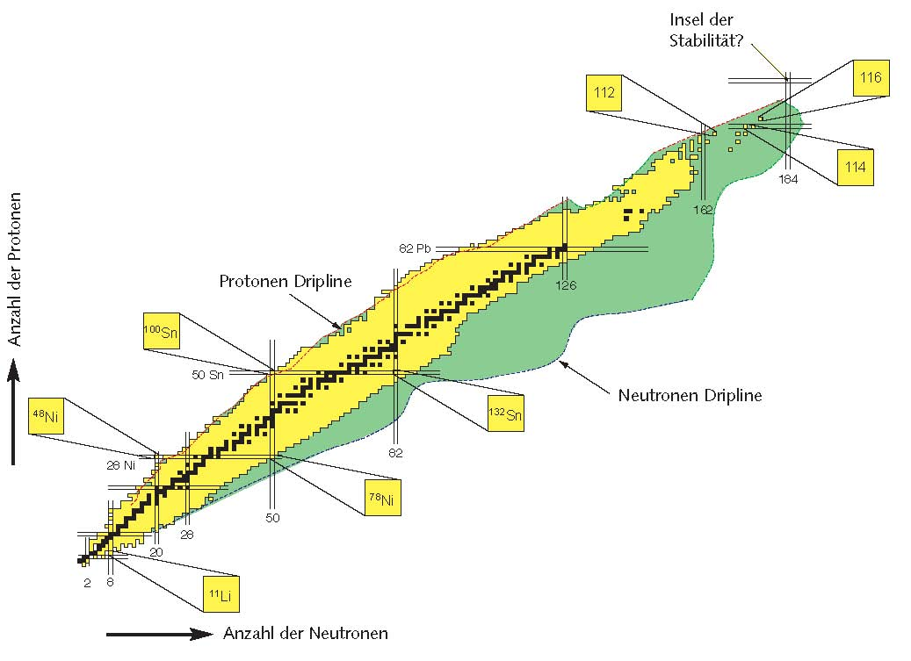
Key nuclear physics questions
How are complex nuclei built from their basic constituents?
nucleon-nucleon interaction, effect of nucleon structure
What are the limits of nuclear existence?
where does the nuclide chart end?
  neutron and proton driplines, superheavy elements
How does the ordering of quantum states alter far away from stability? shell quenching, new magic numbers
How to explain collective phenomena from individual motion?
relevant degrees of freedom, symmetries, collective motion
How are the elements and isotopes found in the Universe formed?
  the origin of the heavy elements

Slide 12
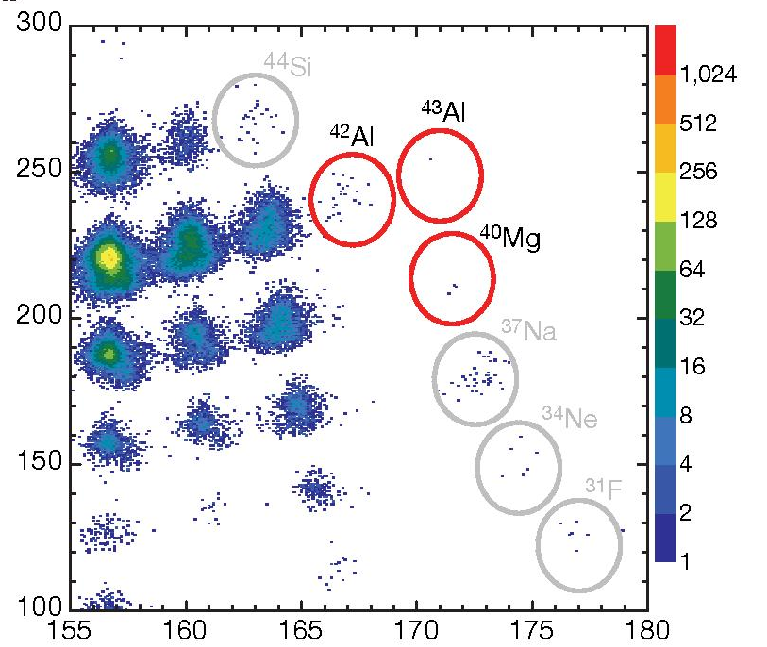
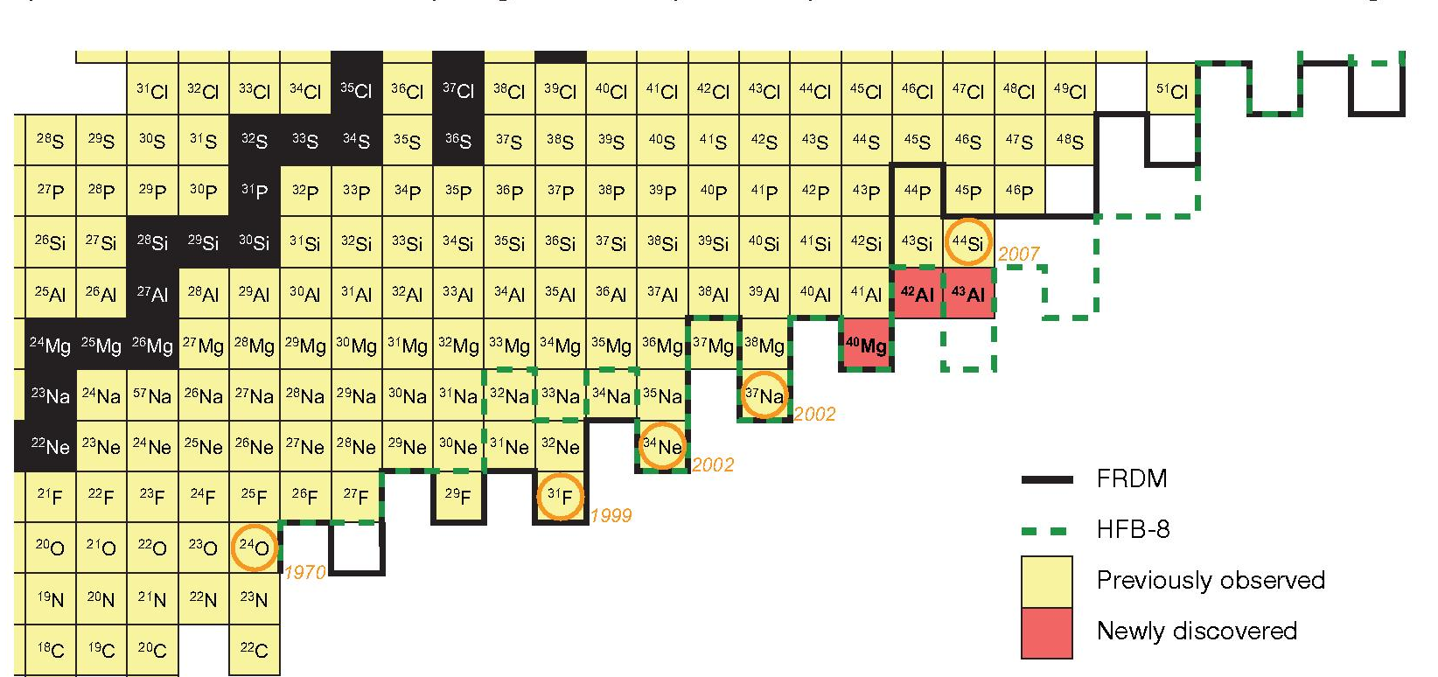
What are the limits of nuclear existence?
Energy loss (MeV)
Z=14
Z=12
Z=10
Momentum corrected TOF (ns)
T. Baumann et al., Nature 449 (2007) 1022.

Slide 13
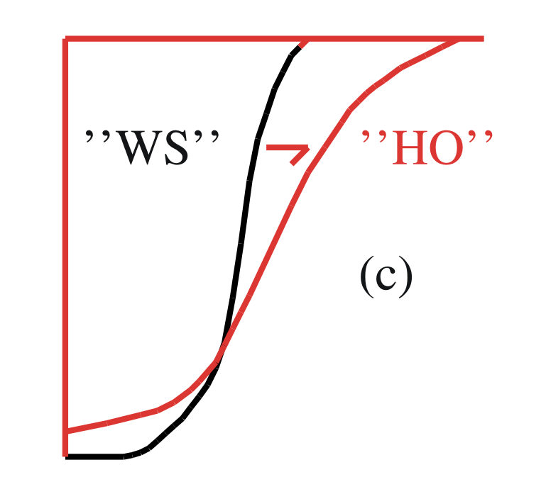
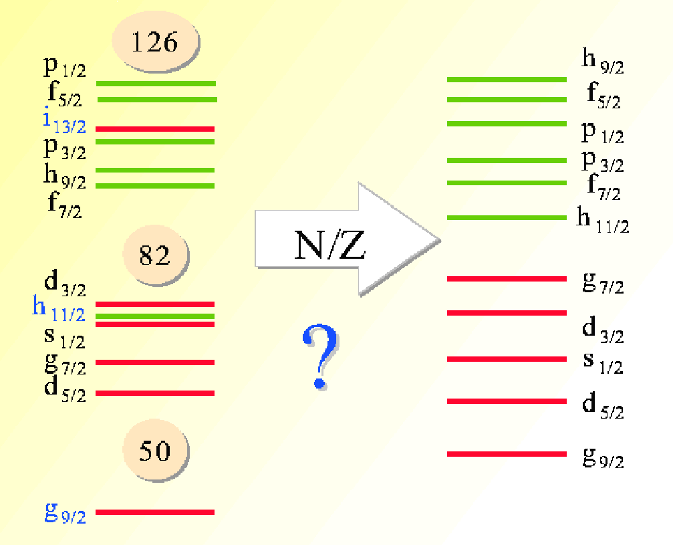
Nuclear potential
‘normal’
‘neutron rich’
How does the ordering of quantum states alter?
Wood-Saxon
+ spin-orbit
diffuse surface
+ spin-orbit
How does the ordering of quantum states alter?

Slide 14
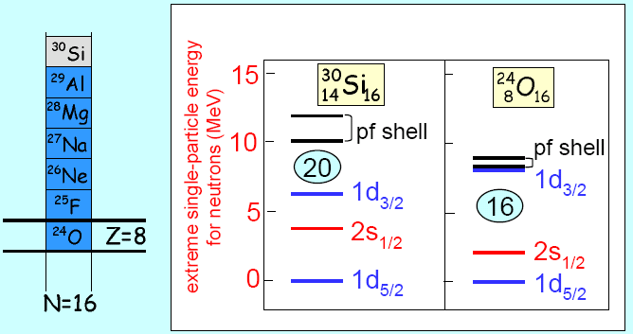
Standard magic numbers:
2, 8, 20
New magic number:
16 20
How does the ordering of quantum states alter?

Slide 15
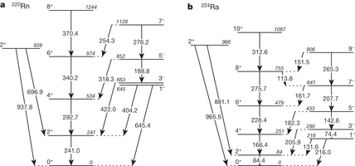
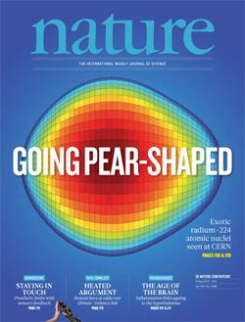
Collective phenomena from individual motion
CERN-ISOLDE
L.P. Gaffney et al, Nature 497, 199 (2013)

Slide 16
Key nuclear physics questions
  What are the limits of nuclear existence?
  Do new forms of collective motion occur far from stability?
  Are there new forms of nuclear matter in loosely bound nuclei?
  How does the ordering of quantum states alter in dilute matter?
  Do new symmetries appear?
  How are the elements and isotopes found in the Universe formed?
  Where are the sites of the r-process(es) of nucleosynthesis?
  What is the nuclear equation of state for neutron stars?
  How does the ordering of quantum states
  alter in highly dilute or neutron-rich matter?
  How are the elements and isotopes
  found in the Universe formed?

Slide 17
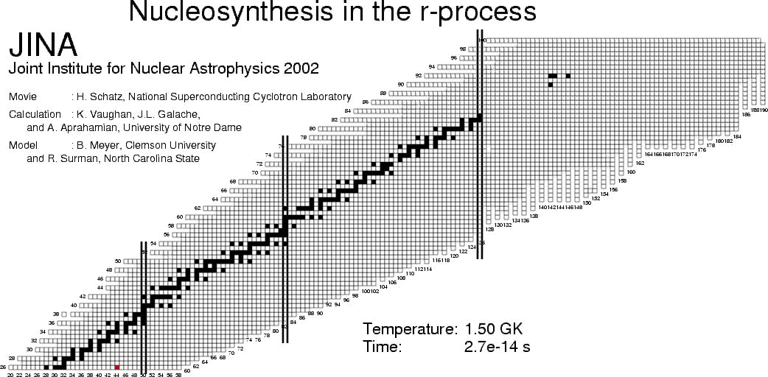
How are the elements found in the Universe formed?
Rapid neutron capture process responsible for
the production of half of the elements heavier than iron

Slide 18
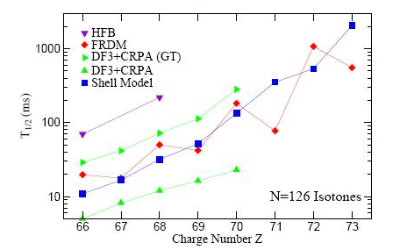
How are the elements found in the Universe formed?
N=126
Abundance
H. Grawe, K. Langanke, G. Martinez-Pinedo, Rep.Progr.Phys.70 (2007)1525.
Mass

Slide 19
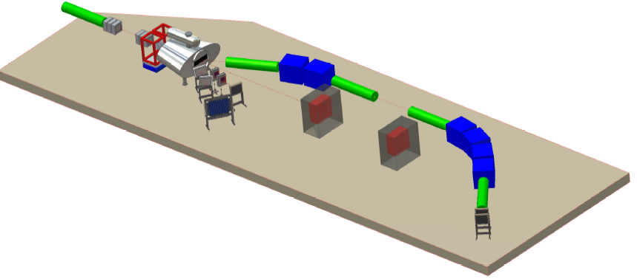
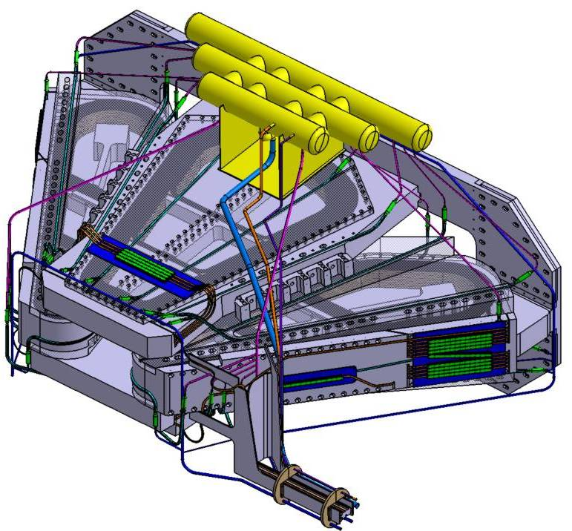
R³B: Reactions with Relativistic Radioactive Beams
Reactions in complete kinematics
RIB
High Resolution measurement
Target
Tracker
Calorimeter
Protons
Neutrons
Heavy
fragments
Large
acceptance
dipole

Slide 20
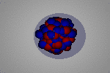
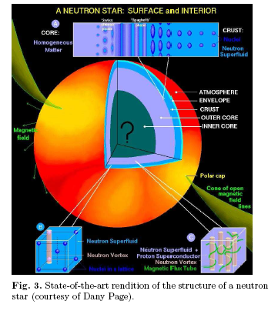
Collective Excitations: Symmetry Energy, EOS and Neutron Stars -
excitation of the neutron skin
¹³⁰Sn

Slide 21
HISPEC: High-resolution in-flight spectroscopy
Exotic nuclei studied via reactions
Particle tracking
(Z,pos.,E)
Identification
(LYCCA,
spectrometer)
Charged particle det., plunger
γ-ray det.

Slide 22
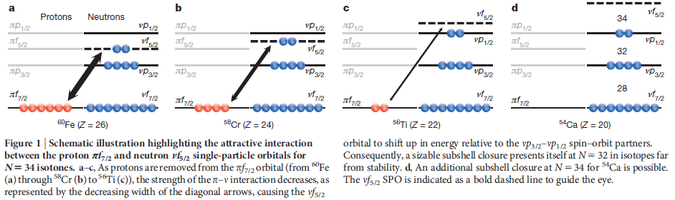
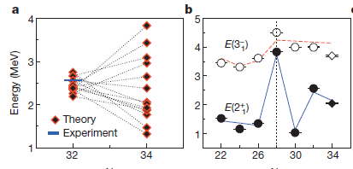
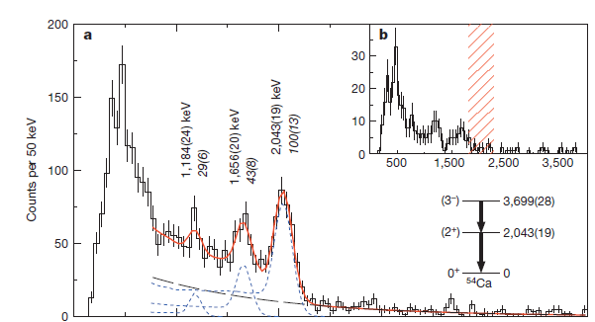
New magic number at N=34
D. Steppenbeck et al. , Nature 502, 210 (2013)
RIKEN

Slide 23


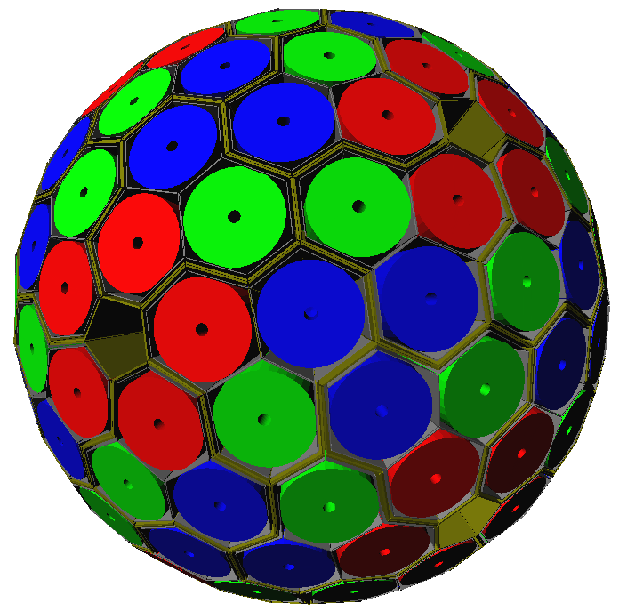













AGATA
(Advanced GAmma Tracking Array)
4π γ-array for Nuclear Physics Experiments at European accelerators providing radioactive and high-intensity stable beams
Efficiency:
43% (M_{γ} =1) 28%(M_{γ}=30)
(gain ~4) (gain ~1000)
180 large volume 36-fold segmented Ge crystals
Operation of Ge detectors in position sensitive mode
→ γ-ray tracking
AGATA collaboration
Notes:
Summary
List few items
Agata very powerful instrument for nuclear spectroscopy
Exciting science programme subject of this meeting
Aim to propose and start realisation of the full AGATA from 2008

Slide 24
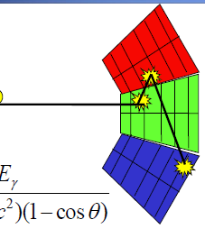
Tracking

Slide 25
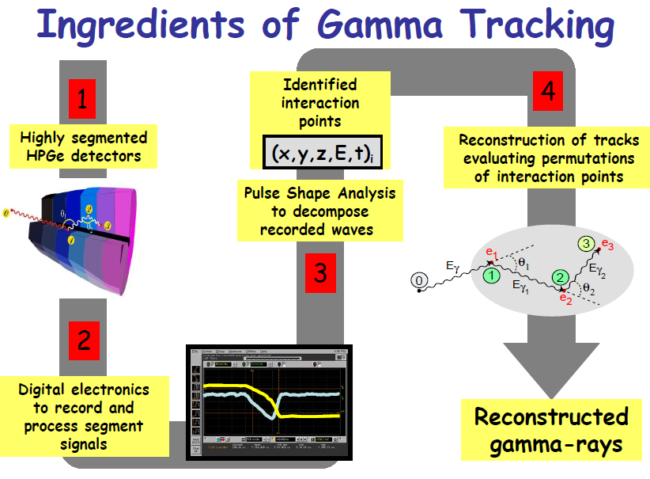

Slide 26
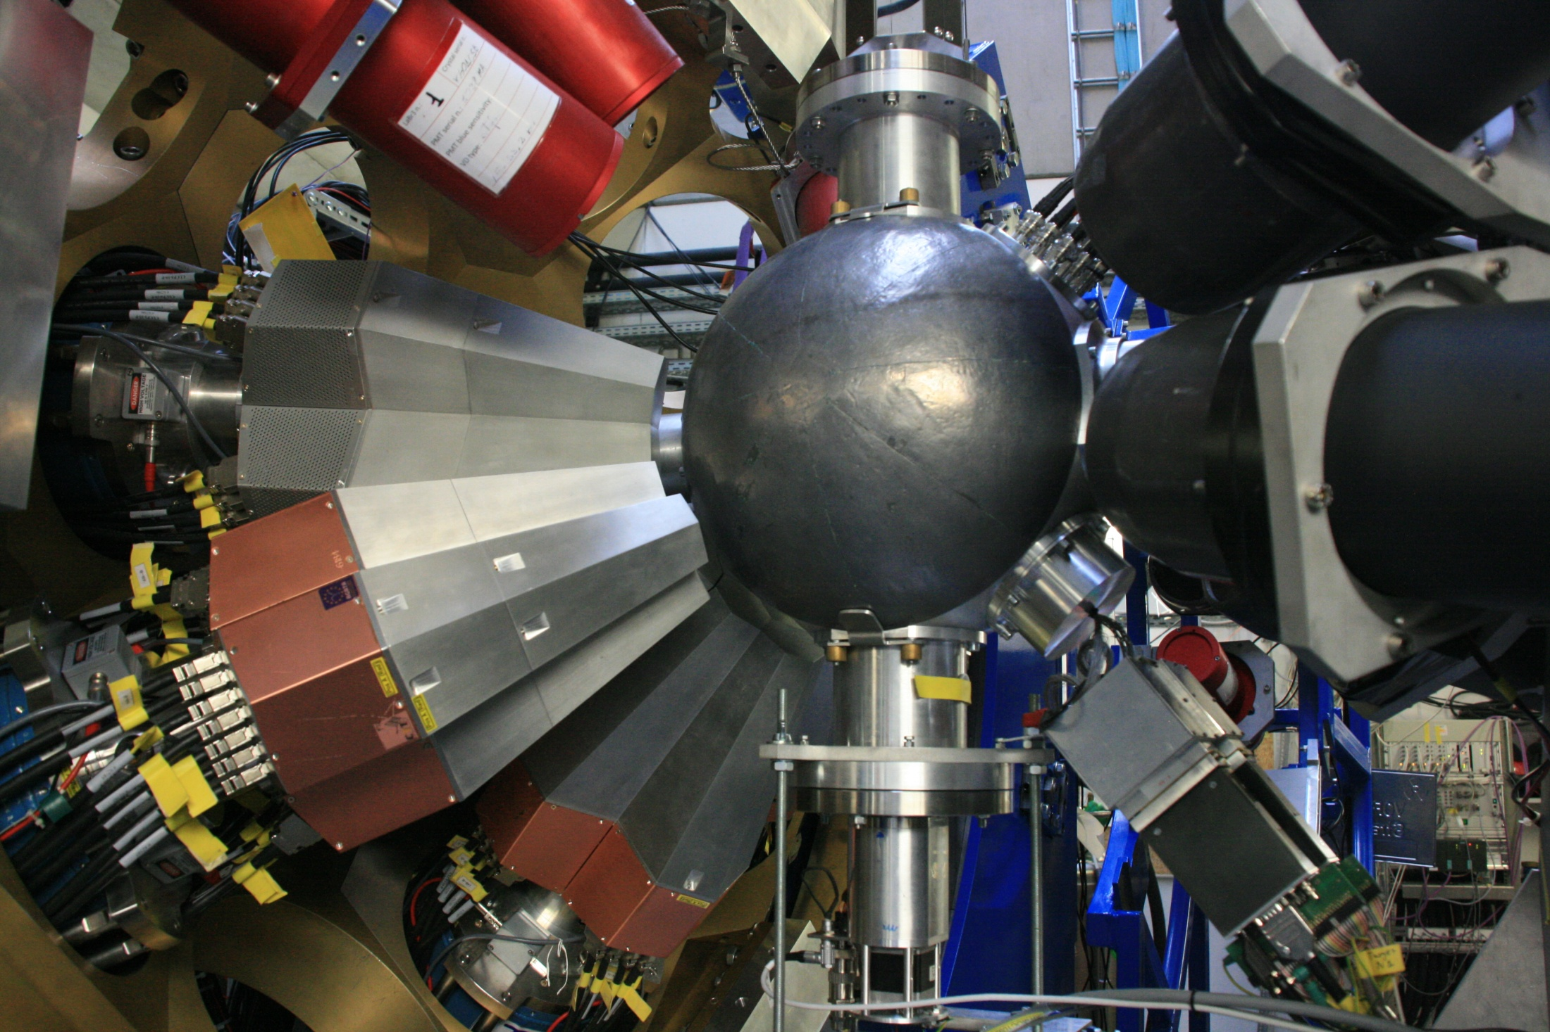
AGATA demonstrator at GSI (Germany) ~20 crystals

Slide 27
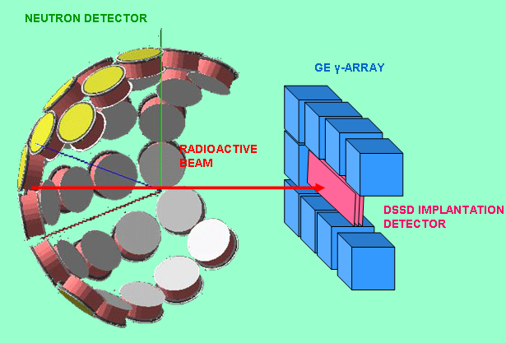
Decay Spectroscopy
High sensitivity: ~1 ion/hour

Slide 28
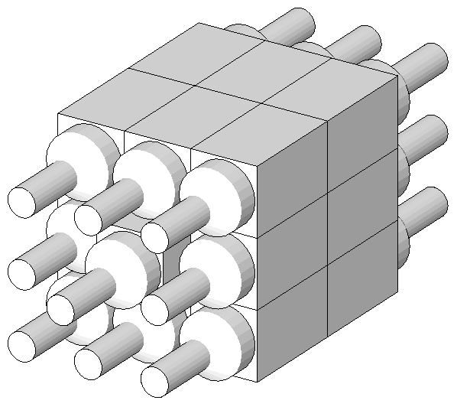
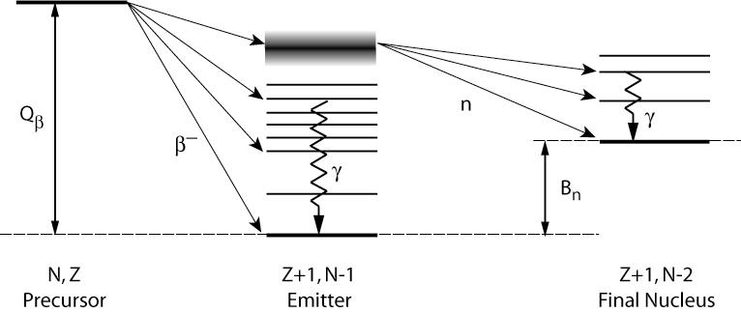
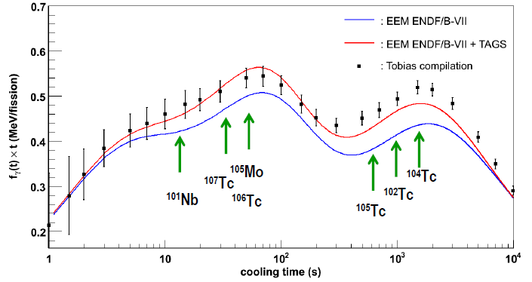
Total absorption spectrometer (TAS)
Decay heat from 239Pu
A. Algora et al., Phys. Rev. Lett. 105 (2010) 202501
More heat taken away by
gammas than previously thought

Slide 29
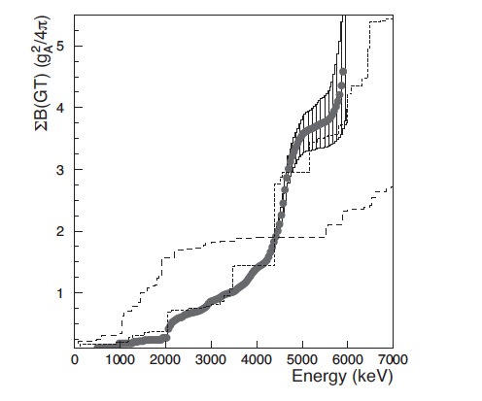

Shape of the nucleus
oblate
⁷⁶Sr
76Sr
prolate
E. Nácher et al. PRL 92 (2004) 232501

Slide 30
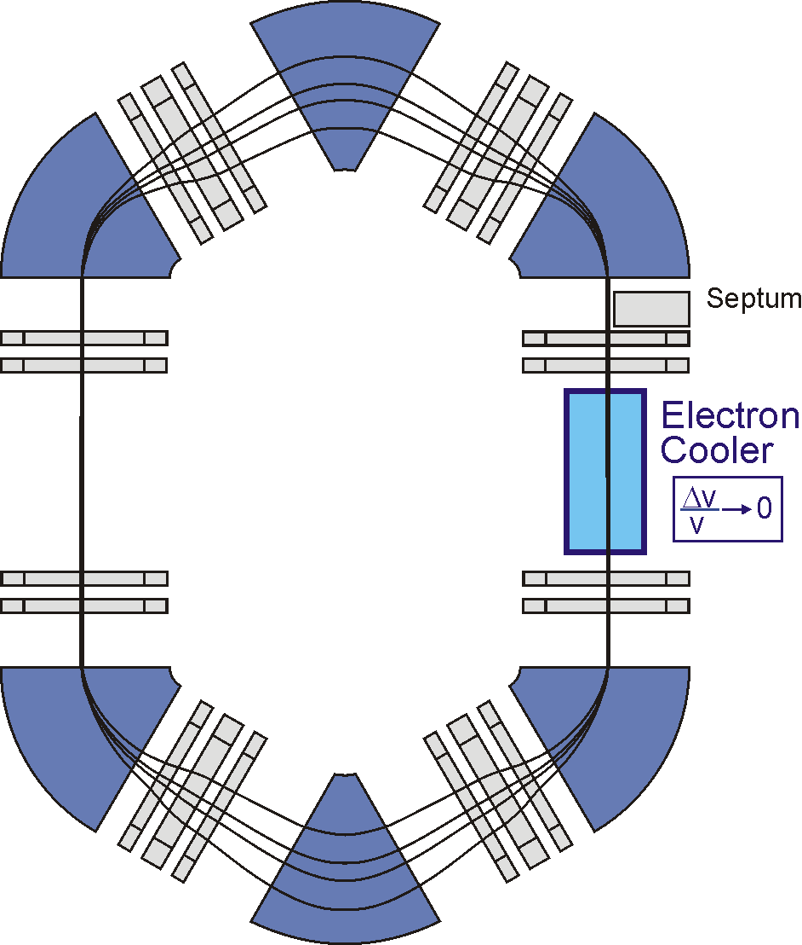






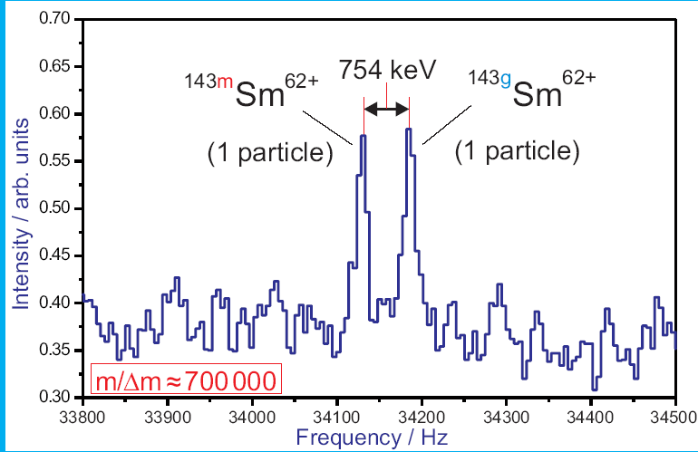
ILIMA: Isomeric beams,
Lifetimes and Masses
4 particles with different m/q
Very sensitive:
1 particle
is enough
time
Measures:
half-lives, masses,
decay modes

Slide 31
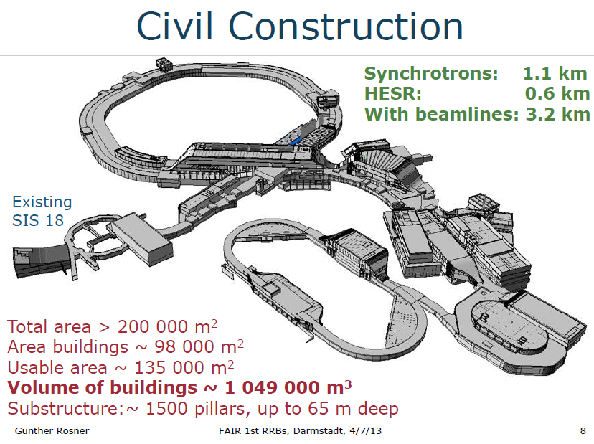

Slide 32
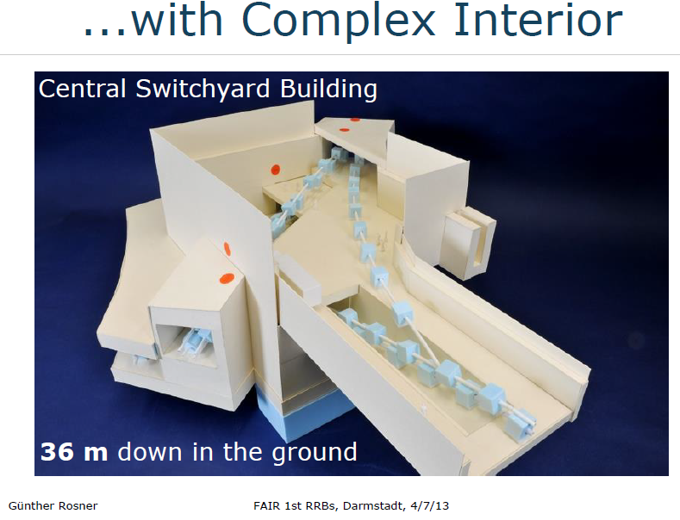

Slide 33
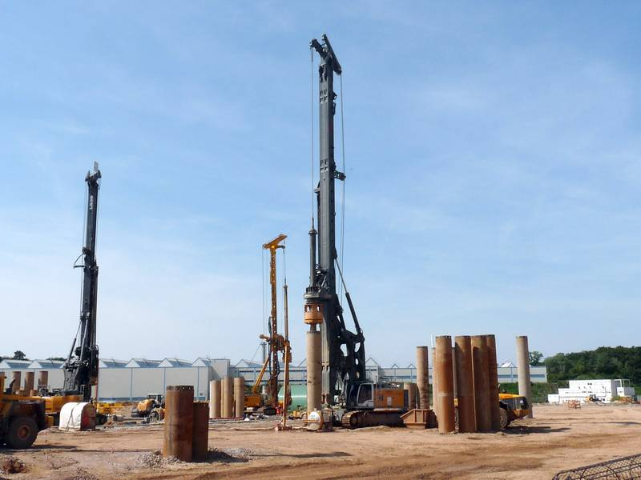
All drilling rigs are on site. On the photo is the biggest one available in Europe.

Slide 34
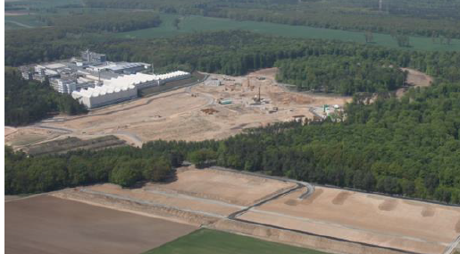

Slide 35
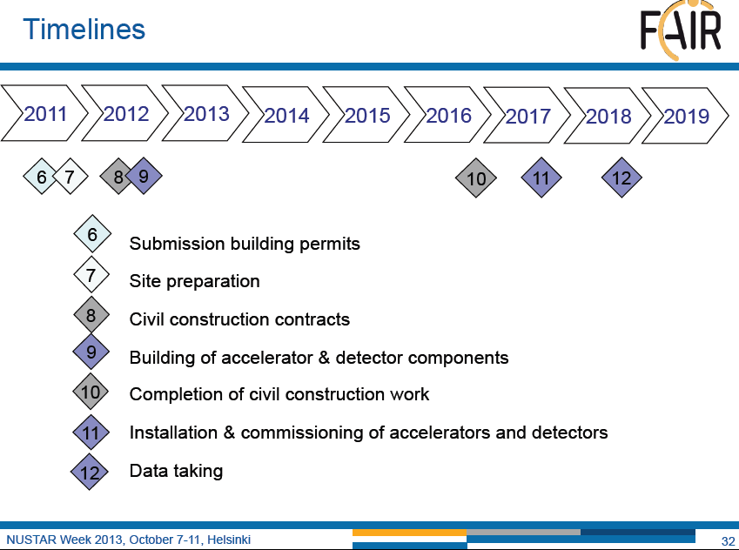

Slide 36
Summary
Renaissance of nuclear physics
Fundamental questions addressed:
- how is an atomic nucleus constructed from its
individual nucleons and the interactions between them?
- ordering of quantum states
- new forms of collective motion
- ‘application’: how are the elements synthesised
in the Universe
NUSTAR

Slide 37
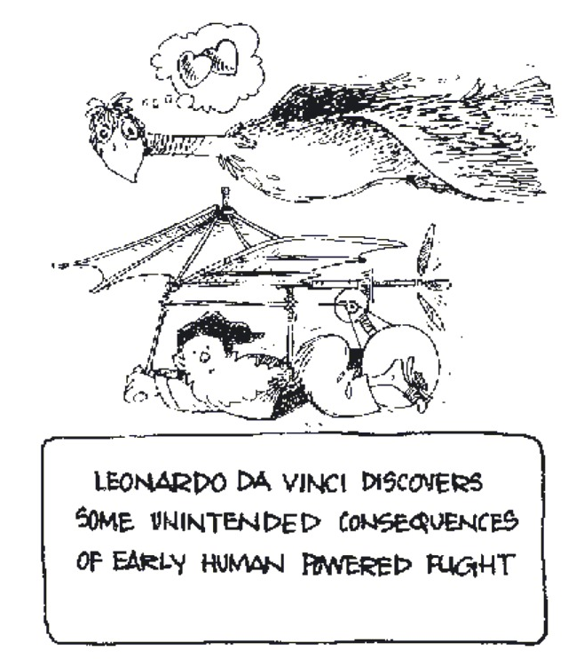
New radioactive ion beam
facilities (NUSTAR)
-known unknowns
-surprises?
Leonardo Da Vinci discovers
some unexpected consequences
of early human powered flight

Slide 38
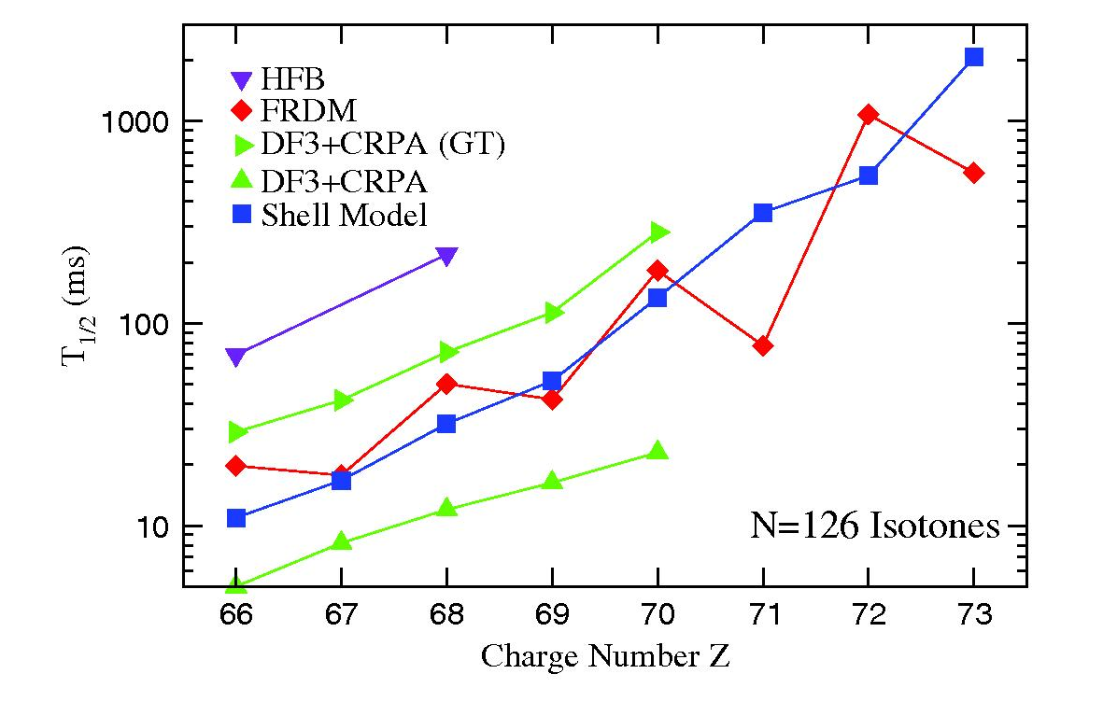
Half-lives of neutron-rich N~126 nuclei
N=126 r-process path nuclei
H. Grawe, K. Langanke, G. Martinez-Pinedo, Rep. Prog. Phys. 70, 1525 (2007)
The FF ν i_{13/2} -> πh_{11/2} dominates; also GT νh_{9/2} ->πh_{11/2}

Slide 39
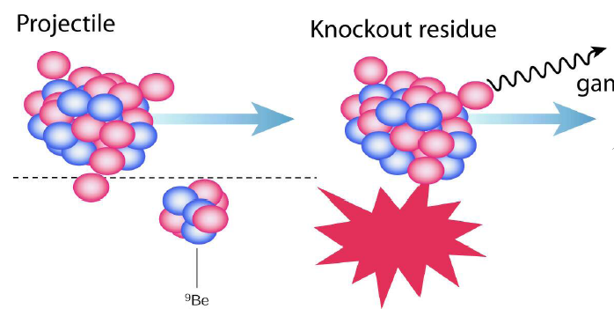
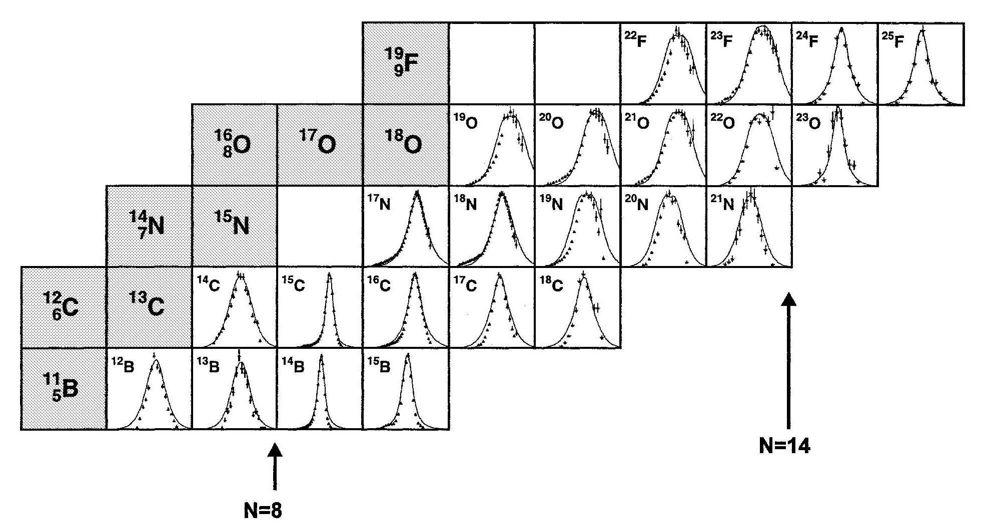
How does the ordering of quantum states alter?
γ
ν
s1/2
d5/2
p1/2
P||
?
8
A. Gade
One neutron removal cross sections
Longitudinal momentum
E. Sauvan et al., Phys. Lett. B491 (2000) 1

Slide 40
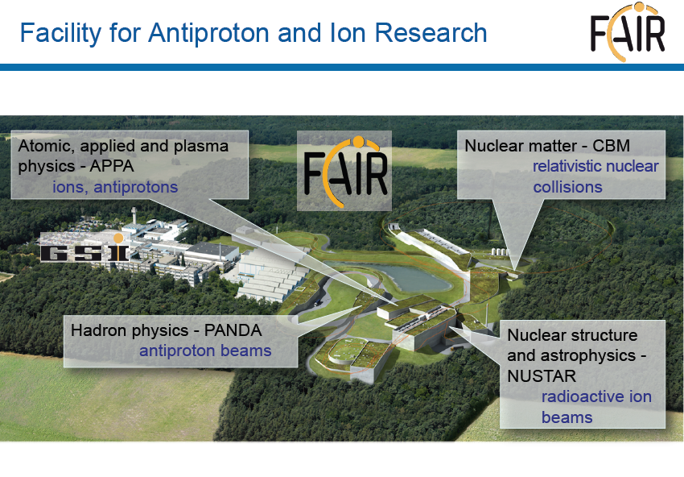
Capital cost: 1187M€

Slide 41
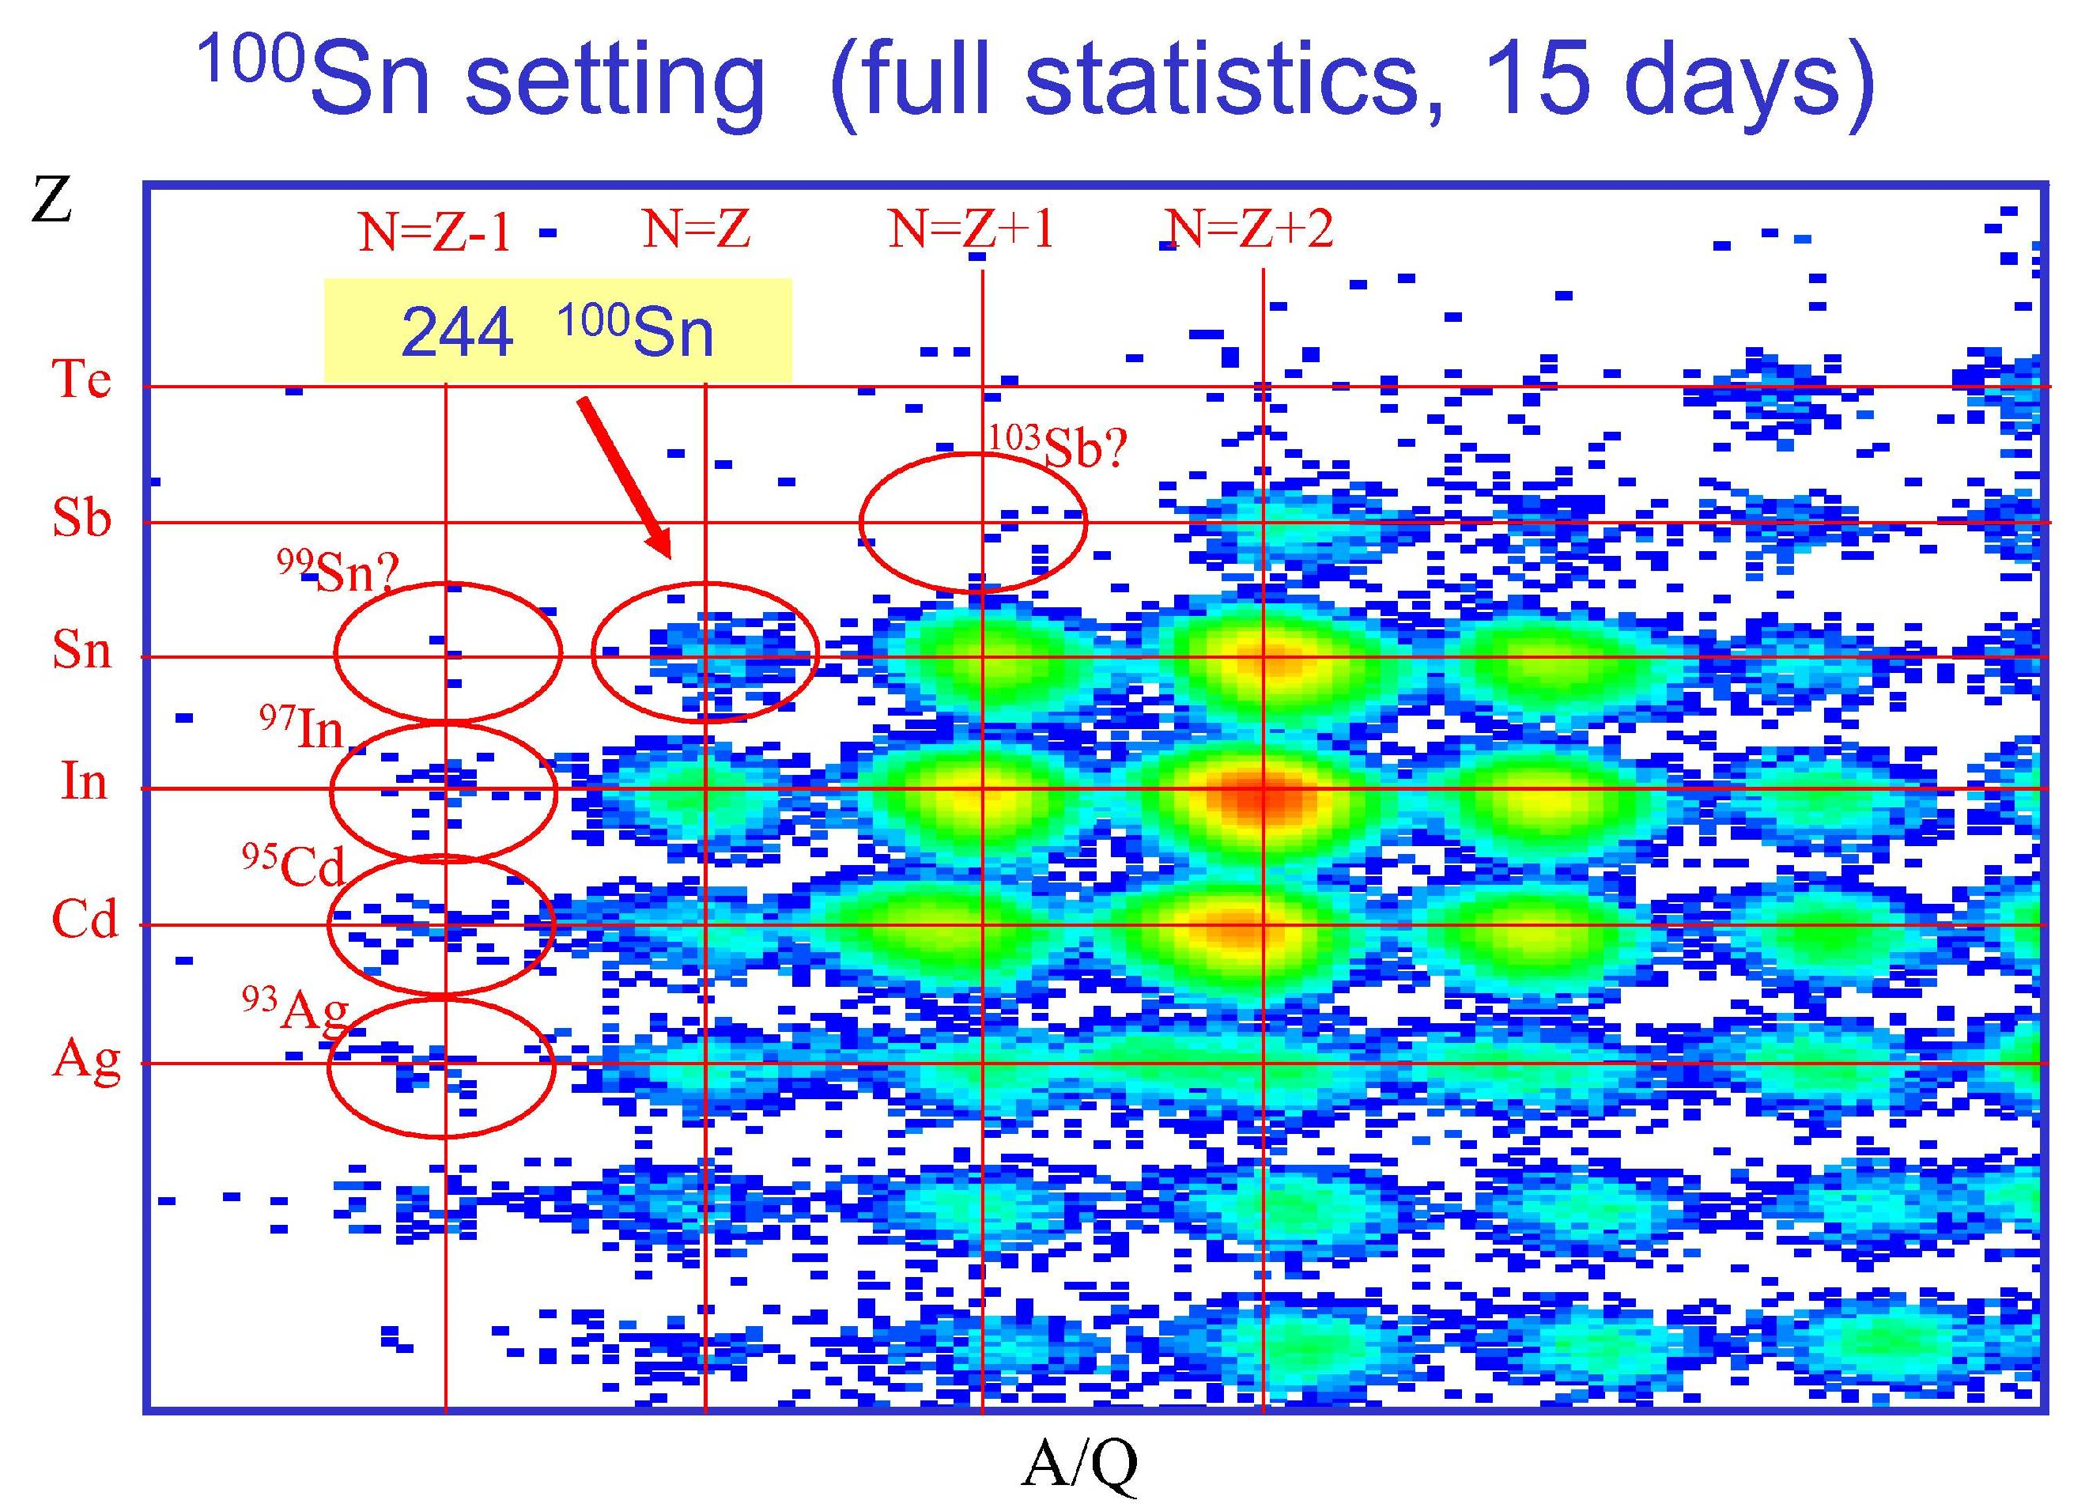
T. Faestermann, K. Eppinger, C. Hinke et al, RNB8, May 2009

Slide 42

T1/2=1.16(20) s
C. Hinke et al, Nature ~(2012)

Slide 43

Pulse shape analysis
Amplitude
Time
Signal digitalised
Pulse shape analysis
=> Spatial resolution 1-2 mm

Slide 44

Segmented Ge detectors
6x6 segments + 1 core signal
=> Spatial resolution ~1cm
S. Akkuyun et al., Nucl. Instr. Meth. A668 (2012) 26

Slide 45

AGATA demonstrator in Legnaro (Italy) 15 crystals
S. Akkuyun et al., Nucl. Instr. Meth. A668 (2012) 26

Slide 46
Key nuclear physics questions
  What are the limits of nuclear existence?
  Do new forms of collective motion occur far from stability?
  Are there new forms of nuclear matter in loosely bound nuclei?
  How does the ordering of quantum states alter in dilute matter?
  Do new symmetries appear?
  How are the elements and isotopes found in the Universe formed?
  Where are the sites of the r-process(es) of nucleosynthesis?
  What is the nuclear equation of state for neutron stars?
  How does the ordering of quantum states
  alter in highly dilute or neutron-rich matter?
  How are the elements and isotopes
  found in the Universe formed?

Slide 47


Decay heat and the structure of fission products
_{Z}X_{N} ->_{Z+1}Y_{N-1} + e⁻ + antineutrino
Energy taken away by
gammas, electrons, neutrons, antineutrinos
Neutron detection efficiency: 30%
M.N. Gomes-Hornillos et al., J. of Phys: Conf. Series 312 (2011) 052008

Slide 48



Slide 49
What are the limits of nuclear existence?
Relative theoretical predictions of mass models for the Cs isotopes
Known masses
S_{n}=0
titan.triumf.ca

Slide 50



SHE Synthesis
– Present Status
FLNR
RIKEN
GSI
low cross-sections
(→ ≈ 35 fb)
high cross-sections
(0.5 – 5 pb)
D.Ackermann
Dieter-Ackermann_GSI/University_of_Mainz_-_IReS-Symposium-2004

Slide 51


Experimental setup
Accelerator SIS provides a
E/A=1 GeV ²³⁸U beam
Projectile fragmentation on Be target
The ions are separated and identified in the Fragment
Separator

Slide 52

Fragment Separator at GSI
HPGe

Slide 53

Ge Cluster detectors
Typically: 100MeV/u, ε_{γ}=0.06, ∆E_{γ}/E_{γ}=0.02
Target chamber
CATE
beam
Ge Cluster
ε=1.3% (1.3MeV)
E=100 MeV/u
ε=2.8% (Lorentz boost)
dE/E<2%
HECTOR
Ge Miniball

Slide 54





The Frontiers
[ 2 ]
[ 3 ]
[ 1 ]
[ 4 ]
Notes:
One thing that has not changed is the nature of the subject. There are, in my view, four main frontiers in Nuclear Physics. These are not hard and fast frontiers but general areas where there is a lot of interest and excitement and consequently a great deal of effort world-wide.

Slide 55

S. Akkuyun et al., Nucl. Instr. Meth. A668 (2012) 26

Slide 56
Relativistic energy beams => huge reduction of Doppler broadening
d(⁴⁸Ti,p)⁴⁹Ti, v/c ~6.5%
Notes:
56

Slide 57


fast beam experiments
³⁶Ca
3015(16) keV
Secondary fragmentation
2⁺
Atomic background
P. Doornenbal et al., Phys. Lett. B 647 (2007) 237.
⁵⁸Cr
Coulomb excitation
A. Bürger et al., Phys. Lett B622, 29 (2005)

Slide 58




Ordering of quantum states: shell quenching at N=82?
r-process abundances
exp.
pronounced shell gap
shell structure quenched
mass number A
information on excited
states essential!!
(DESPEC, R3B, HISPEC)
Assumption of N=82 and N=126 shell quenching leads to a considerable
improvement in the global abundance fit in r-process calculations
A. Jungclaus et al., Phys. Rev. Lett. 99, 132501 (2007) pre DESPEC experiment
Notes:
Certainly all of you have seen this figure before. It shows the solar r-process abundances with the characteristic two peaks around mass 130 and 195 which are closely related to the N=82 respectively N=126 shell gaps. These gaps determine the properties of the waiting-point nuclei in the r-process path shown here as red squares and therefore the dynamics of the nucleosynthesis of elements above iron.
Already in the nineties it has been shown that the assumption of a N=82 shell quenching leads to a considerable improvement in the global abundance fit in r-process calculations, namely the filling of the troughs around A=120 and 140 - shown here in blue compared to the non-quenched calculation in green. However ...

Slide 59


Ordering of quantum states: shell quenching at N=126?
r-process abundances
exp.
pronounced shell gap
shell structure quenched
mass number A
²⁰⁴Pt: four proton-hole in double magic ²⁰⁸Pb
S.Steer, Zs. Podolyak, P.H. Regan et al, submitted to Phys. Rev. Lett.
shortening the half-lives of the N=126 nuclei with the effect of shifting up
the point where the r-process path leaves the N=126 isotones
pre DESPEC experiment
Notes:
Certainly all of you have seen this figure before. It shows the solar r-process abundances with the characteristic two peaks around mass 130 and 195 which are closely related to the N=82 respectively N=126 shell gaps. These gaps determine the properties of the waiting-point nuclei in the r-process path shown here as red squares and therefore the dynamics of the nucleosynthesis of elements above iron.
Already in the nineties it has been shown that the assumption of a N=82 shell quenching leads to a considerable improvement in the global abundance fit in r-process calculations, namely the filling of the troughs around A=120 and 140 - shown here in blue compared to the non-quenched calculation in green. However ...

Slide 60


Single-particle structure from direct reactions
(HISPEC, R3B)
γ
Knock-out reaction
Peripheral collision
relativistic energies
Possible with few particles/s
P||
Momentum distribution:
L of knocked-out particle
Cross sections:
exclusive for excited states
via gamma-decay (➔ AGATA)
➔ spectroscopic factors
ΔL=3
ΔL=1
f 5/2
p 1/2
p 3/2
ΔL=1
x
x
⁵⁶Ti
PRELIMINARY
P. Maierbeck (TUM) et al., GSI-FRS + MINIBALL

Slide 61

Collective Excitations of Neutron-Rich Nuclei
- Symmetry Energy, Neutron Skin, EOS, Neutron Stars -
LAND collaboration
(pre R3B)
A. Klimkiewicz, PRL subm.
P. Adrich, PRL 95 (2005)
Photoabsorption
P. Ring et al.
¹²⁴Sn
Coulomb excitation
¹³⁰Sn
¹³²Sn
neutron skin ⬅➔ core vibration
Notes:
Eleectromagnetic dissociation as function of excitation energy
Photo-neutron cross esction

Slide 62




How to explain collective phenomena from individual motion?
Shapes and sizes (halo nuclei)
Charge radius (fm)
¹¹Li ₈
Matter radius (fm)
I. Tanihata et al., Phys. Rev. Lett. 55 (1985) 2676.
¹⁷Ne ₇
W. Geithner et al., Phys. Rev. Lett. 101 (2008) 252502.
density
Radius (fm)
cross section measurement isotope shift, laser spectroscopy

Slide 63
How to explain collective phenomena from individual motion?
Photon-neutron
P. Ring et al.
P. Ring et al.
¹²⁴Sn
Coulomb dissociation
¹³⁰Sn
¹³²Sn
P. Adrich et al., Phys. Rev. Lett. 95 (2005) 132501.
neutron skin ⬅➔ core vibration
Notes:
Eleectromagnetic dissociation as function of excitation energy
Photo-neutron cross esction

Slide 64









Technical challenges and solutions
Target & Beam Catcher
Cryogenics
Remote Handling
SC Multiplets
SC Dipoles
Radiation Resistant Magnets

Slide 65

Lund-York-Cologne CAlorimeter (LYCCA)
Two modules
  LCP detection ii) Fragment identification
(magnetic separator)
beam from
Super FRS
Diamond ?
Start TOF
Diamond ?
Stop TOF
n DSSD’s
Light particle
energy detection
x CsI detectors
particle energy
(E) detection
x DSSD’s
particle energy
loss (ΔE)
DSSD’s:
6cm x 6cm, 32 x 32 strips, 500μm
total lab angle (2m separation) ± 2.6°
Fragment identification
from ΔE, E, tracking and TOF
CsI’s:
2cm x 2cm, 3 x 3 x 3 array
3cm thick, stops 100 MeV protons
Possibly 13 telescopes for final design
First LYCCA Tests in 2007

Slide 66

How does the ordering of quantum states alter?
T. Otsuka et al., Phys. Rev. Lett. 87 (2001) 082502.; 95 (2005) 232502.
Standard
magic numbers:
2, 8, 20
New
magic numbers:
6, 16

Slide 67
How does the ordering of quantum states alter?
‘normal’
‘neutron rich’
How does the ordering of quantum states alter?
Wood-Saxon
+ spin-orbit
diffuse surface
+ spin-orbit
Nuclear potential

Slide 68
Identification of fragments
~15 cm
position (arb. units)
Fragmentation of 1 GeV/u ²⁰⁸Pb

Slide 69
How to explain collective phenomena from individual motion?
Shapes and sizes (halo nuclei)
Charge radius (fm)
¹¹Li ₈
Matter radius (fm)
I. Tanihata et al., Phys. Rev. Lett. 55 (1985) 2676.
¹⁷Ne ₇
W. Geithner et al., Phys. Rev. Lett. 101 (2008) 252502.
density
Radius (fm)
cross section measurement isotope shift, laser spectroscopy

Slide 70
AIDA implantation and detection system
(Edinburgh, Daresbury, Liverpool)
8 x 8 cm Si
128 x 128 strips
1 mm thickness
ΔE
8 cm
Veto
24 cm
implantation at energy of several GeV
Decay of energy of 50 keV->several MeV => ASIC developed
Notes:
ASIC= application specific integrated circuit

Slide 71

AIDA
+
LaBr₃(Ce)
array

Slide 72
How to explain collective phenomena from individual motion?
Photon-neutron
P. Ring et al.
P. Ring et al.
¹²⁴Sn
Coulomb dissociation
¹³⁰Sn
¹³²Sn
P. Adrich et al., Phys. Rev. Lett. 95 (2005) 132501.
neutron skin ⬅➔ core vibration
Notes:
Eleectromagnetic dissociation as function of excitation energy
Photo-neutron cross esction

Slide 73



DESPEC
Detector size decided (maximum efficiency, timescale, versatility): Φ=1.5”; L=2 “
Detectors ordered; Photo-multiplier tubes ordered
Plans to use the detectors at:
RIKEN within the EURICA campaign
ILL Grenoble
DESPEC mechanical design
discussion about integrating the Total Absorption Spectrometer with AIDA
P.H. Regan, Appl. Rad. and Iso. 70, 1337 (2012)

Slide 74

S. Akkuyun et al.,
Nucl. Instr. Meth. A668 (2012) 26

Slide 75





DESPEC Simulations (2) – optimisation of array
1.5” cylindrical crystals chosen
  Hybrid does give greater efficiency (for point source) but no flexibility in array configuration (particularly if can’t afford all detectors)
  Cylindrical crystals cheaper
  Bearing in mind using detectors prior to use at FAIR
  Array to be 36 1.5” dia LaBr3 in ‘cross’ configuration
Effort starting on understanding the effect of events occurring at different positions across AIDA

Slide 76

Gamma-ray tracking arrays
(AGATA and GRETA)
HPGe shell
No Compton shield
x, y, x, t, E
of each interaction
has to be determined
=> High efficiency, high peak/total

Slide 77


R3B Mechanics and ASIC cooling (1)
Calorimeter
Activity difficult
Plan rescheduled
Final ‘backup’ design to be presented this week at GSI
High energy Ions
From this direction
3 Layers
of Silicon
Vacuum Chamber
Liquid Hydrogen Target
Gold Foil surround (Not Shown)

Slide 78


Fragment Separator at GSI
Identification in mass and charge in the FRS:
β
238
SC21
TOF
SC41
U
(⁹Be)‏
Stopper
sci43
Dipoles Bρ
sci42
2
ΔE ~ Z

Slide 79
FAIR (Facility for Antiproton and Ion Research)
New accelerators => higher primary beam intensities

Slide 80

In flight fragmentation (and fission): separation and identification
Fragment Separator (GSI, Darmstadt, Germany)
Ge
Relativistic energy fragmentation: => heavy ions
Decay (internal and β, α) spectroscopy:
- decay out from the isomer is correlated with the fragment
(100 ns – 1 ms)
- very sensitive (ion beams > 1 ion/hour)

Slide 81

Study of excited states
Z=68; N=90 Z=64; N=83

Slide 82


N=82: towards the shell quenching region?
information on excited
states is essential
r-process abundances
exp.
pronounced shell gap
shell structure quenched
Assumption of N=82 and N=126 shell quenching leads to a considerable
improvement in the global abundance fit in r-process calculations
A. Jungclaus et al., Phys. Rev. Lett. 99 (2007) 132501.
M. Górska et al., Phys. Lett. B 672 (2009) 313.
¹³⁰Cd₈₂ ¹³¹In₈₂
Notes:
Certainly all of you have seen this figure before. It shows the solar r-process abundances with the characteristic two peaks around mass 130 and 195 which are closely related to the N=82 respectively N=126 shell gaps. These gaps determine the properties of the waiting-point nuclei in the r-process path shown here as red squares and therefore the dynamics of the nucleosynthesis of elements above iron.
Already in the nineties it has been shown that the assumption of a N=82 shell quenching leads to a considerable improvement in the global abundance fit in r-process calculations, namely the filling of the troughs around A=120 and 140 - shown here in blue compared to the non-quenched calculation in green. However ...

Slide 83

R³B
Reactions in Complete Kinematics
RIB
High Resolution measurement
Target
Tracker
Calorimeter
Protons
Neutrons
Heavy
fragments
Large
acceptance
dipole

Slide 84

FAIR Research Highlights
Accelerator Physics & Gym:
Eight Rings & two Linacs
GSI
P-Linac
SIS 100/300
SIS 18
FAIR
QCD-Phase Diagram: CBM
HI beams 2 to 45 AGeV; 400 users
UNILAC
SHE
CBM
100 m
ESR
Rare-Isotope
Production Target
T.T.
Panda
Super
FRS
HESR
FZ Jülich
PP& AP
Antiproton
Production Target
Hadron Structure, QCD & Medium
Cooled antiprotons < 15 GeV, 500 users
Nucl.Phys.&Astro NUSTAR
RI beam- fragmentation; 800 users
Warm Dense Plasmas
Bunch-compression & Petawatt- Laser 250 users
RESR
FLAIR
CR
Fundamental Symmetries
Ultra-High EM Fields SPARC; FLAIR
Antiprotons, Hi-Z ions; 250 users
NESR
Materials Science,
Space- and Radiation Biology
(Ion- & antiproton- beams; 350 users
C.Scheidenberger

Slide 85
Particle tracking
(Z,pos.,E)
Identification
(LYCCA,
spectrometer)
Charged particle det., plunger
γ-ray det.

Slide 86


DESPEC (decay spectroscopy)
Modular system

Slide 87

Key nuclear physics questions
  What are the limits of nuclear existence?
  Do new forms of collective motion occur far from stability?
  Are there new forms of nuclear matter in loosely bound nuclei?
  How does the ordering of quantum states alter in dilute matter?
  Do new symmetries appear?
  How are the elements and isotopes found in the Universe formed?
  Where are the sites of the r-process(es) of nucleosynthesis?
  What is the nuclear equation of state for neutron stars?

