Slide 1
Overview of work done
Carlos Solans
Valencia TileCal meeting
19th May 2009

Slide 2
Service work
Contributed to calorimeter (Tile+LAr +L1Calo+CTP) slice week (20-26 April)
  Good agreement between DSP and offline magnitudes
  ROD/DSP monitoring producing results
  Steadily running at 80kHz (DSP only) for 30 min
  ROD busy/ROS not accepting events issue not understood.
  ROD configuration patch applied.
Contributing to HLT slice (Calo+ID+Muon+HLT) week (4-10 May)
  Taking DAQ on call shifts whole week.
  Couple of DSP not booting problems and a misbehaving drawer.
Compiled 2 Tile online releases (tile-2.0.1, tile-2.0.1.1)
  Installed tdaq-02-00-01 in the lab (Valencia, CERN)

Slide 3
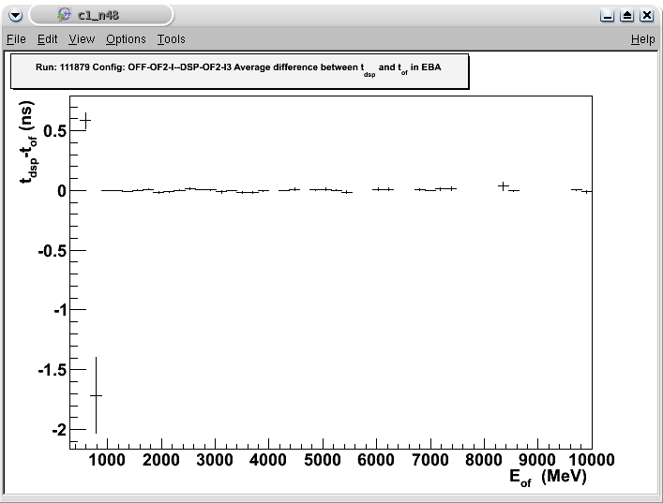
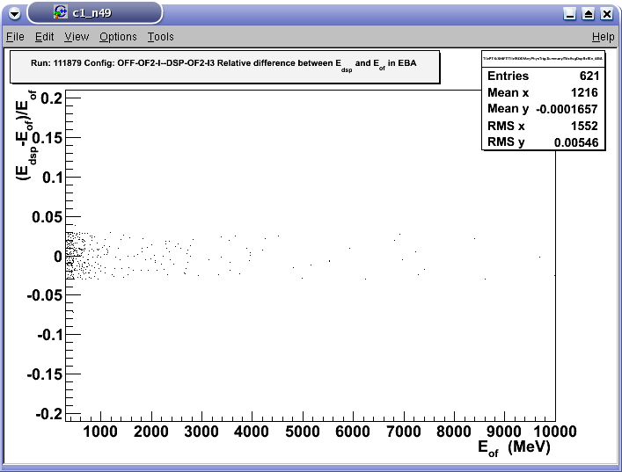
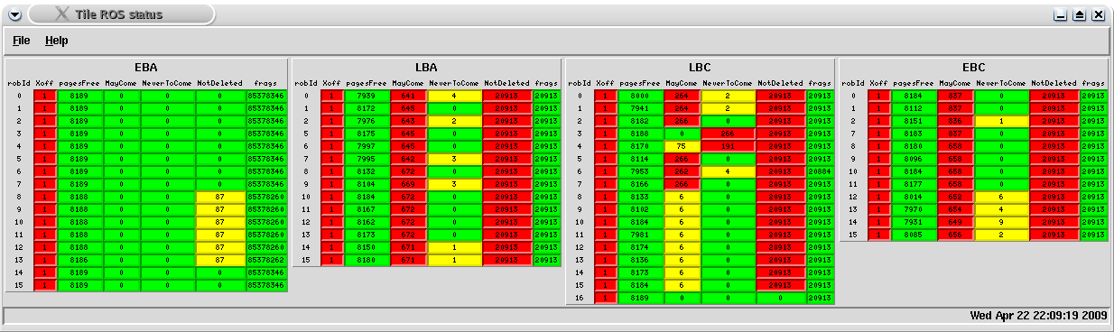
Service work
Plots produced by EF monitoring running online. (AKA Mike’s tool)
ROS status after a non-recoverable busy
Good agreement between OF-DSP-I and OF-OFF-I

Slide 4
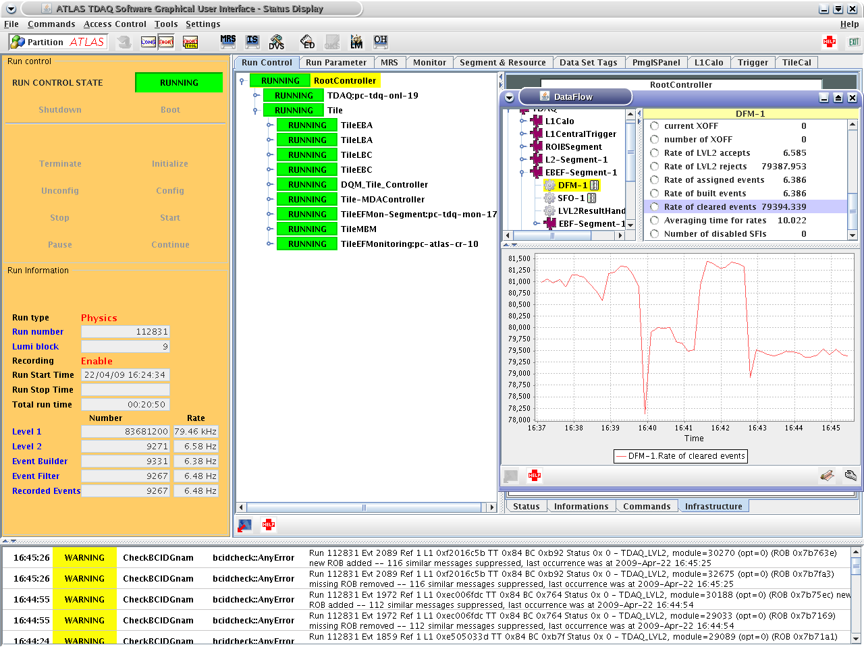
80 kHz!

Slide 5
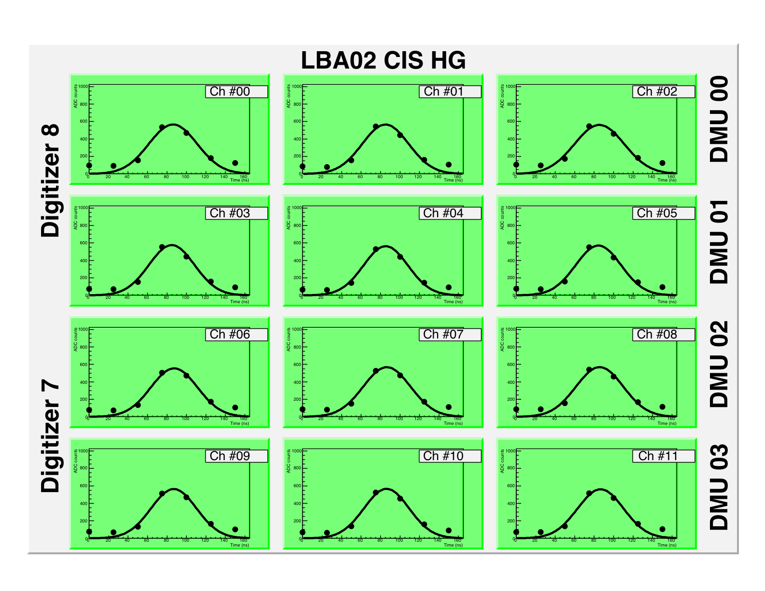
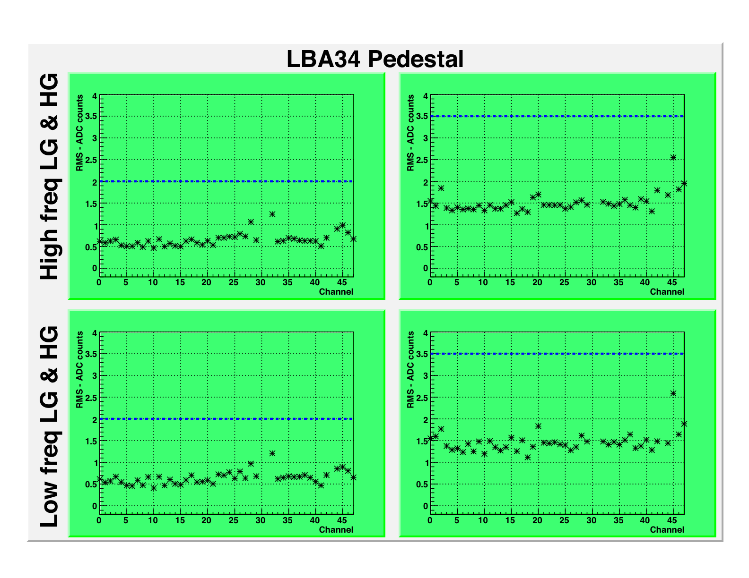
Tile commissioning DVS
In situ tests on the super-drawers
Response to charge injection
Pedestal level
CRC check under stress conditions (100kHz pedestal)
Mezzanine address checking (response to pedestal change)

Slide 6
Tile commissioning DAQ
Two data flow schemas
  Combined running (high rate)
  CIS calibration (storage of calibration params with the data)
L1A
L1A
TTC
ROD
TTC
ROD
Data
Data
Data
ROS
LAE
ROS
Events
Data
Data
File/L2
ROS
Events
Combined
High rate DAQ
DVS development
ROD/DSP testing
Monitoring
Reconstruction validation
File
Calibration
CIS development

Slide 7
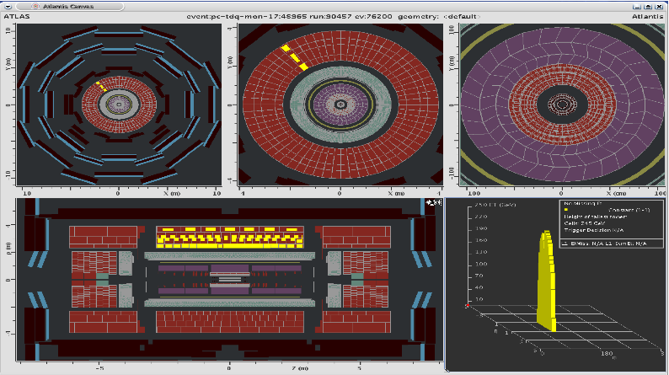
Intercalibration Tile+L1Calo

Slide 8
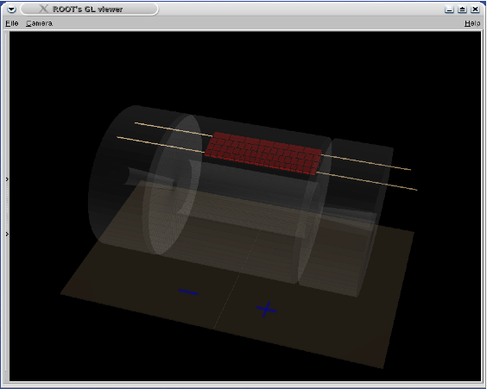
Intercalibration Tile+L1Calo
Beam scraping event

Slide 9

Analysis
Exclusion limit and expected sensitivity for MSSM Higgs to tau tau in the lepton hadron channel
Visible mass observable
  MSSM Higgs to tau tau lh selection cuts (Link)
  Likelihood fit of the S+B to B only pseudo-experiments
  Status presented last week

Slide 10
Conclusions
ATLAS Tile DAQ and DVS under control
  Few developments missing for running
Still lot of work to do on my analysis
  Increase the number of morphings, backgrounds
  Higgs mass scan
  Event selection efficiency
  Work on sensitivity code
  Running feynhiggs

