Slide 1
Overview of work done
Carlos Solans
Valencia TileCal meeting
6th May 2009

Slide 2
Service work
Contributed to calorimeter (Tile+LAr +L1Calo+CTP) slice week (20-26 April)
Good agreement between DSP and offline magnitudes
ROD/DSP monitoring producing results
Steadily running at 80kHz (DSP only) for 30 min
ROD busy/ROS not accepting events issue not understood.
ROD configuration patch applied.
Contributing to HLT slice (Calo+ID+Muon+HLT) week (4-10 May)
Taking DAQ on call shifts whole week.
Couple of DSP not booting problems and a misbehaving drawer.
Compiled 2 Tile online releases (tile-2.0.1, tile-2.0.1.1)
Installed tdaq-02-00-01 in the lab (Valencia, CERN)

Slide 3
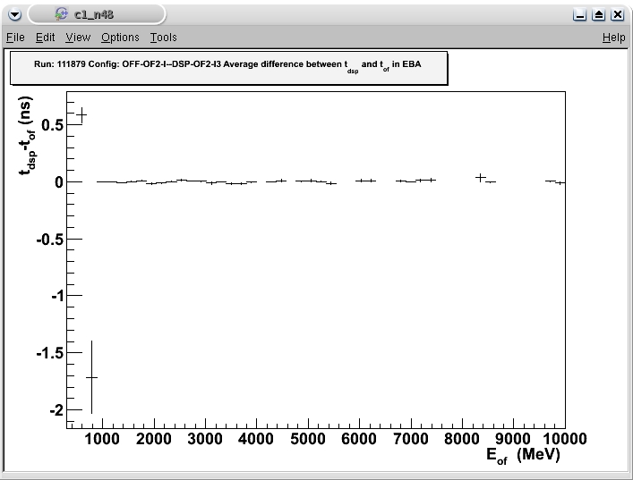
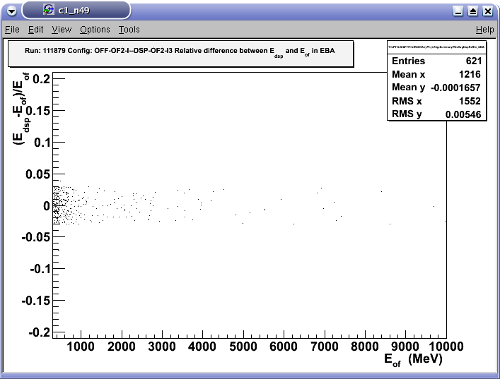
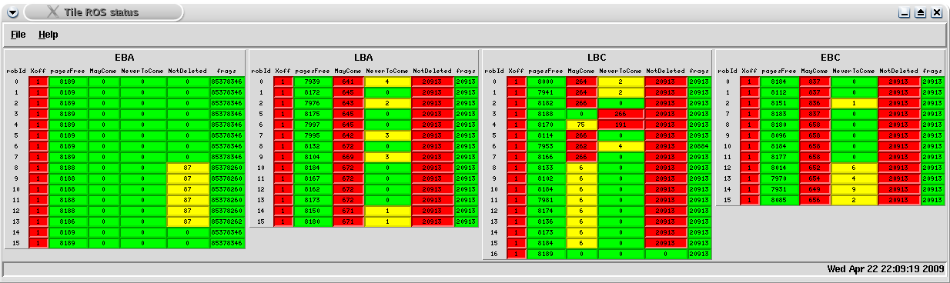
Service work
Plots produced by EF monitoring running online. (AKA Mike’s tool)
ROS status after a non-recoverable busy
Good agreement between OF-DSP-I and OF-OFF-I

Slide 4
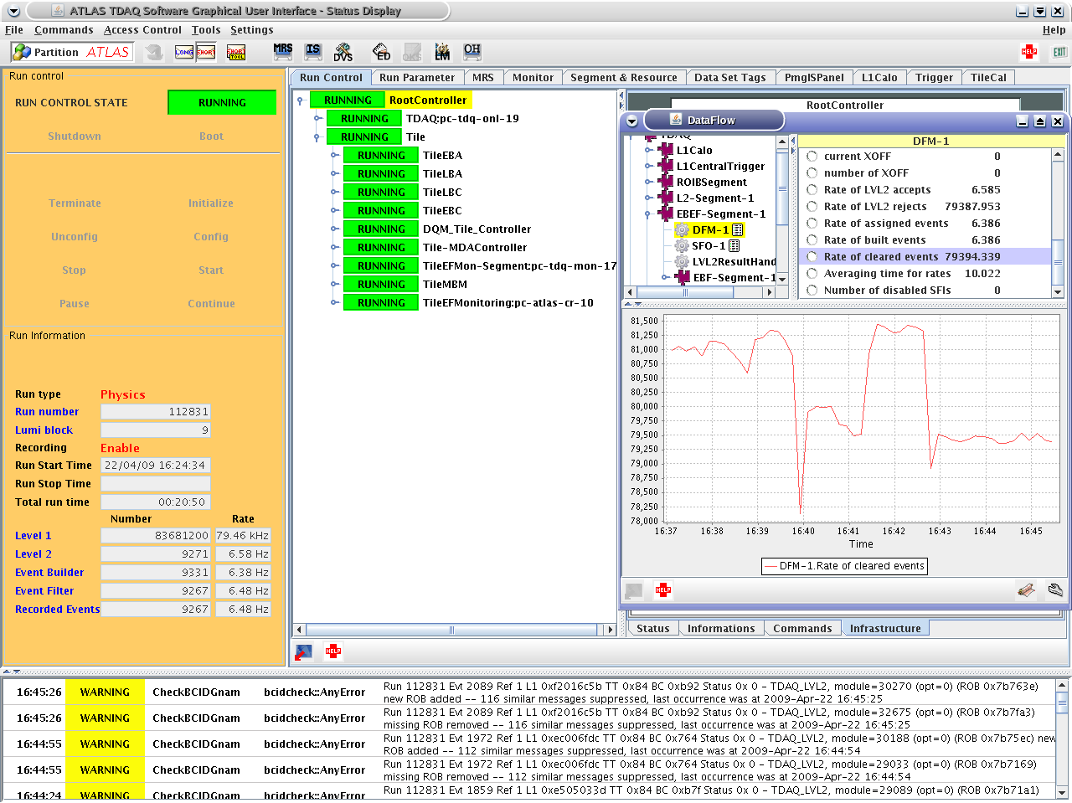
80 kHz!

Slide 5
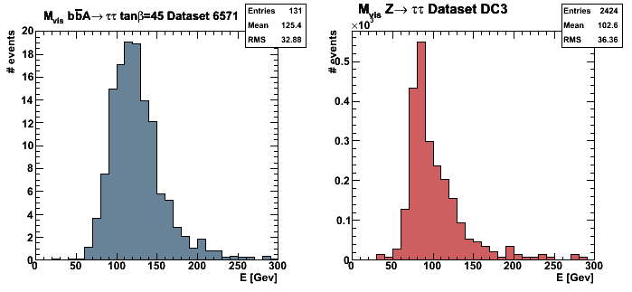

Analysis
Exclusion limit and expected sensitivity for MSSM Higgs to tau tau in the lepton hadron channel
Given a set of datasets (A signal, Z background) in Ntuples
We compute the Mvis (template) applying event selection cuts
MSSMHiggsToTauTauToLH

Slide 6

Analysis II
As we have no data to compare with, we define a pseudo-experiment as a poisson fluctuation of the background.
We fit to each pseudo-experiment a model of signal + background. The expected value for each bin is
We will fit a Likelihood function of the data to the parameters which is maximum at the best value of the parameters.
Numerically means that we will minimize the minus log likelihood.
As the likelihood function is not known a priori we can specify that it has a dependency on known systematic uncertainties (Luminosity, cross sections)

Slide 7
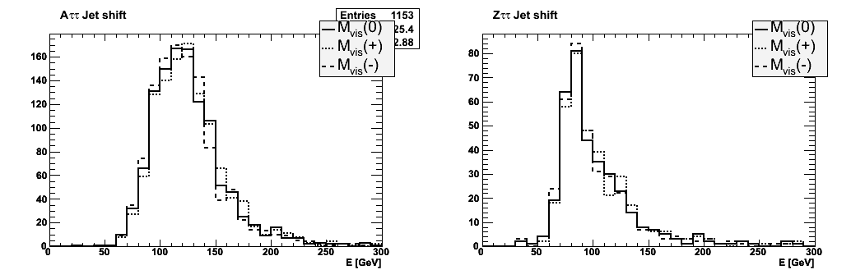

Analysis III
Other systematic uncertainties due to the error in the energy scale can be introduced with morphing parameters
Apart from the nominal template we should compute two new templates that take into account the energy scale shift positive and negative.
As a first order approximation the templates in our fit are
Therefore the Likelihood function should take into account these systematic uncertainties

Slide 8
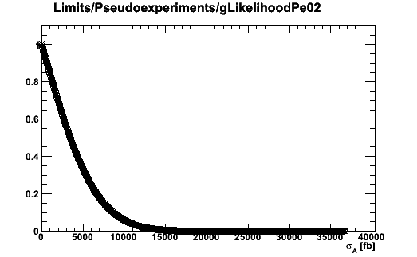
Analysis IV
For each pseudo-experiment we do a signal cross section scan.
We try to fit the pseudo-experiment to a model where each time there is more and more signal (signal cross section is fixed).
For numerical reasons we normalize the value of the likelihood to a certain value as we are not interested in the value of the likelihood but on its integral.
The p-value at 95% indicates the limit for the signal cross section.
It is less than 5% probable that the true signal cross section greater than this limit.
As more and more signal is present
in the model to which the data is fit,
the likelihood is smaller and smaller.
It is less likely that the data is described by the model.

Slide 9
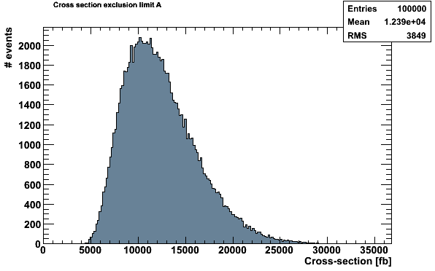
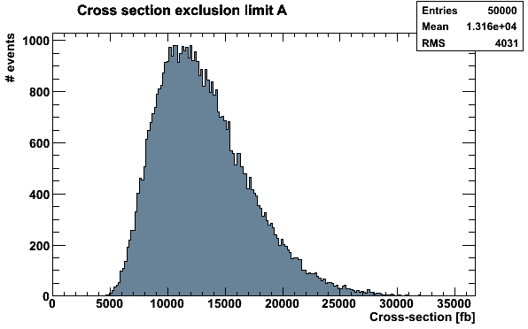
Analysis results
mA=150 GeV tanBeta=45 No morphing
mA=150 GeV tanBeta=45 jet=5%
Mean: 12307 fb
Median: 11851 fb
Band (1sigma): (8728 – 16261)fb
Band (2sigma): (6523 – 21406)fb
Mean: 13075 fb
Median: 12586 fb
Band (1sigma): (9279 – 17180)fb
Band (2sigma): (7074 – 22509)fb

Slide 10
Conclusions and AOB
Still lot of work to do on my analysis
Increase the number of morphings, backgrounds
Higgs mass scan
Event selection efficiency
Work on sensitivity code
Running feynhiggs
AOB
Preparing abstract on commissioning status and performance for IEEE NSS-MIC 2009

