Slide 1


Study of tt-bar events in the dilepton channel with tau lepton in ATLAS
ATLAS Top Quark Physics Workshop
22-24 April 2009
Mª Teresa Pérez García-Estañ
Susana Cabrera Urbán
IFIC ( CSIC – Universidad de Valencia )

Slide 2
outline
Physics motivations
Offline tau reconstruction algorithms
Tau1p3p
TauRec
Merged
Analysis at 14 TeV
TopQuarkAODtoROOTuple/TopView
Selection criteria
Results
Prospects at 10 TeV
ARATopQuarkAnalysis

Slide 3
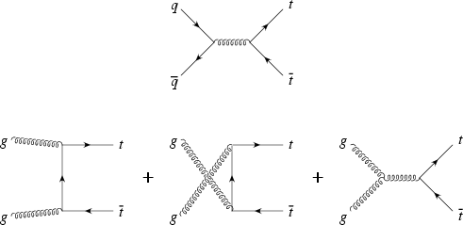
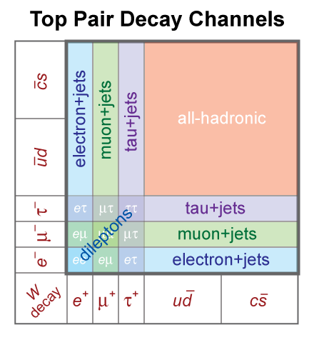
INTRODUCTION
Top pair production through strong interactions
√s=1.96 (14) TeV:
85 (10) ±5% qq
15 (90) ±5% gg
TEVATRON σ_{tt} (QCD-NLO) ≅ 6.7 pb
LHC: σtt (QCD-NLO) ≅ 840 pb
Electroweak decays ~100% BR( t→W⁺b)
tt → W(→lν)bW(→lν)b (e+µ: 5%)
→ DILEPTONIC
tt → W(→lν)bW(→qq)b (e+µ:35%)
→ 1 LEPTON PLUS JETS
tt → W(→qq)bW(→qq)b ( 45% )
→ FULL HADRONIC
Notes:
El quark top se produce en pares via interacción fuerte.
Hay dos mecanismos de producción: aniquilación de quarks y fusión de gluones.
Campo de eventos: numero de eventos esperados para una luminosidad integrada
Dada y cierta sección eficaz, teniendo en cuenta BR, sin tener en cuenta eficiencia de selección.

Slide 4
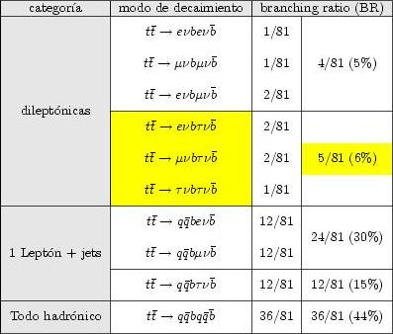

Physics motivations: tau lepton
ttbar decaying modes/branching ratios
tau lepton:
m = 1776.99^{+0.29}_{-0.26} MeV
τ = (290.6±1.0)10⁻¹⁵ s
cτ = 87.11 μm
Standard Model(SM)
ttH → tt ττ (100-150 GeV)
qqH → qq ττ
New physics
SUSY
Extra dimensions
MSSM Higgs
A/H → ττ
H⁺→ τν

Slide 5

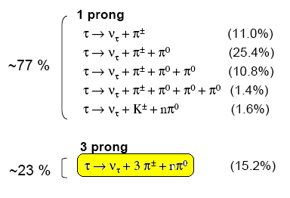
Tau Physics
Leptonic decay modes:
Hadronic decay modes:
→ ν_{τ} + π±
τ → ν_{τ} + π± + nπ⁰
~ 65 %
How do we identify them?

Slide 7
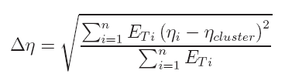
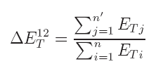
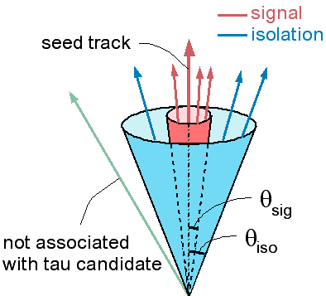
Offline reconstruction algorithms
variables
Electromagnetic radius, R_{em}
Isolation fraction in the calorimeter
Number of tracks, N_{tr}
Tau charge
Transverse energy width in the η strip layer
Lifetime signed pseudo impact parameter
E_{T}/p_{T} leading track
Number of hits on the η strip layer
Notes:
Aislamiento en el calorimetro←→ deposicion colimada de energia (TauRec) y trazas en un cono pequeño (Tau1p3p)

Slide 8
Tau1p3p
E_{T} ~ 20-70 GeV
1 good quality track: p_{T}> 9 GeV
Search for tracks with p_{T}> 2 GeV in ΔR < 0.2
τ_{1P}
τ_{3P}
2 near tracks
(η,φ) from bary centre of tracks
∑charge = +-1
NO near track
(η,φ) from track at vertex
Energetic calibration
Energetic calibration
build discriminant variables
use ΔR < 0.2
0.2 < ΔR < 0.4 for isolation only
τ_{1P} - single-prong candidates
τ_{3P} - three-prong candidates
Notes:
Diseñado para la identificación de taus en la búsqueda y higgs ligeros y SUSY “soft”: ET ~ 20-70 GeV
Utiliza que el tau hadronico no es un jet sino 1/3 trazas + piones neutros

Slide 9
TauRec
Seed → TopoJets (clusters) reconstructed with E_{t}> 10 GeV y |η| < 2.5
Search for tracks (from TrackParticle container) around the seed (topo jet) in a cone ΔR < 0.2 → use information from the calorimeter and the inner detector
Candidates with 1,2 & 3 tracks are selected
Energy calibration (H1, cell weight assignment related to energy and η)
Discriminant variable(Likelihood) build using tau identification variables
Notes:
Topo Jets: Topological clustering is used as one of the two major clusterization algorithms for calorimeters in ATLAS. The basic idea is to group cells in clusters based on their neighbor relations and on the significance of their energy contents. This results in clusters with a variable number of cells in contrast to the fixed size clusters provided by the SlidingWindowClustering.
tauRec starts from the Cone 0.4 TopoJets, that is a cone 0.4 clustering algorithm run on TopoClusters. Every TopoJet that has Et > 10 GeV and |eta| < 2.5 is considered a tau candidate. For each candidate, tauRec associates tracks within dR<0.3 of the TopoJet centre, that pass the track quality selection criteria. A likelihood is formed to determine how likely a tau candidate originates from a hadronically decaying tau or another sample.

Slide 10
Tau Algorithm Merging
Seed: tracks (E_{t} > 6 GeV) and TopoJets (E_{t} > 10 GeV)
First Tau1p3p
for each tau1p3p seed, a TopoJet is searched for within 0.2 cone radius
if TopoJet is found, then tauRec reconstruction is also run on this
in this case, the candidate is an overlap candidate
protection against using the same jet twice (if matched to two good quality tau1p3p leading tracks)
if no TopoJet found within 0.2 of tau1p3p seed, the candidate is tau1p3p-only
Unused TopoJets are seeds for additional tauRec candidates
tauRec reconstruction run as normal
these candidates are tauRec-only candidates

Slide 11
Analysis
TopQuarkAODtoROOTuple
http://ghodbane.web.cern.ch/ghodbane/top/ntuple.12.0.6.html
ttbar, Ztautau, W+Njets, Wbb, SingleTop
Tau1p3p
MuonID
TopView
https://twiki.cern.ch/twiki/bin/view/AtlasProtected/TopView
ttbar, Ztautau, W+njets, Wbb, SingleTop
QCD dijets
Tau1p3p + TauRec
MuonID + StacoMuon
ARATopQuarkAnalysis
https://atlas-france.in2p3.fr/cgi-bin/twiki/bin/view/Atlas/ARATopQuarkAnalysis
TopPhysTools (¿&TauTools?)
https://twiki.cern.ch/twiki/bin/view/AtlasProtected/TopPhysTools
https://twiki.cern.ch/twiki/bin/view/AtlasProtected/TauDPDMaker

Slide 13
TopQuarkAODtoROOTuples MC samples
ttbar
trig1_misal1_mc12.005200.T1_McAtNlo_Jimmy.recon.AOD.v12000601
Ztautau
trig1_misal1_mc12.008156.AlpgenJimmyZtautauNp2LooseCut. recon.AOD.v12000601
Wbb
trig1_misal1_mc12.006281.AlpgenJimmyWbbNp1.recon.AOD.v12000605
trig1_misal1_mc12.006282.AlpgenJimmyWbbNp2.recon.AOD.v12000605_tid015410
trig1_misal1_mc12.006283.AlpgenJimmyWbbNp3.recon.AOD.v12000605_tid015411
Single Top
trig1_misal1_mc12.005500.AcerMC_Wt.recon.AOD.v12000604_tid009895
trig1_misal1_mc12.005501.AcerMC_schan.recon.AOD.v12000604_tid009896
trig1_misal1_mc12.005502.AcerMC_tchan.recon.AOD.v12000604_tid009897

Slide 14
TopQuarkAODtoROOTuples MC samples
W+Njets
- First only W+3jets:
trig1_misal1_mc12.008241.AlpgenJimmyWenuNp3_pt20_filt3jet.recon.AOD.v12000601
trig1_misal1_mc12.008245.AlpgenJimmyWmunuNp3_pt20_filt3jet.recon.AOD.v12000601
- Finally W+Njets (N≤5)
trig1_misal1_mc12.006101.AlpgenJimmyWenuNp0LooseCut.recon.AOD.v12000605_tid014144
trig1_misal1_mc12.006102.AlpgenJimmyWenuNp1LooseCut.recon.AOD.v12000605_tid014147
trig1_misal1_mc12.006103.AlpgenJimmyWenuNp2LooseCut.recon.AOD.v12000605_tid014150
trig1_misal1_mc12.006104.AlpgenJimmyWenuNp3LooseCut.recon.AOD.v12000605_tid01415
trig1_misal1_mc12.006105.AlpgenJimmyWenuNp4LooseCut.recon.AOD.v12000605_tid014156
trig1_misal1_mc12.006106.AlpgenJimmyWenuNp5LooseCut.recon.AOD.v12000605_tid014159
trig1_misal1_mc12.006107.AlpgenJimmyWmunuNp0LooseCut.recon.AOD.v12000605_tid018113
trig1_misal1_mc12.006108.AlpgenJimmyWmunuNp1LooseCut.recon.AOD.v12000605_tid014165
trig1_misal1_mc12.006109.AlpgenJimmyWmunuNp2LooseCut.recon.AOD.v12000605_tid014168
trig1_misal1_mc12.006110.AlpgenJimmyWmunuNp3LooseCut.recon.AOD.v12000605_tid014171
trig1_misal1_mc12.006111.AlpgenJimmyWmunuNp4LooseCut.recon.AOD.v12000605_tid014174
trig1_misal1_mc12.006112.AlpgenJimmyWmunuNp5LooseCut.recon.AOD.v12000605_tid014177

Slide 15
Background
Z → ττ + 2 jets
Physic background.
Reduction through kinematic and angular criteria
W + N jets, Wbb, SingleTop
Instrumental background.
Tau identification cuts for reduction.

Slide 16
Selection criteria
Un isolated lepton (e o µ ) with P_{T} >20 GeV (trigger object) and | η | < 2.5
tau identification:
One τ lepton: E_{T}> 15 GeV .
Tau1p3p: discriminant = 1
TauRec: Likelihood > 6 (TopWG recomendation)
At least 2 energetic jets with | η | < 2:
E_{T}(1er jet) > 50 GeV
E_{T}(2nd jet) > 30 GeV
Missing transverse energy E_{T}>25 GeV
H_{T}:= E_{T} + Σ E_{T(leptones)} + Σ E_{T(jets)} H_{T}>250 GeV
Z veto
Opossite sign (OS)
Btagging

Slide 17
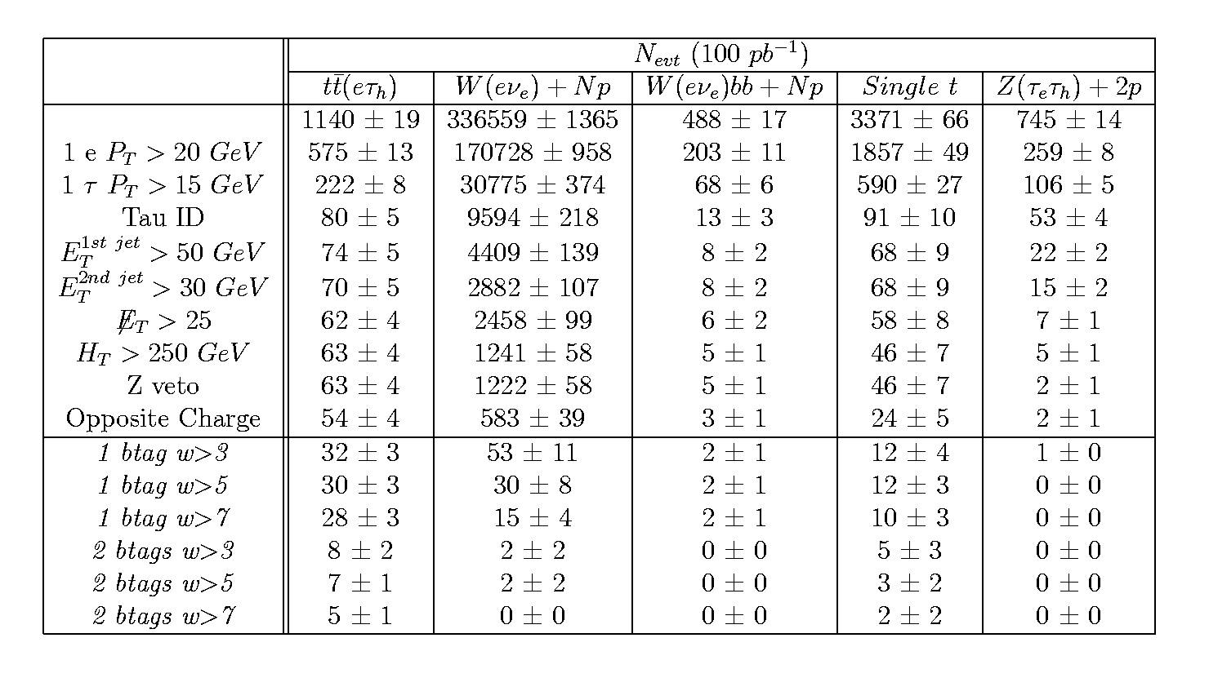
Summary (e,τ _{had})

Slide 18
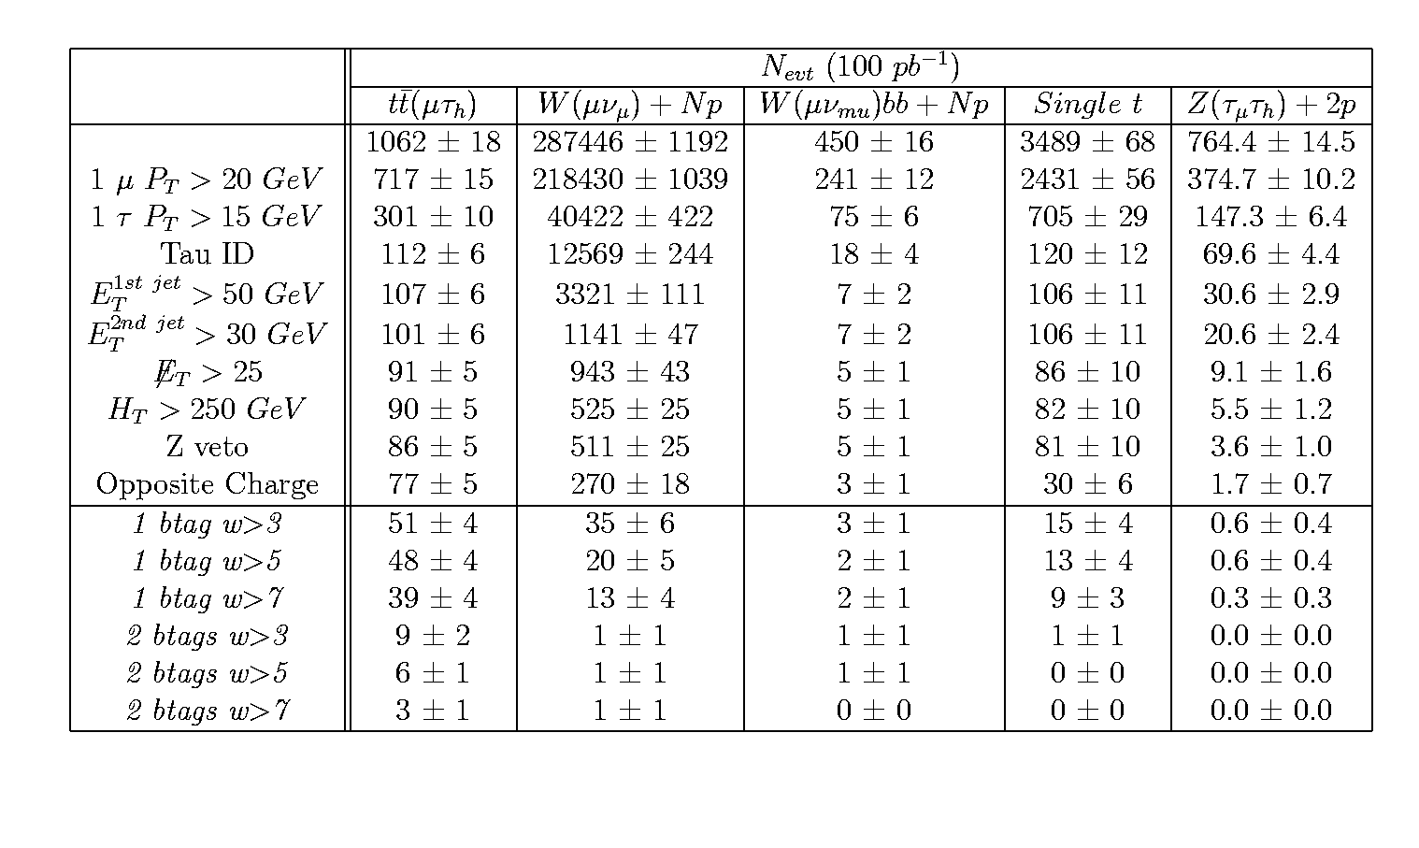
Summary (µ,τ _{had})

Slide 19
TopQuarkAODtoROOTuple: Summary
Need to use b-tagging to distinguish the tt-bar →bW(→τ_{had})bW(→e/μ) signal at 100 pb⁻¹
Wbb insignificant when compared with W+jets & SingleTop
Btagging
1 small S/B ratio
2 Dominant backgrounds (W+jets y SingleTop) drastically reduced, but we lost almost all the signal (3-5 events).
S/B ~2 (electronic channel) and ~ 3 (muonic channel).
Contribution:
ATLAS note ATL-COM-PHYS-2008-068
ATLAS CSC note phys-int-2008-003

Slide 21
TopView MC samples
ttbar
trig1_misal1_mc12.005200.T1_McAtNlo_Jimmy.recon.AOD.v12000601_tid005997
Ztautau
trig1_misal1_mc12.008156.AlpgenJimmyZtautauNp2LooseCut.recon.AOD.v12000601_tid006628
W+jets
trig1_misal1_mc12.006101.AlpgenJimmyWenuNp0LooseCut.recon.AOD.v12000605_tid014144
trig1_misal1_mc12.006102.AlpgenJimmyWenuNp1LooseCut.recon.AOD.v12000605_tid014147
trig1_misal1_mc12.006103.AlpgenJimmyWenuNp2LooseCut.recon.AOD.v12000605_tid014150
trig1_misal1_mc12.006104.AlpgenJimmyWenuNp3LooseCut.recon.AOD.v12000605_tid01415
trig1_misal1_mc12.006105.AlpgenJimmyWenuNp4LooseCut.recon.AOD.v12000605_tid014156
trig1_misal1_mc12.006106.AlpgenJimmyWenuNp5LooseCut.recon.AOD.v12000605_tid014159
trig1_misal1_mc12.006107.AlpgenJimmyWmunuNp0LooseCut.recon.AOD.v12000605_tid018113
trig1_misal1_mc12.006108.AlpgenJimmyWmunuNp1LooseCut.recon.AOD.v12000605_tid014165
trig1_misal1_mc12.006109.AlpgenJimmyWmunuNp2LooseCut.recon.AOD.v12000605_tid014168
trig1_misal1_mc12.006110.AlpgenJimmyWmunuNp3LooseCut.recon.AOD.v12000605_tid014171
trig1_misal1_mc12.006111.AlpgenJimmyWmunuNp4LooseCut.recon.AOD.v12000605_tid014174
trig1_misal1_mc12.006112.AlpgenJimmyWmunuNp5LooseCut.recon.AOD.v12000605_tid014177

Slide 22
TopView MC samples
Wbb
trig1_misal1_mc12.006281.AlpgenJimmyWbbNp1.recon.AOD.v12000605
trig1_misal1_mc12.006282.AlpgenJimmyWbbNp2.recon.AOD.v12000605_tid015410
trig1_misal1_mc12.006283.AlpgenJimmyWbbNp3.recon.AOD.v12000605_tid015411
Single Top
trig1_misal1_mc12.005500.AcerMC_Wt.recon.AOD.v12000604_tid009895
trig1_misal1_mc12.005501.AcerMC_schan.recon.AOD.v12000604_tid009896
trig1_misal1_mc12.005502.AcerMC_tchan.recon.AOD.v12000604_tid009897
QCD dijets
trig1_misal1_csc11.005009.J0_pythia_jetjet.recon.AOD.v12000604_tid010586
trig1_misal1_csc11.005010.J1_pythia_jetjet.recon.AOD.v12000601_tid006001
trig1_misal1_csc11.005011.J2_pythia_jetjet.recon.AOD.v12000503_tid005591
trig1_misal1_csc11.005012.J3_pythia_jetjet.recon.AOD.v12000604_tid009525
trig1_misal1_csc11.005013.J4_pythia_jetjet.recon.AOD.v12000605_tid009524
trig1_misal1_csc11.005014.J5_pythia_jetjet.recon.AOD.v12000601_tid006004
trig1_misal1_csc11.005015.J6_pythia_jetjet.recon.AOD.v12000601_tid005996
trig1_misal1_csc11.005016.J7_pythia_jetjet.recon.AOD.v12000601_tid006005

Slide 23
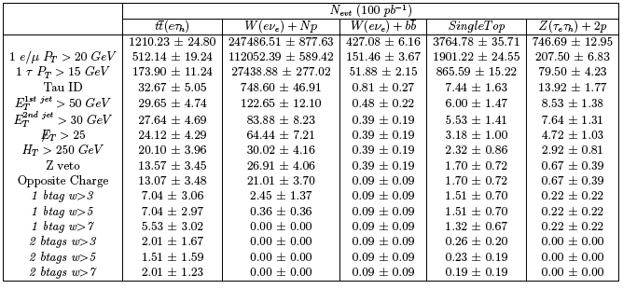
Summary (TauRec (e,τ_{had}))

Slide 24
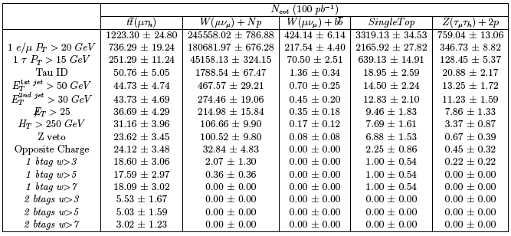
Summary (TauRec (μ,τ_{had}))

Slide 25
TopView: Summary&Plans
Results are consistent with TopQuarkAODtoROOTuple
Wbb insignificant when compared with W+jets & SingleTop
Need to use b-tagging to distinguish the tt-bar →bW(→τ_{had})bW(→e/μ) signal at 100 pb⁻¹
Btagging : with 1 btaggin we get S/B~1.5 in the electronic channel and S/B~ 6 in the muonic channel. (greater difference between channels than with TopQuarkAODtoROOTuple).
Efficiency problems after OS cut applying Tau1p3p
Test with:
Tau1p3p/TauRec
MuonID/StacoMuon
Pending of repeating the analysis with mc08 samples and release 14 (Tau1p3p &TauRec merged, 10 TeV)

Slide 26
QCD dijets: Motivations
W+jets is the dominant “instrumental” background with jets misidentificated as tau leptons. (ATL-COM-PHYS-2008-068)
We have estimated the W+jets background directly from our W+Njets samples, counting the number of events that pass the ttbar (lepton, τ_{HAD}) selection criteria.
In order to make a more realistic estimation of the W+jets background, we have calculated fake rates using QCD dijets MC samples.

Slide 27
QCD dijets: selection criteria
Events with Njets ≥ 2
2 more energetic jets (similar Pt)
Back to back jets → ∆φ ≥ (π-0.3)
Randomly choose one as the “tag jet” and the other will be the “probe jet”
tag jet
n_{trak min} = 4 (p_{T}≤ 50 GeV) + 1 track for each additional 50 GeV interval in p_{T}
Probe jet
Tau1p3p → Tau_Discriminant = 1
TauRec → Tau_logLikelihoodRatio > 4
Probe jet = FR-Tau_Candidates
FR-Tau_ID

Slide 28
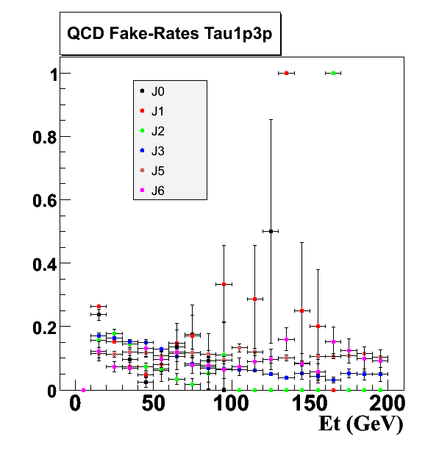
QCD Results (I)
Tau1p3p
FR ~10%
10% Discrepancy from
One sample to another

Slide 29
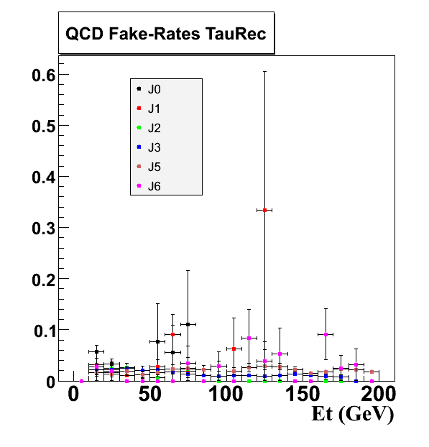
QCD Results (II)
TauRec
FR ~5%
5% Discrepancy from
One sample to another

Slide 30
QCD dijets: Summary & plans
QCD dijets
We have estimated FR from QCD dijets samples
Future:
apply to ttbar and W+jets
Parametrize FR as a function of ΣE_{T}

Slide 31
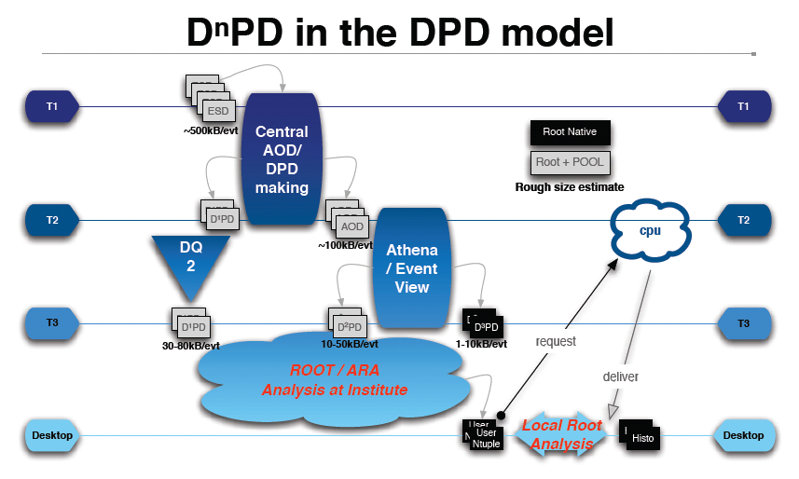
Release 14

Slide 32
EventViewbasedPackages

Slide 33
ARATopQuarkAnalysis
GOAL: repeat the analysis at 10 TeV to check if this channel will be observable at the beggining of the LHC
3 aims:
add tau monitoring variables
TauRec, Tau1p3p, merged details
https://twiki.cern.ch/twiki/bin/view/Atlas/TauDataQualityMonitoring
QCD fake rates calculation & aplication to ttbar+background samples
Top mixing sample analysis
work in progress……..

Slide 34
mc08 TopWG official samples
Link Hypernews:
https://groups.cern.ch/group/hn-atlas-TopPhysicsWG/Lists/Archive/Flat.aspx?RootFolder=%2fgroup%2fhn-atlas-TopPhysicsWG%2fLists%2fArchive%2ftop%20mixing%20sample%20Jet%20stream%20registered&FolderCTID=0x012002001823315957BA9D4A9BED606ED727658E
QCD dijets
user.top.D3PD_rel14050006_MC08.mc08.105009.J0_pythia_jetjet.recon.AOD.e344_s479_r541.20090119_GANGA
user.top.D3PD_rel14050006_MC08.mc08.105010.J1_pythia_jetjet.recon.AOD.e344_s479_r541.20090119_GANGA
user.top.D3PD_rel14050006_MC08.mc08.105011.J2_pythia_jetjet.recon.AOD.e344_s479_r541.20090119_GANGA
user.top.D3PD_rel14050006_MC08.mc08.105012.J3_pythia_jetjet.recon.AOD.e344_s479_r541.20090119_GANGA
user.top.D3PD_rel14050006_MC08.mc08.105013.J4_pythia_jetjet.recon.AOD.e344_s479_r541.20090119_GANGA
user.top.D3PD_rel14050006_MC08.mc08.105014.J5_pythia_jetjet.recon.AOD.e344_s479_r541.20090119_GANGA
user.top.D3PD_rel14050006_MC08.mc08.105015.J6_pythia_jetjet.recon.AOD.e344_s479_r541.20090119_GANGA
user.top.D3PD_rel14050006_MC08.mc08.105016.J7_pythia_jetjet.recon.AOD.e344_s479_r563.20090119_GANGA
ttbar
user.top.D3PD_rel14050006_MC08.mc08.105200.T1_McAtNlo_Jimmy.recon.AOD.e357_s462_r541.20090119_GANGA
user.top.D3PD_rel14050006_MC08.mc08.105204.TTbar_FullHad_McAtNlo_Jimmy.recon.AOD.e363_s462_r563.20090121_GANGA
Single top
user.top.D3PD_rel14050006_MC08.mc08.105500.AcerMC_Wt.recon.AOD.e352_s462_r541.20090119_GANGA
user.top.D3PD_rel14050006_MC08.mc08.105502.AcerMC_tchan.recon.AOD.e352_s462_r541.20090119_GANGA
user.top.D3PD_rel14050006_MC08.mc08.105503.AcerMC_Wt_dilep.recon.AOD.e352_s462_r541.20090119_GANGA

Slide 35
mc08 TopWG official samples
W+jets
user.top.D3PD_rel14050006_MC08.mc08.107680.AlpgenJimmyWenuNp0_pt20.recon.AOD.e368_s462_r563.20090119_GANGA user.top.D3PD_rel14050006_MC08.mc08.107681.AlpgenJimmyWenuNp1_pt20.recon.AOD.e368_s462_r563.20090119_GANGA user.top.D3PD_rel14050006_MC08.mc08.107682.AlpgenJimmyWenuNp2_pt20.recon.AOD.e368_s462_r563.20090119_GANGA user.top.D3PD_rel14050006_MC08.mc08.107683.AlpgenJimmyWenuNp3_pt20.recon.AOD.e368_s462_r563.20090119_GANGA user.top.D3PD_rel14050006_MC08.mc08.107684.AlpgenJimmyWenuNp4_pt20.recon.AOD.e368_s462_r563.20090119_GANGA user.top.D3PD_rel14050006_MC08.mc08.107685.AlpgenJimmyWenuNp5_pt20.recon.AOD.e368_s462_r563.20090119_GANGA user.top.D3PD_rel14050006_MC08.mc08.107690.AlpgenJimmyWmunuNp0_pt20.recon.AOD.e368_s462_r563.20090119_GANGA user.top.D3PD_rel14050006_MC08.mc08.107691.AlpgenJimmyWmunuNp1_pt20.recon.AOD.e368_s462_r563.20090119_GANGA user.top.D3PD_rel14050006_MC08.mc08.107692.AlpgenJimmyWmunuNp2_pt20.recon.AOD.e368_s462_r563.20090119_GANGA user.top.D3PD_rel14050006_MC08.mc08.107693.AlpgenJimmyWmunuNp3_pt20.recon.AOD.e368_s462_r563.20090119_GANGA user.top.D3PD_rel14050006_MC08.mc08.107694.AlpgenJimmyWmunuNp4_pt20.recon.AOD.e368_s462_r563.20090119_GANGA user.top.D3PD_rel14050006_MC08.mc08.107695.AlpgenJimmyWmunuNp5_pt20.recon.AOD.e368_s462_r563.20090119_GANGA user.top.D3PD_rel14050006_MC08.mc08.107700.AlpgenJimmyWtaunuNp0_pt20.recon.AOD.e368_s462_r563.20090119_GANGA user.top.D3PD_rel14050006_MC08.mc08.107701.AlpgenJimmyWtaunuNp1_pt20.recon.AOD.e368_s462_r563.20090119_GANGA user.top.D3PD_rel14050006_MC08.mc08.107702.AlpgenJimmyWtaunuNp2_pt20.recon.AOD.e368_s462_r563.20090119_GANGA user.top.D3PD_rel14050006_MC08.mc08.107703.AlpgenJimmyWtaunuNp3_pt20.recon.AOD.e368_s462_r563.20090119_GANGA user.top.D3PD_rel14050006_MC08.mc08.107704.AlpgenJimmyWtaunuNp4_pt20.recon.AOD.e368_s462_r563.20090119_GANGA user.top.D3PD_rel14050006_MC08.mc08.107705.AlpgenJimmyWtaunuNp5_pt20.recon.AOD.e368_s462_r563.20090119_GANGA
Wbb
user.top.D3PD_rel14050006_MC08.mc08.106280.AlpgenJimmyWbbNp0_pt20.recon.AOD.e376_s462_r563.20090119_GANGA
user.top.D3PD_rel14050006_MC08.mc08.106281.AlpgenJimmyWbbNp1_pt20.recon.AOD.e376_s462_r563.20090119_GANGA
user.top.D3PD_rel14050006_MC08.mc08.106282.AlpgenJimmyWbbNp2_pt20.recon.AOD.e376_s462_r563.20090119_GANGA
user.top.D3PD_rel14050006_MC08.mc08.106283.AlpgenJimmyWbbNp3_pt20.recon.AOD.e376_s462_r563.20090119_GANGA

Slide 36
mc08 TopWG official samples
Top mixing
user.RichardHawkings.0108172.topmix_Egamma.AOD.v1
user.RichardHawkings.0108172.topmix_Muon.AOD.v1
user.RichardHawkings.0108172.topmix_Jet.AOD.v1
user.RichardHawkings.0108173.topmix_Egamma.AOD.v2
user.RichardHawkings.0108173.topmix_Muon.AOD.v2
user.RichardHawkings.0108173.topmix_Jet.AOD.v2
user.RichardHawkings.0108174.topmix_Egamma.AOD.v2
user.RichardHawkings.0108174.topmix_Muon.AOD.v2
user.RichardHawkings.0108174.topmix_Jet.AOD.v2
https://twiki.cern.ch/twiki/bin/view/AtlasProtected/TopMixingExercise
ttbar + Single top + W+jets + Z+jets + diboson (WW/WZ/ZZ)

Slide 37
Backup Slides

Slide 38
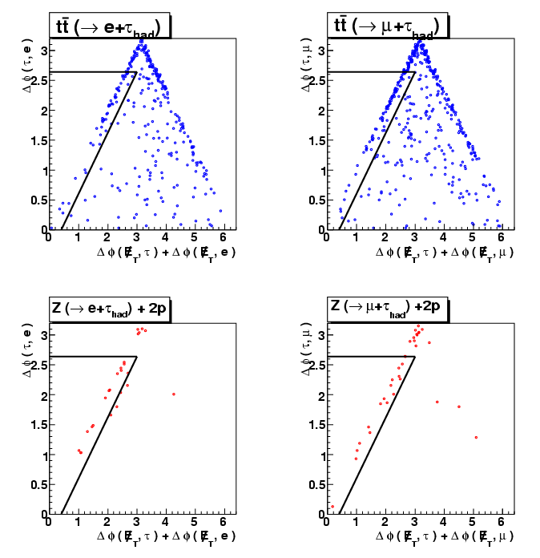
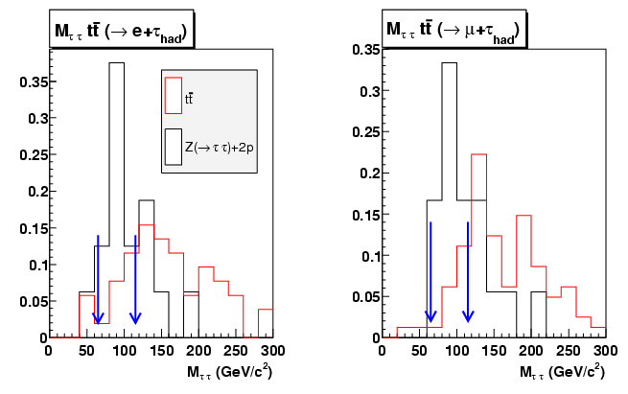
VETO DE BOSONES Z→ττ
e/μ
MET
JETS
τ_{HAD}
Notes:
1)

Slide 39
TopQuarkAODtoROOTuple

Slide 40
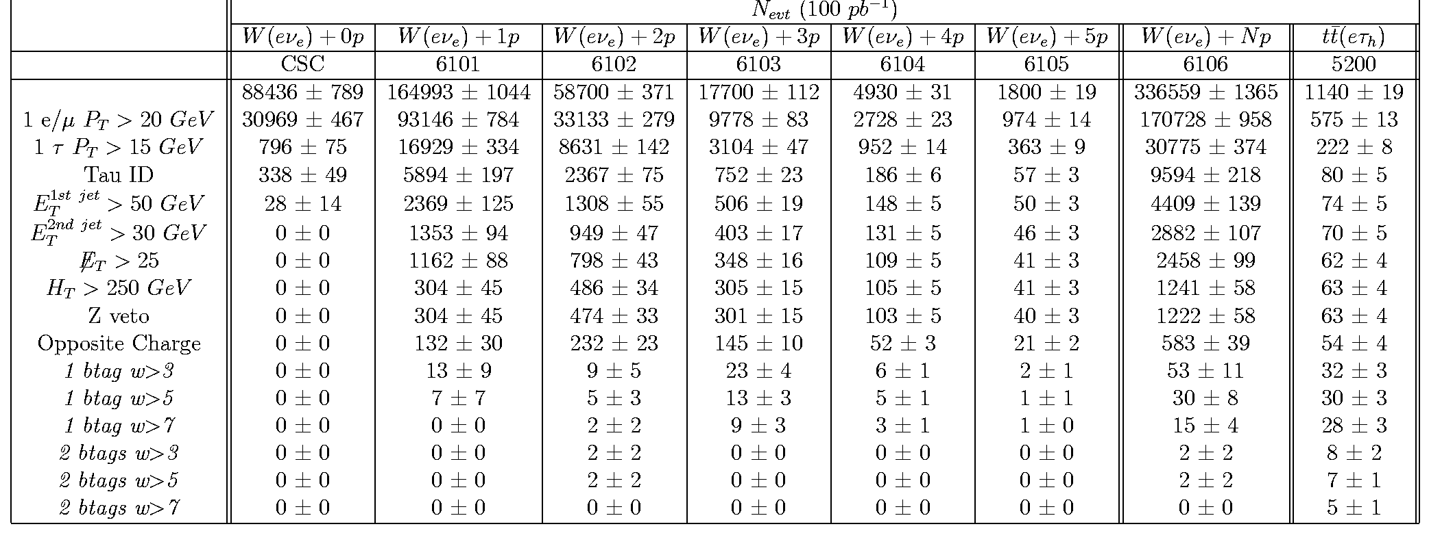
W(→eν)+jets
Notes:
Luminosidad de una muestra de MC: número total de eventos en la muestra / sección eficaz teórica
Eventos esperados en 100 pb-1 := número de eventos en la muestra de MC
Secciones eficaces teóricas de la bibliografía.

Slide 41
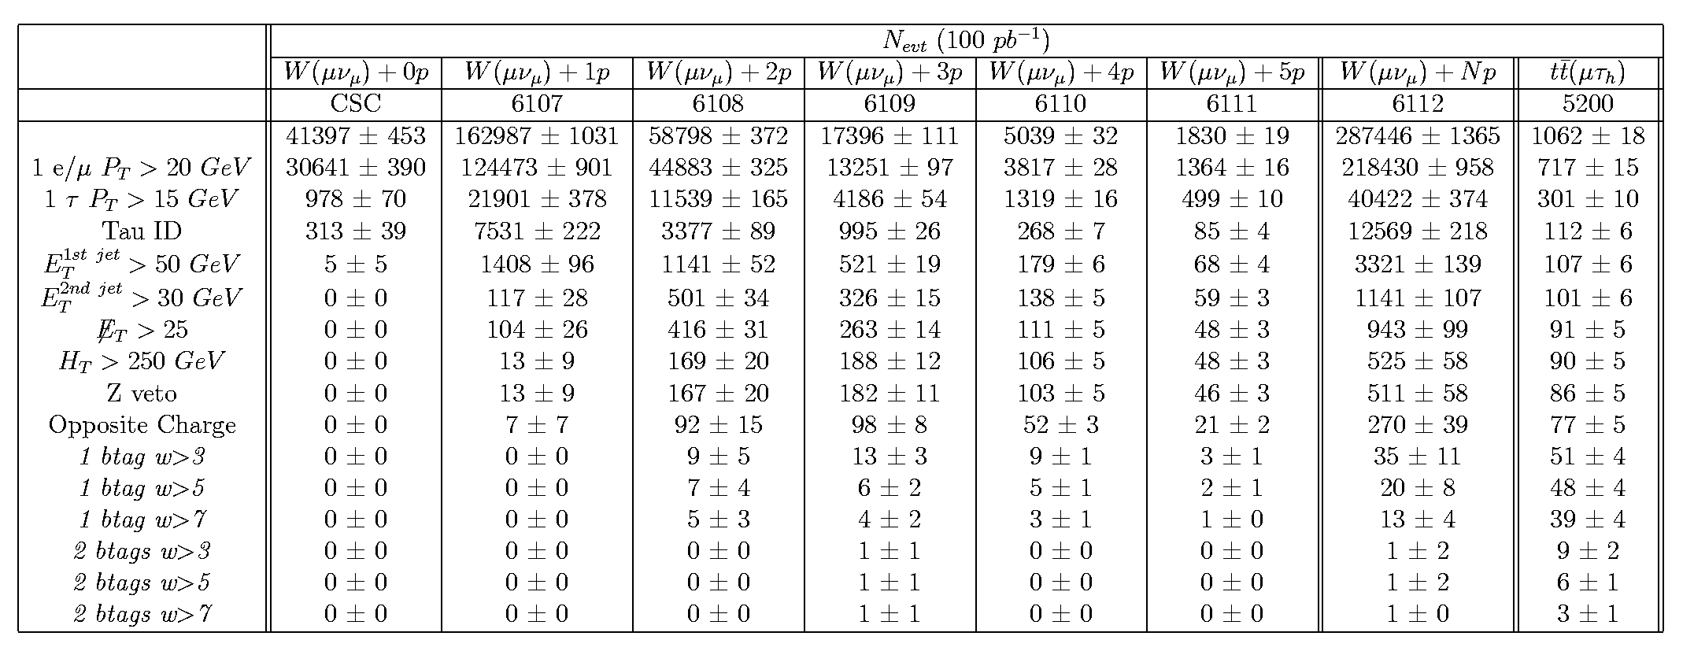
W(→μν)+jets
Notes:
Luminosidad de una muestra de MC: número total de eventos en la muestra / sección eficaz teórica
Eventos esperados en 100 pb-1 := número de eventos en la muestra de MC
Secciones eficaces teóricas de la bibliografía.

Slide 42
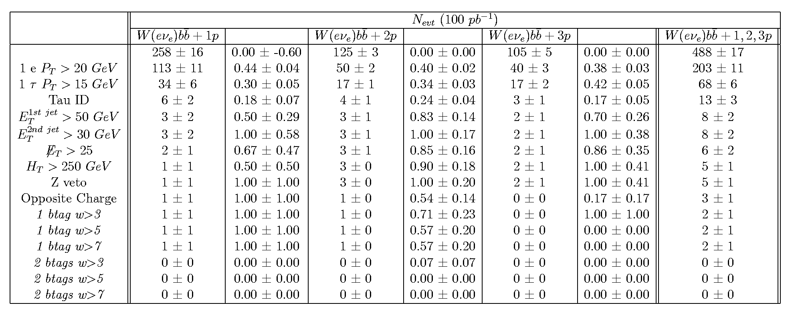
Wbb (e,τ_{had})
W(→eν)+bb :
1 e + MissingEt + 2 b-jets + 1 quark-gluon-jet passing tau ID cuts.

Slide 43
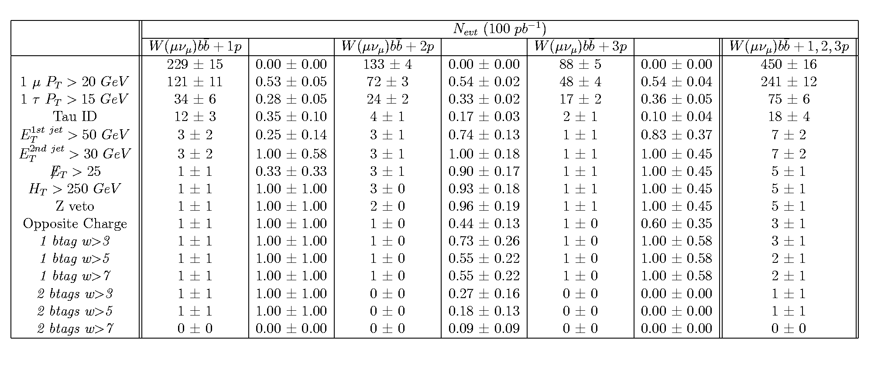
Wbb (µ,τ_{had})
W(→µν)+bb :
1 µ + MissingEt + 2 b-jets + 1 quark-gluon-jet passing tau ID cuts.

Slide 44
SingleTop Background
Wt-channel
s-channel
t-channel
Wt:
W(→e/μ/+τ,ν),t→W(→qq´)b
1lepton (e/µ) + 1 b-jets + 0,2 non-b jets + MET + 1 fake/real tau
s-channel:
[t→W(→e/μ+ν)b]b
1lepton (e/µ) + 2 b-jets + MET + 1 fake tau
t-channel:
[t→W(→e/μ+ν)b]b,q´
1lepton (e/µ) + 1,2 b-jets + 1 non-b jet + MET + 1 fake tau

Slide 45
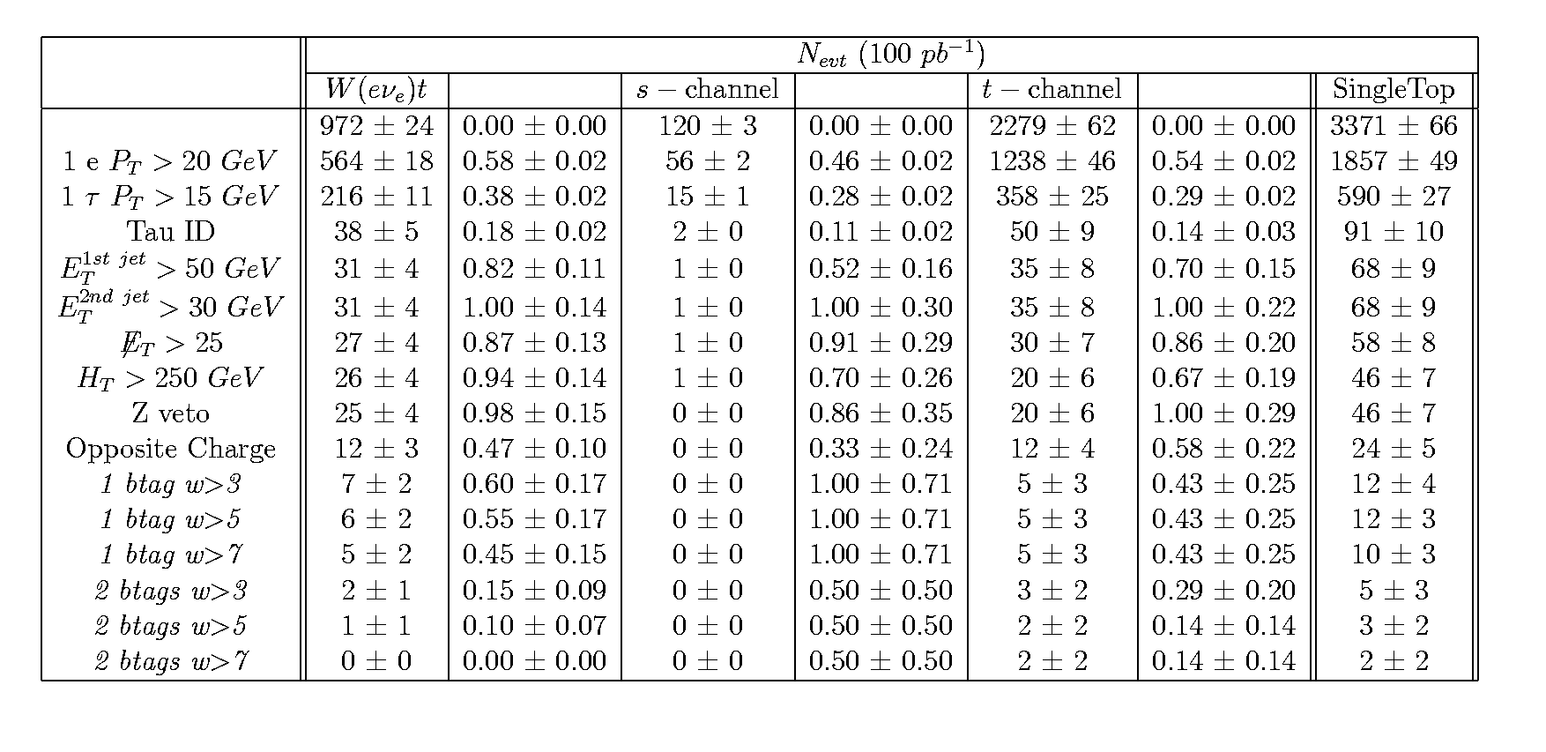
SingleTop (e,τ_{had})

Slide 46
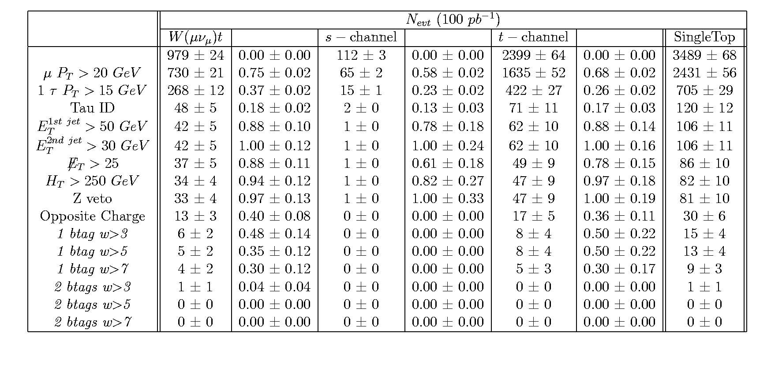
SingleTop (µ,τ_{had})

Slide 47
TopView

Slide 48
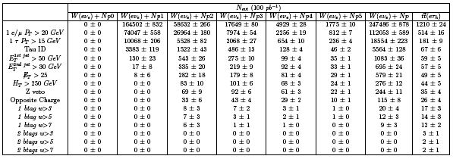
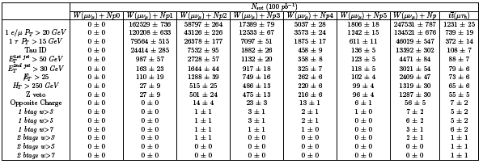
W+jets Tau1p3p

Slide 49
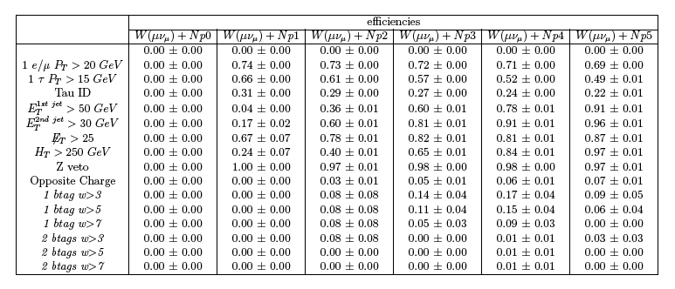
Efficiency W+jets Tau1p3p

Slide 50
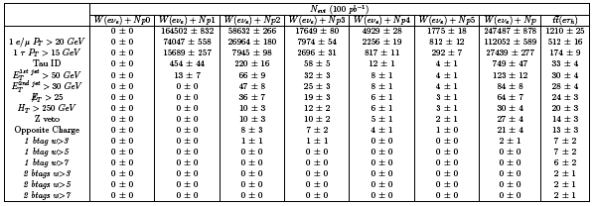
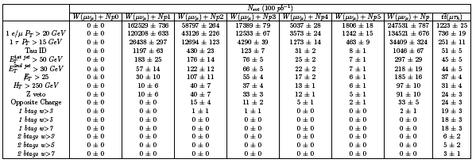
W+jets TauRec

Slide 51
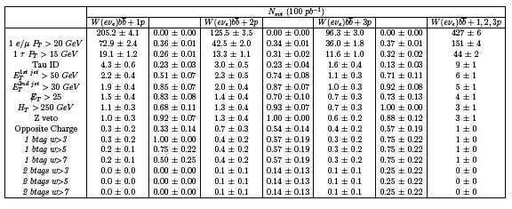
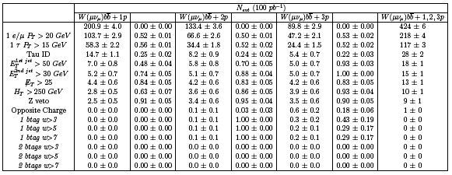
Wbb Tau1p3p

Slide 52
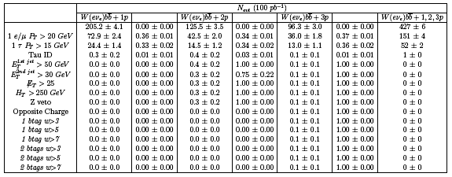
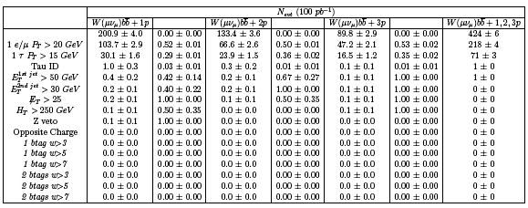
Wbb TauRec

Slide 53
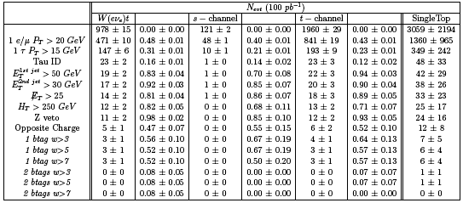
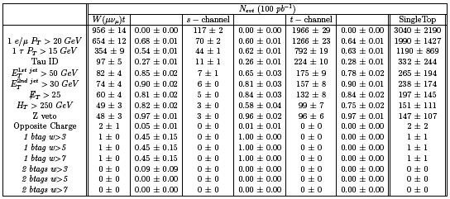
SingleTop Tau1p3p

Slide 54
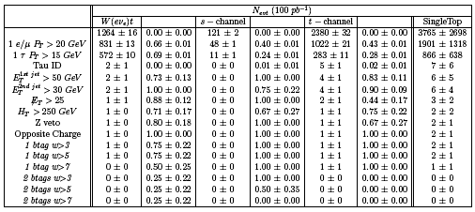
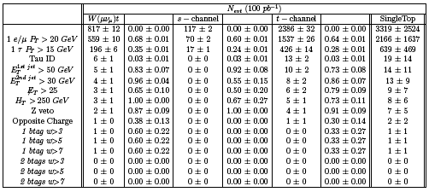
SingleTop TauRec

